Slide 1
QUEENS PLATINUM JUBILEE
KS3 BAKING COMPETITION
Well done and thankyou to all students who entered the Jubilee inspired baking competition! I was very impressed by the entries, and the skills shown.
There will also be a small prize for everyone else who entered.
Collect your prizes from room 64. They will be available from the 14th June!
Mrs Callaway

Slide 2
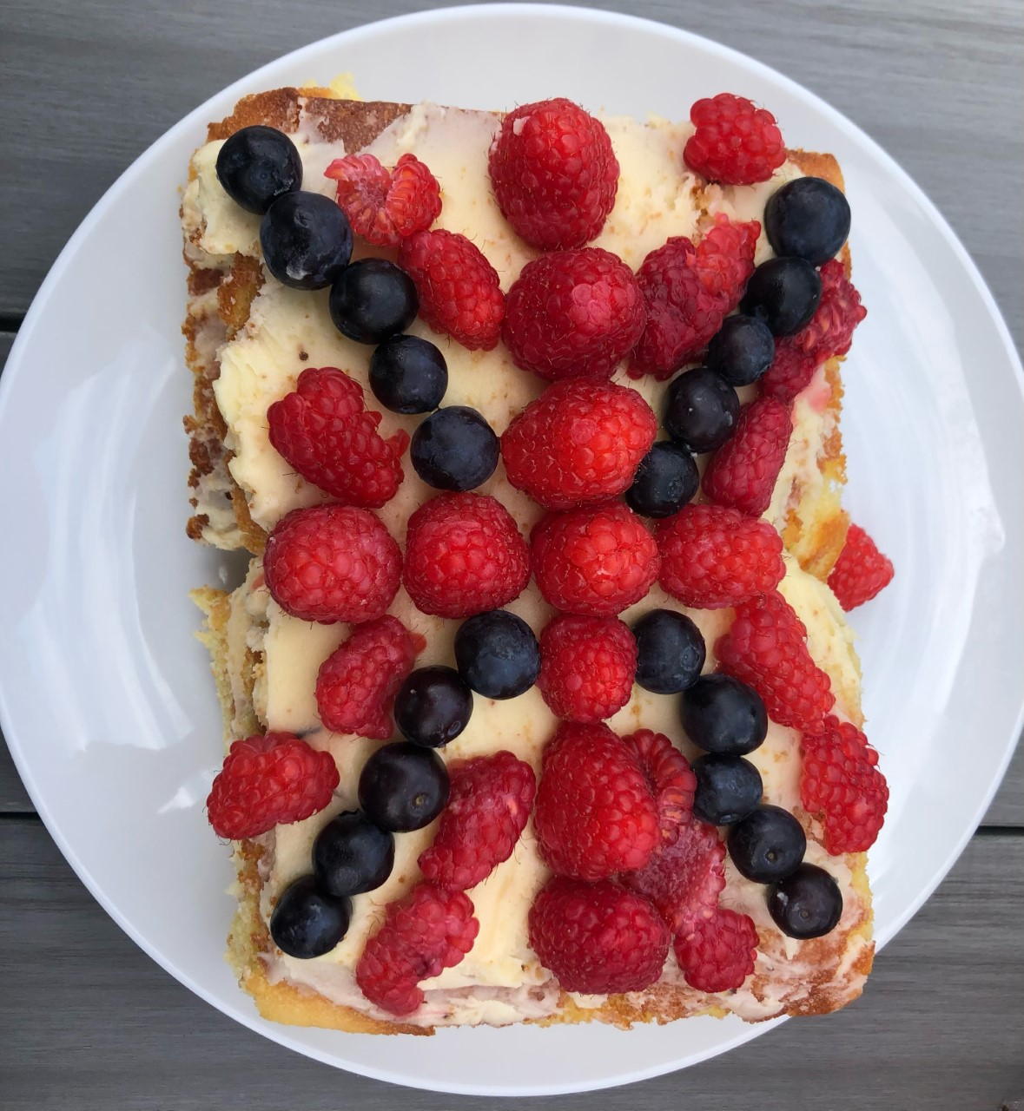
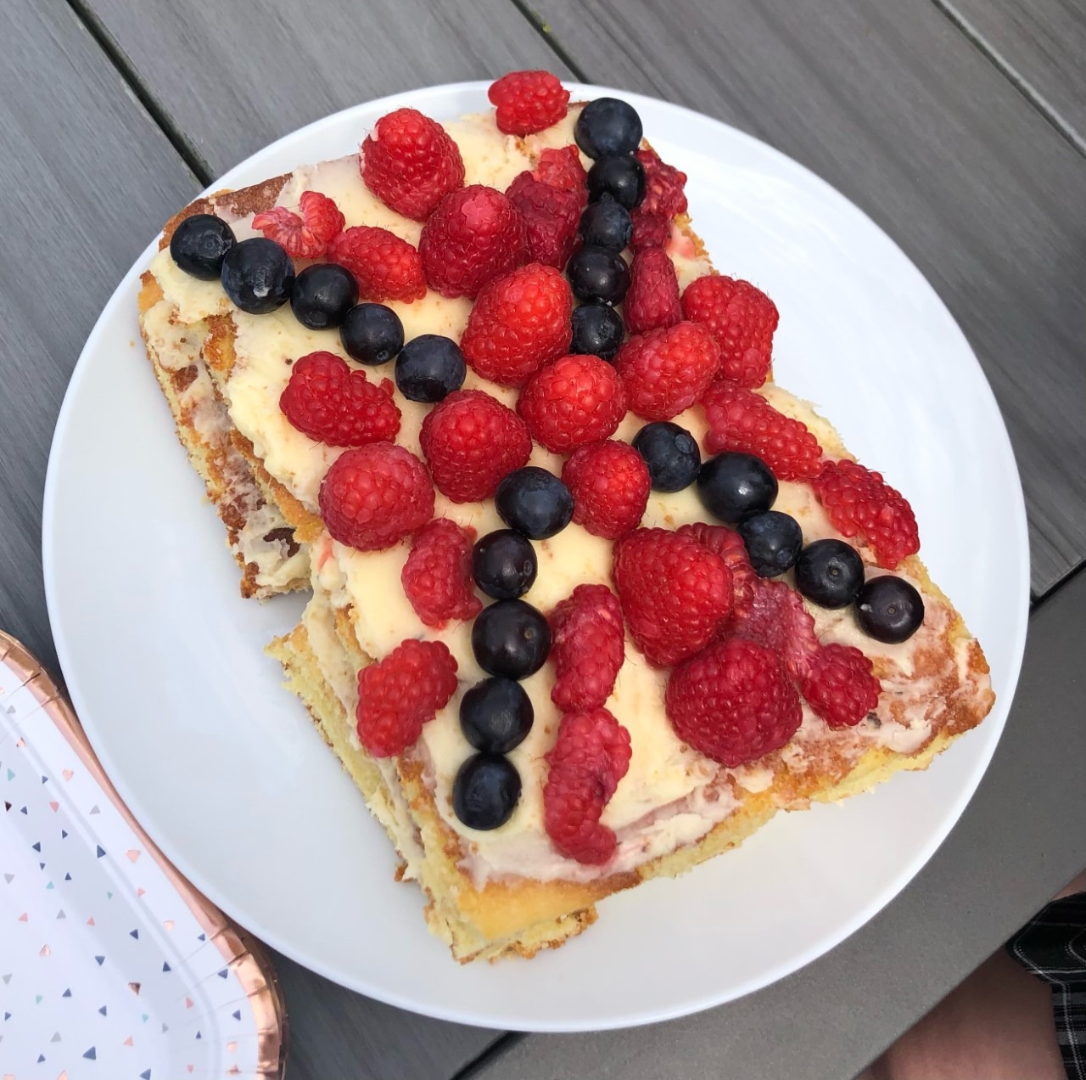
Year 7
Olivia H (7JCL)

Slide 3
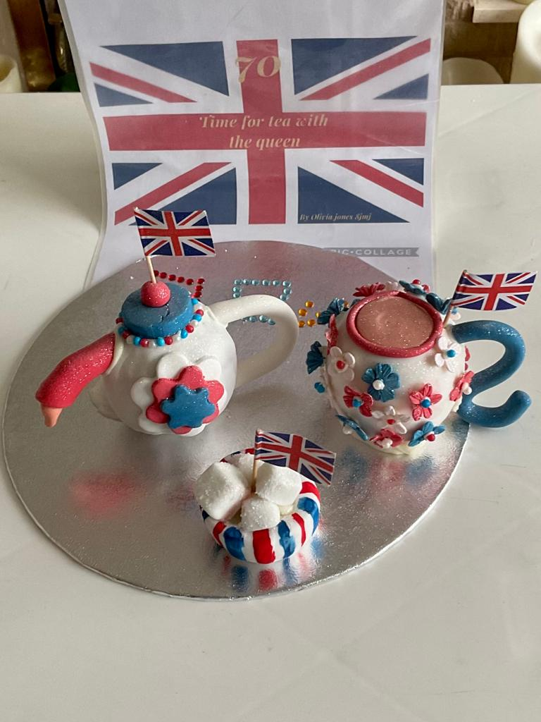
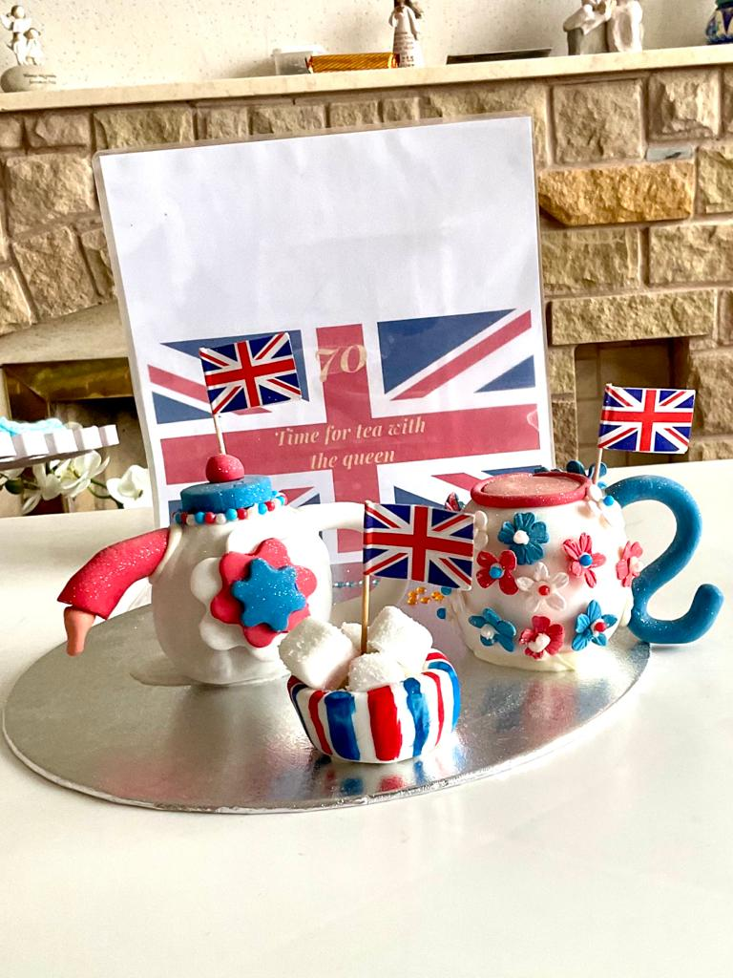
Olivia J 8JMJ
They are all completely edible and made using chocolate oranges and sugar paste.
Year 8

Slide 4
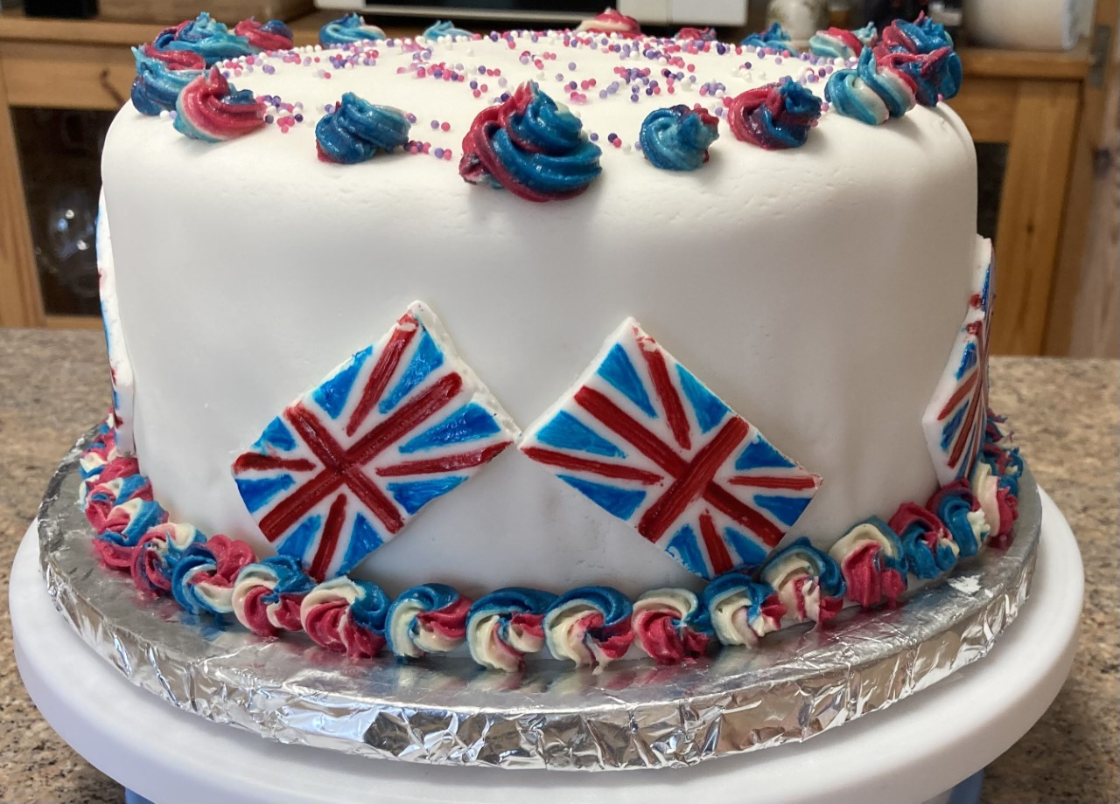
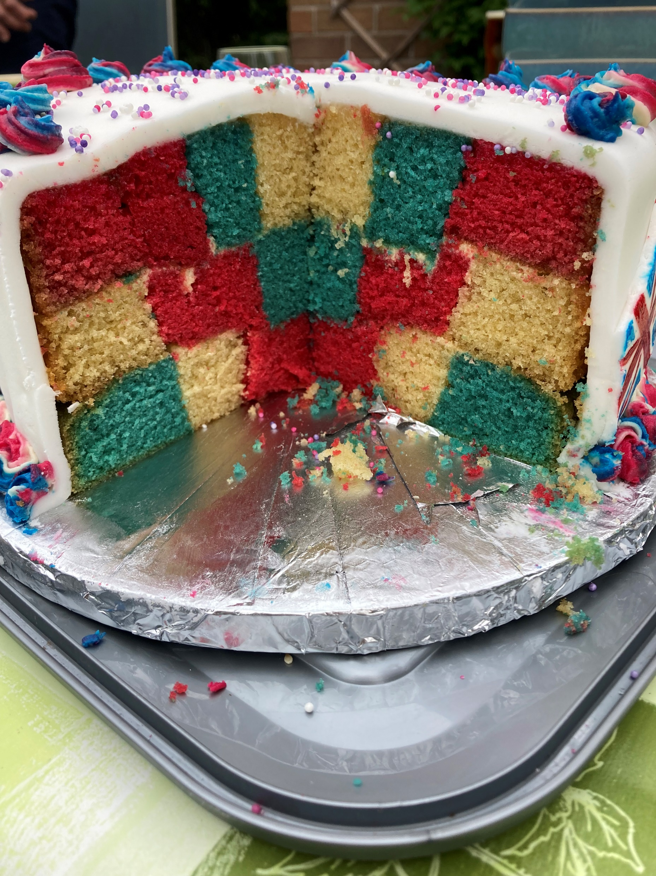
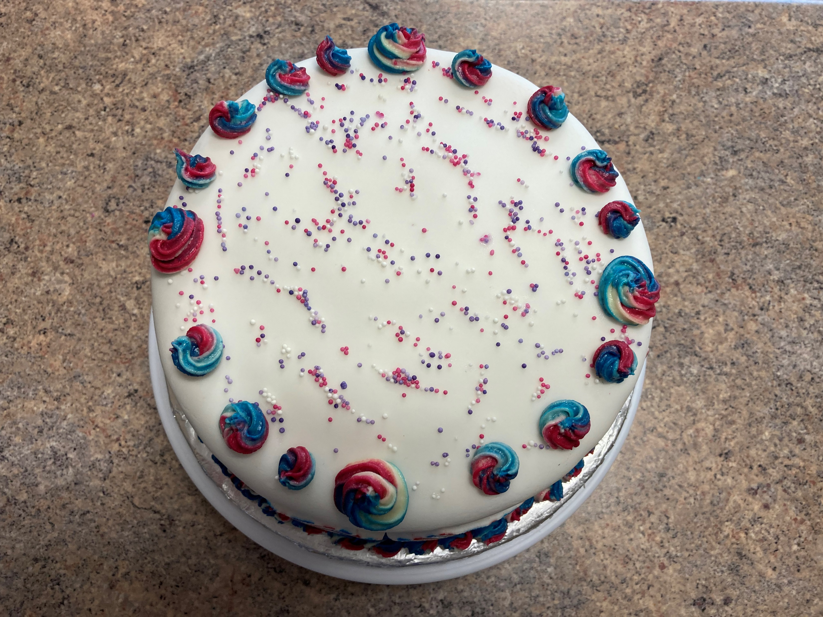
Year 9
This is my entry for the Jubilee Bake Off competition. My inspiration was taken from the flag of the Union Jack and the fly past of the Red Arrows over Buckingham Palace.
Lucy M 9NXF

Slide 5
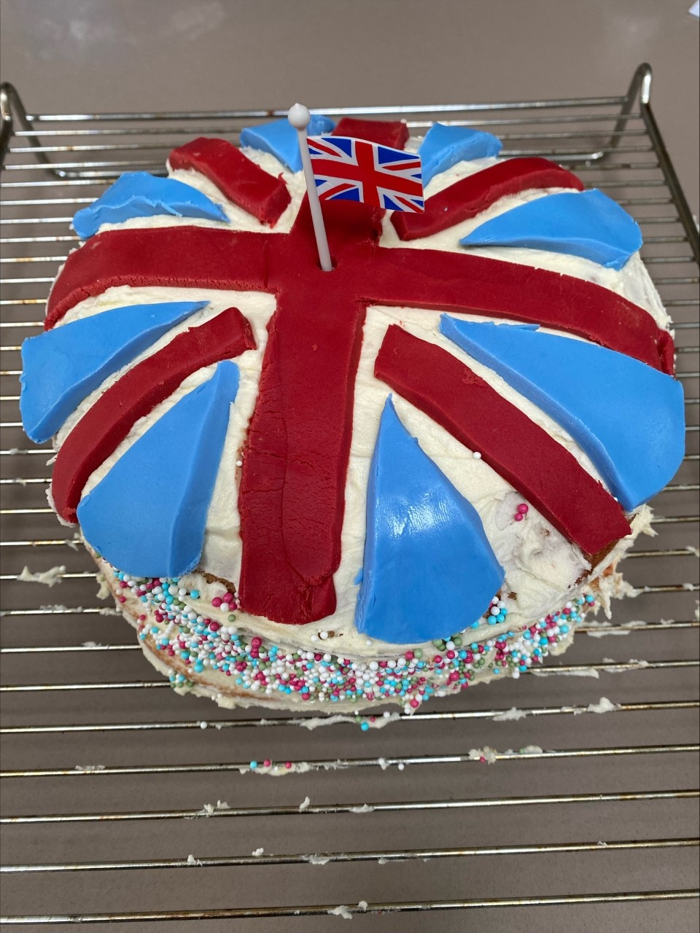
Zoe P Year 8

Slide 6
The Queen’s Jubilee tie dye cake
By Roxana S Y8
Please see the following power point Roxanna sent alongside her work

Slide 7
Ingredients:
1 ½ cup potato starch
3 tbsps flour
8 eggs
½ tsp rum extract (doesn’t have any alcohol)
1 ½ tsps baking powder
1 ½ cup sugar
Red and blue food colouring

Slide 8
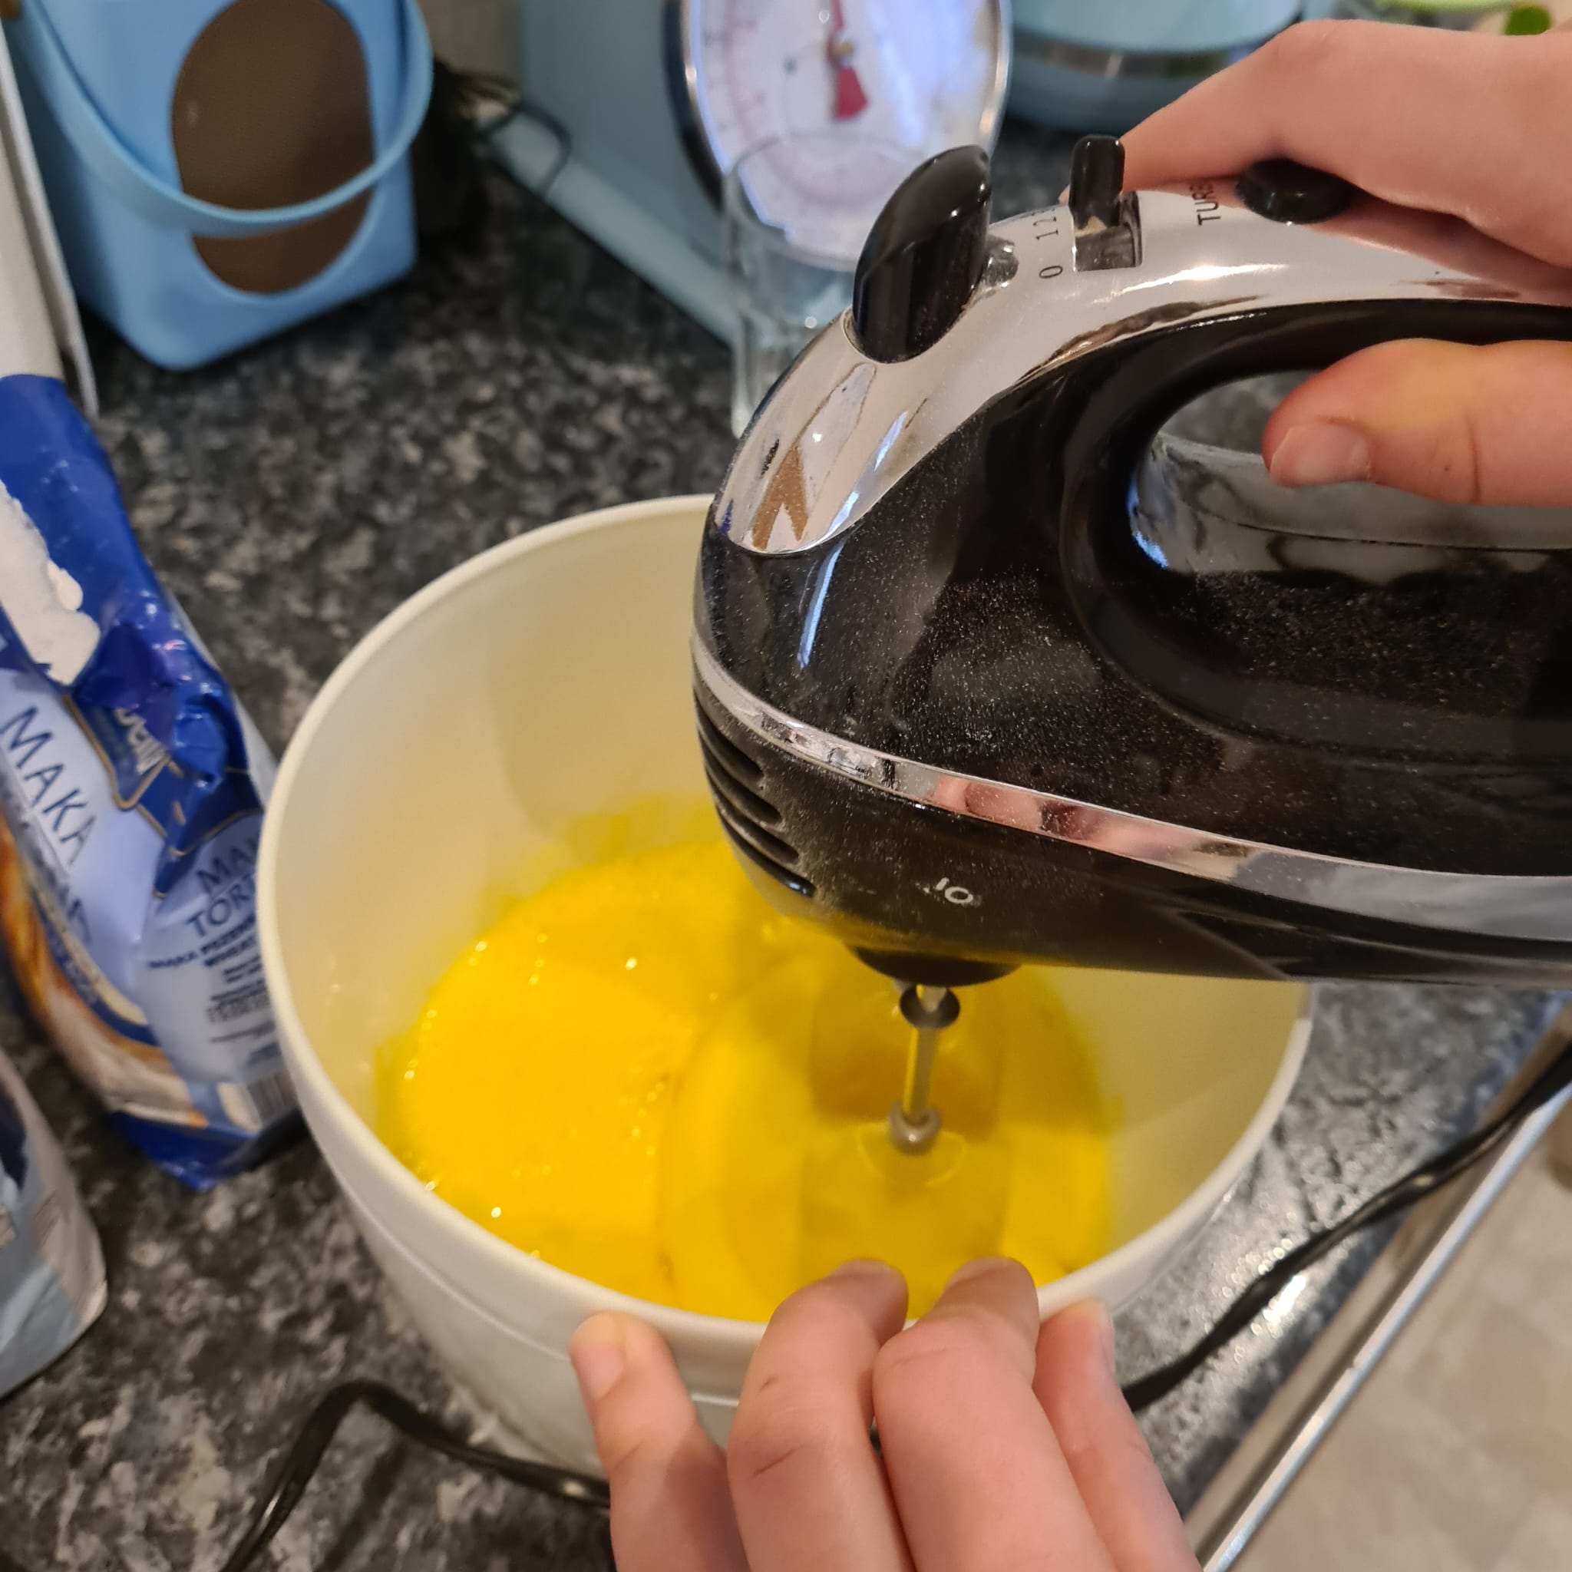
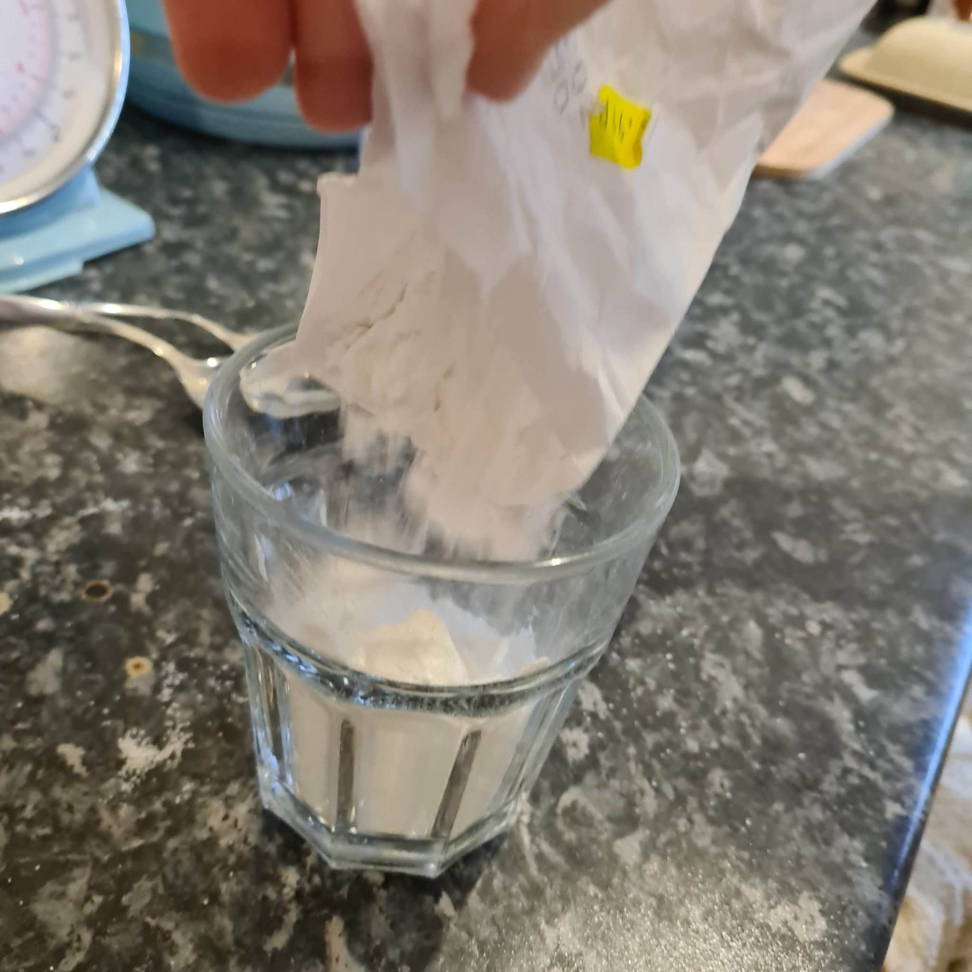
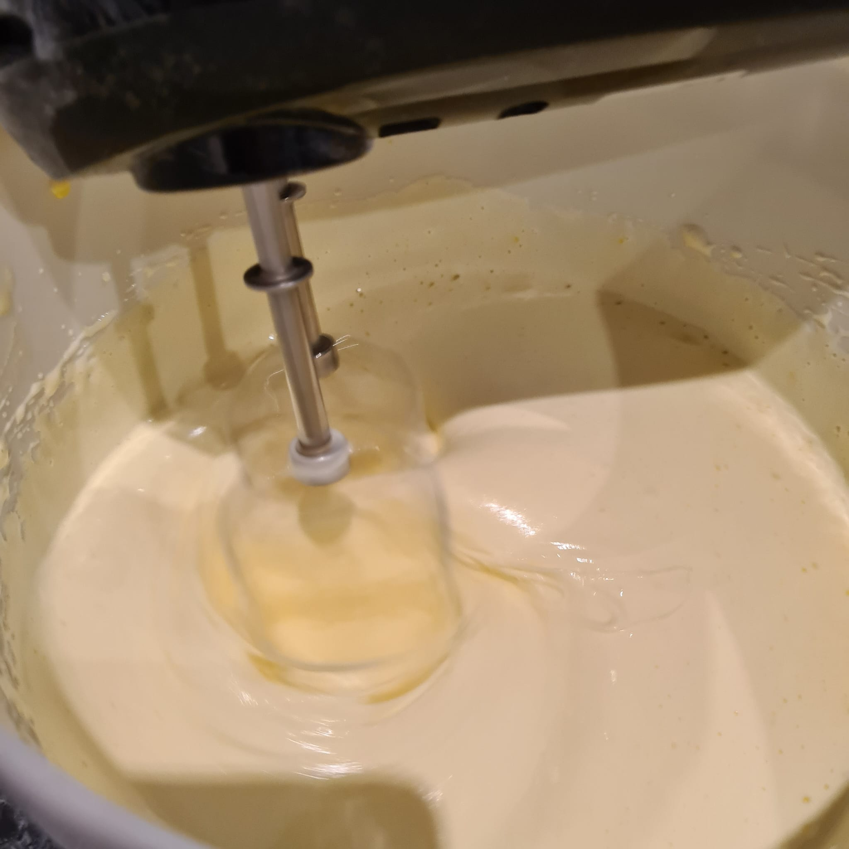
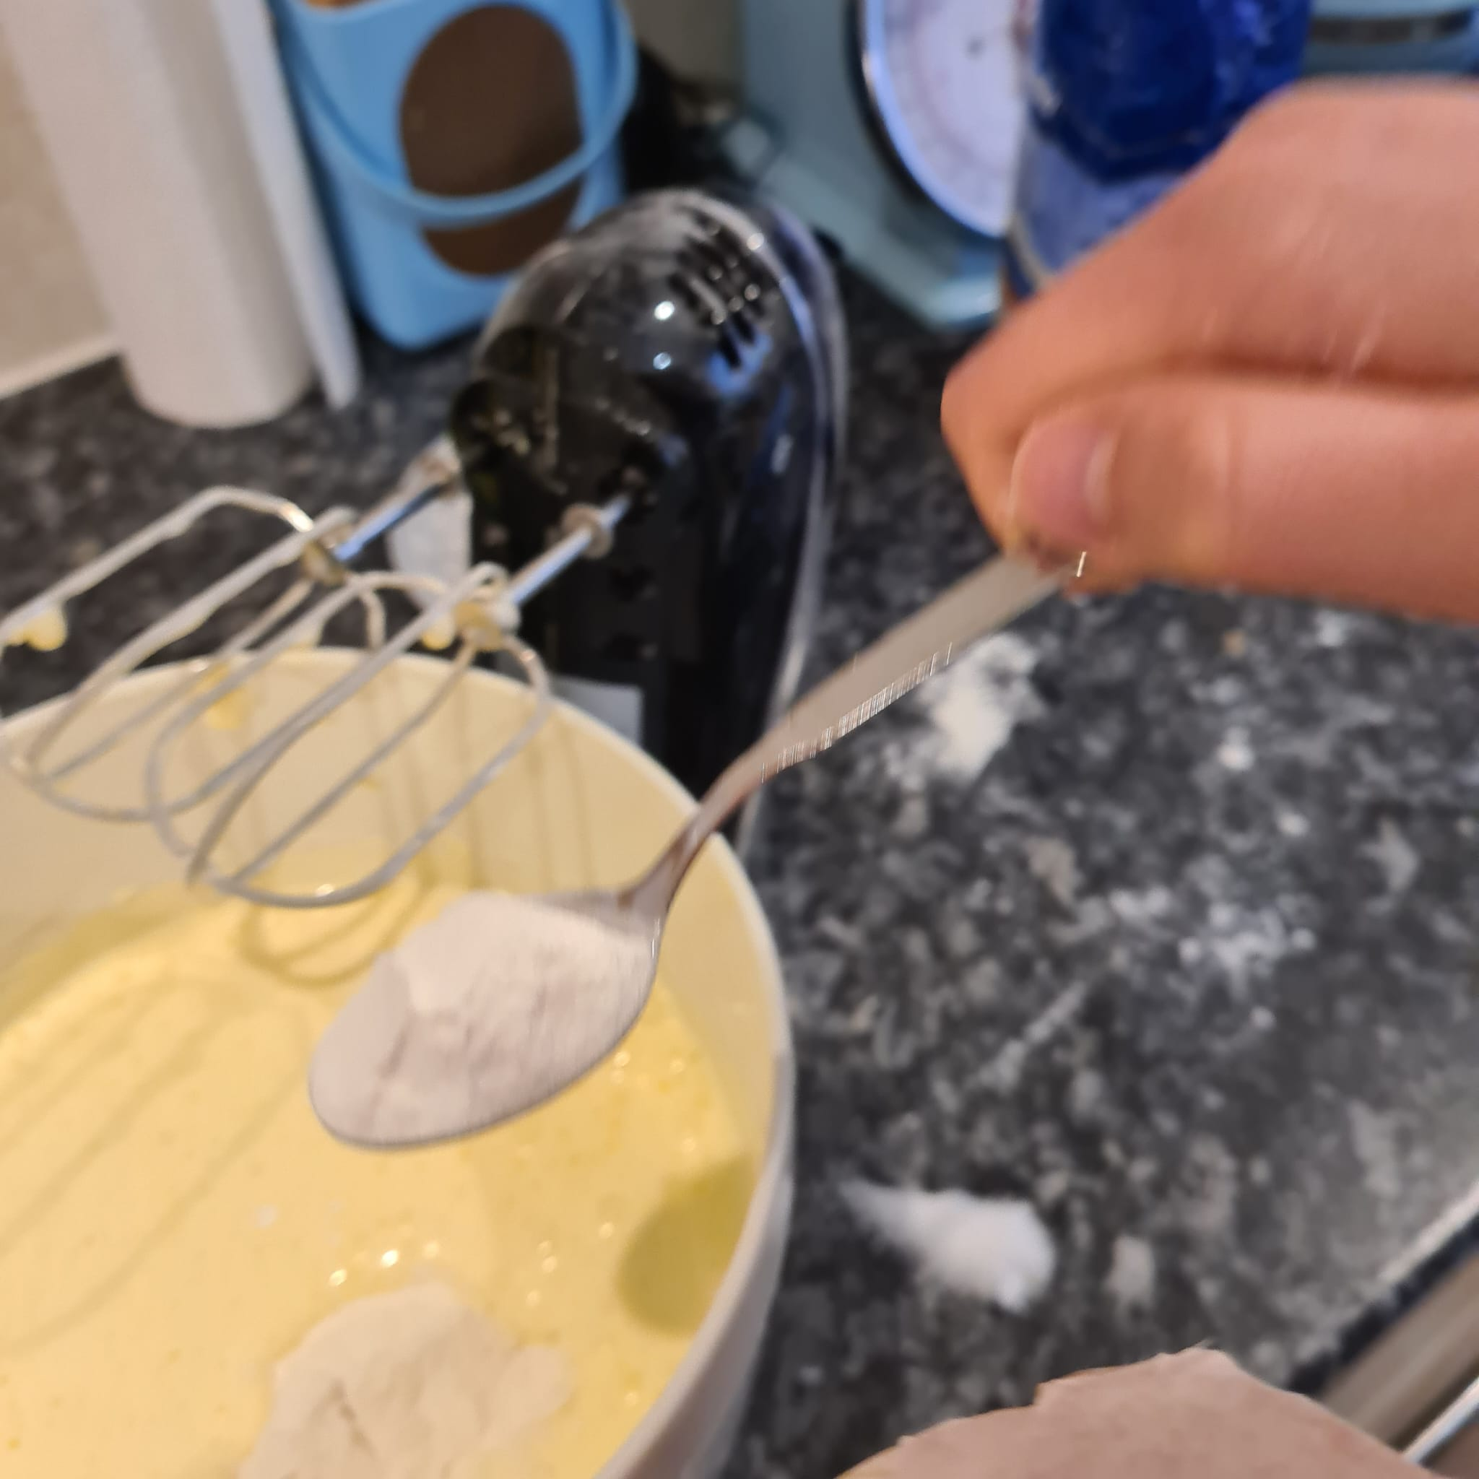
How to make the 2nd and 3rd layers:
Mix 5 eggs and 1 cup of sugar with a blender for 10mins.
Add 2tbsps flour, 1 tsp baking powder, a couple drops of rum extract and 1 cup potato starch and mix it until just combined.

Slide 9
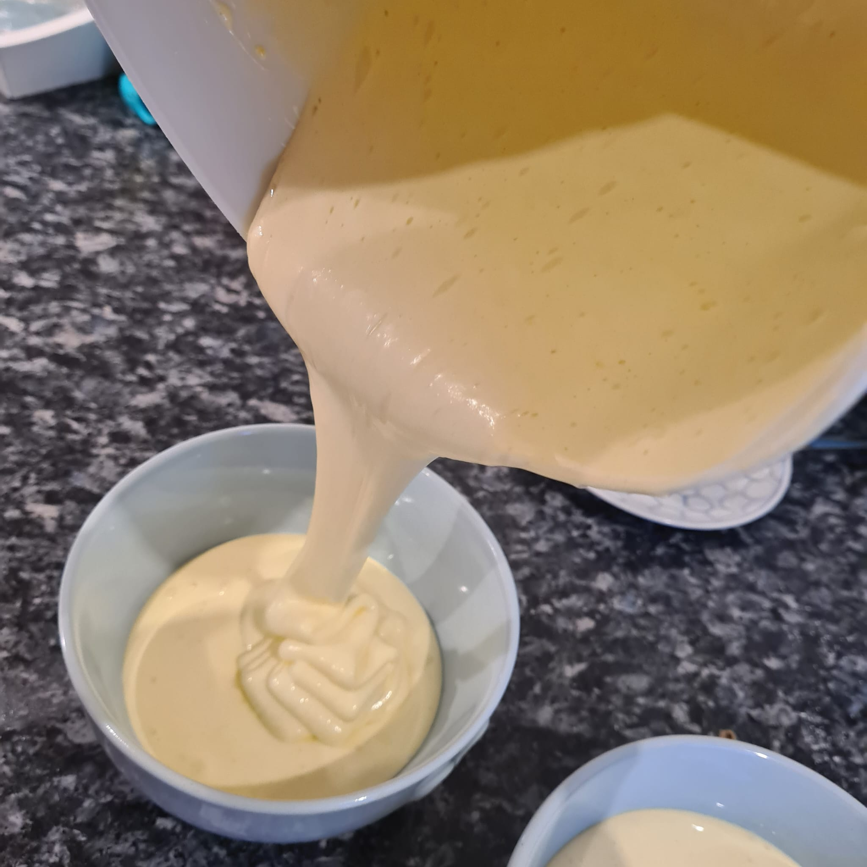
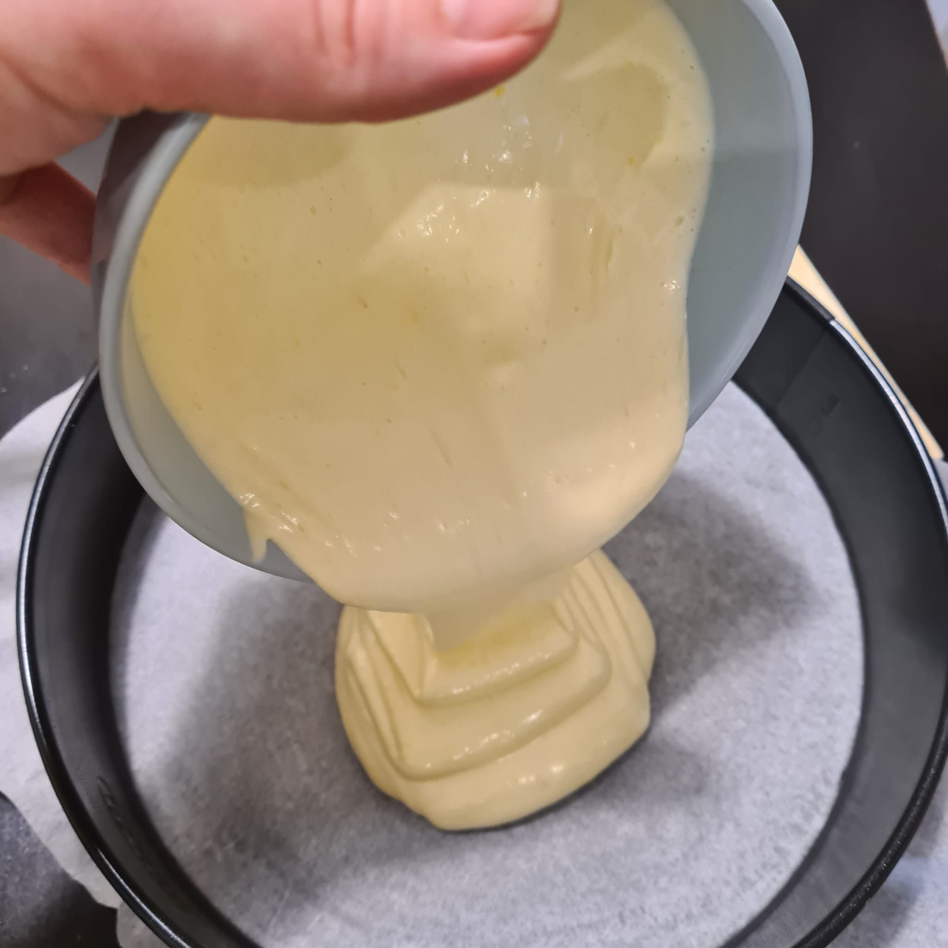
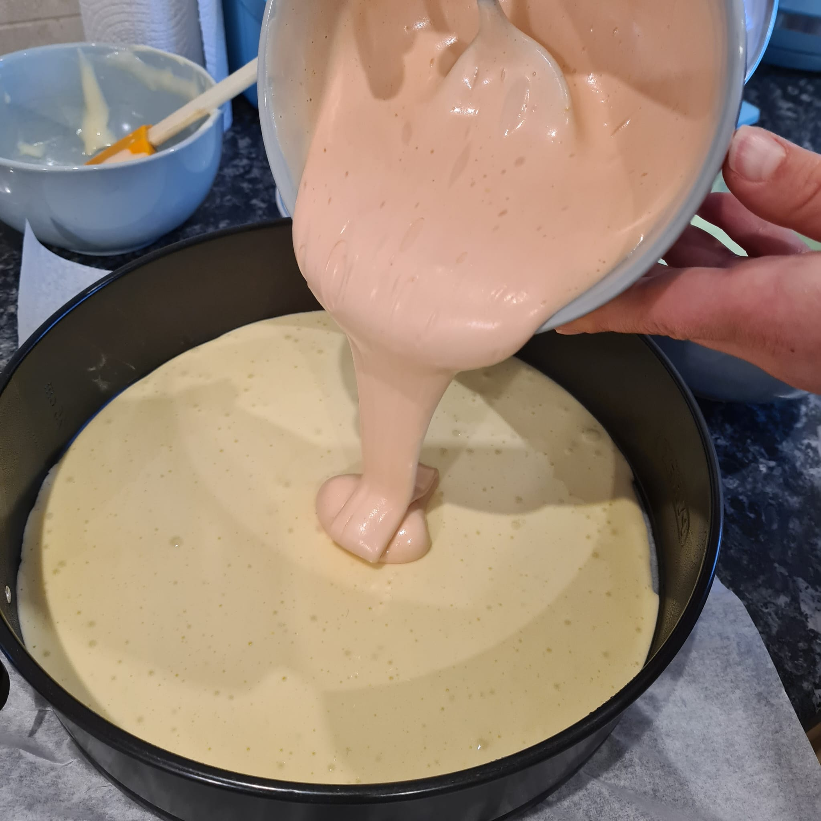
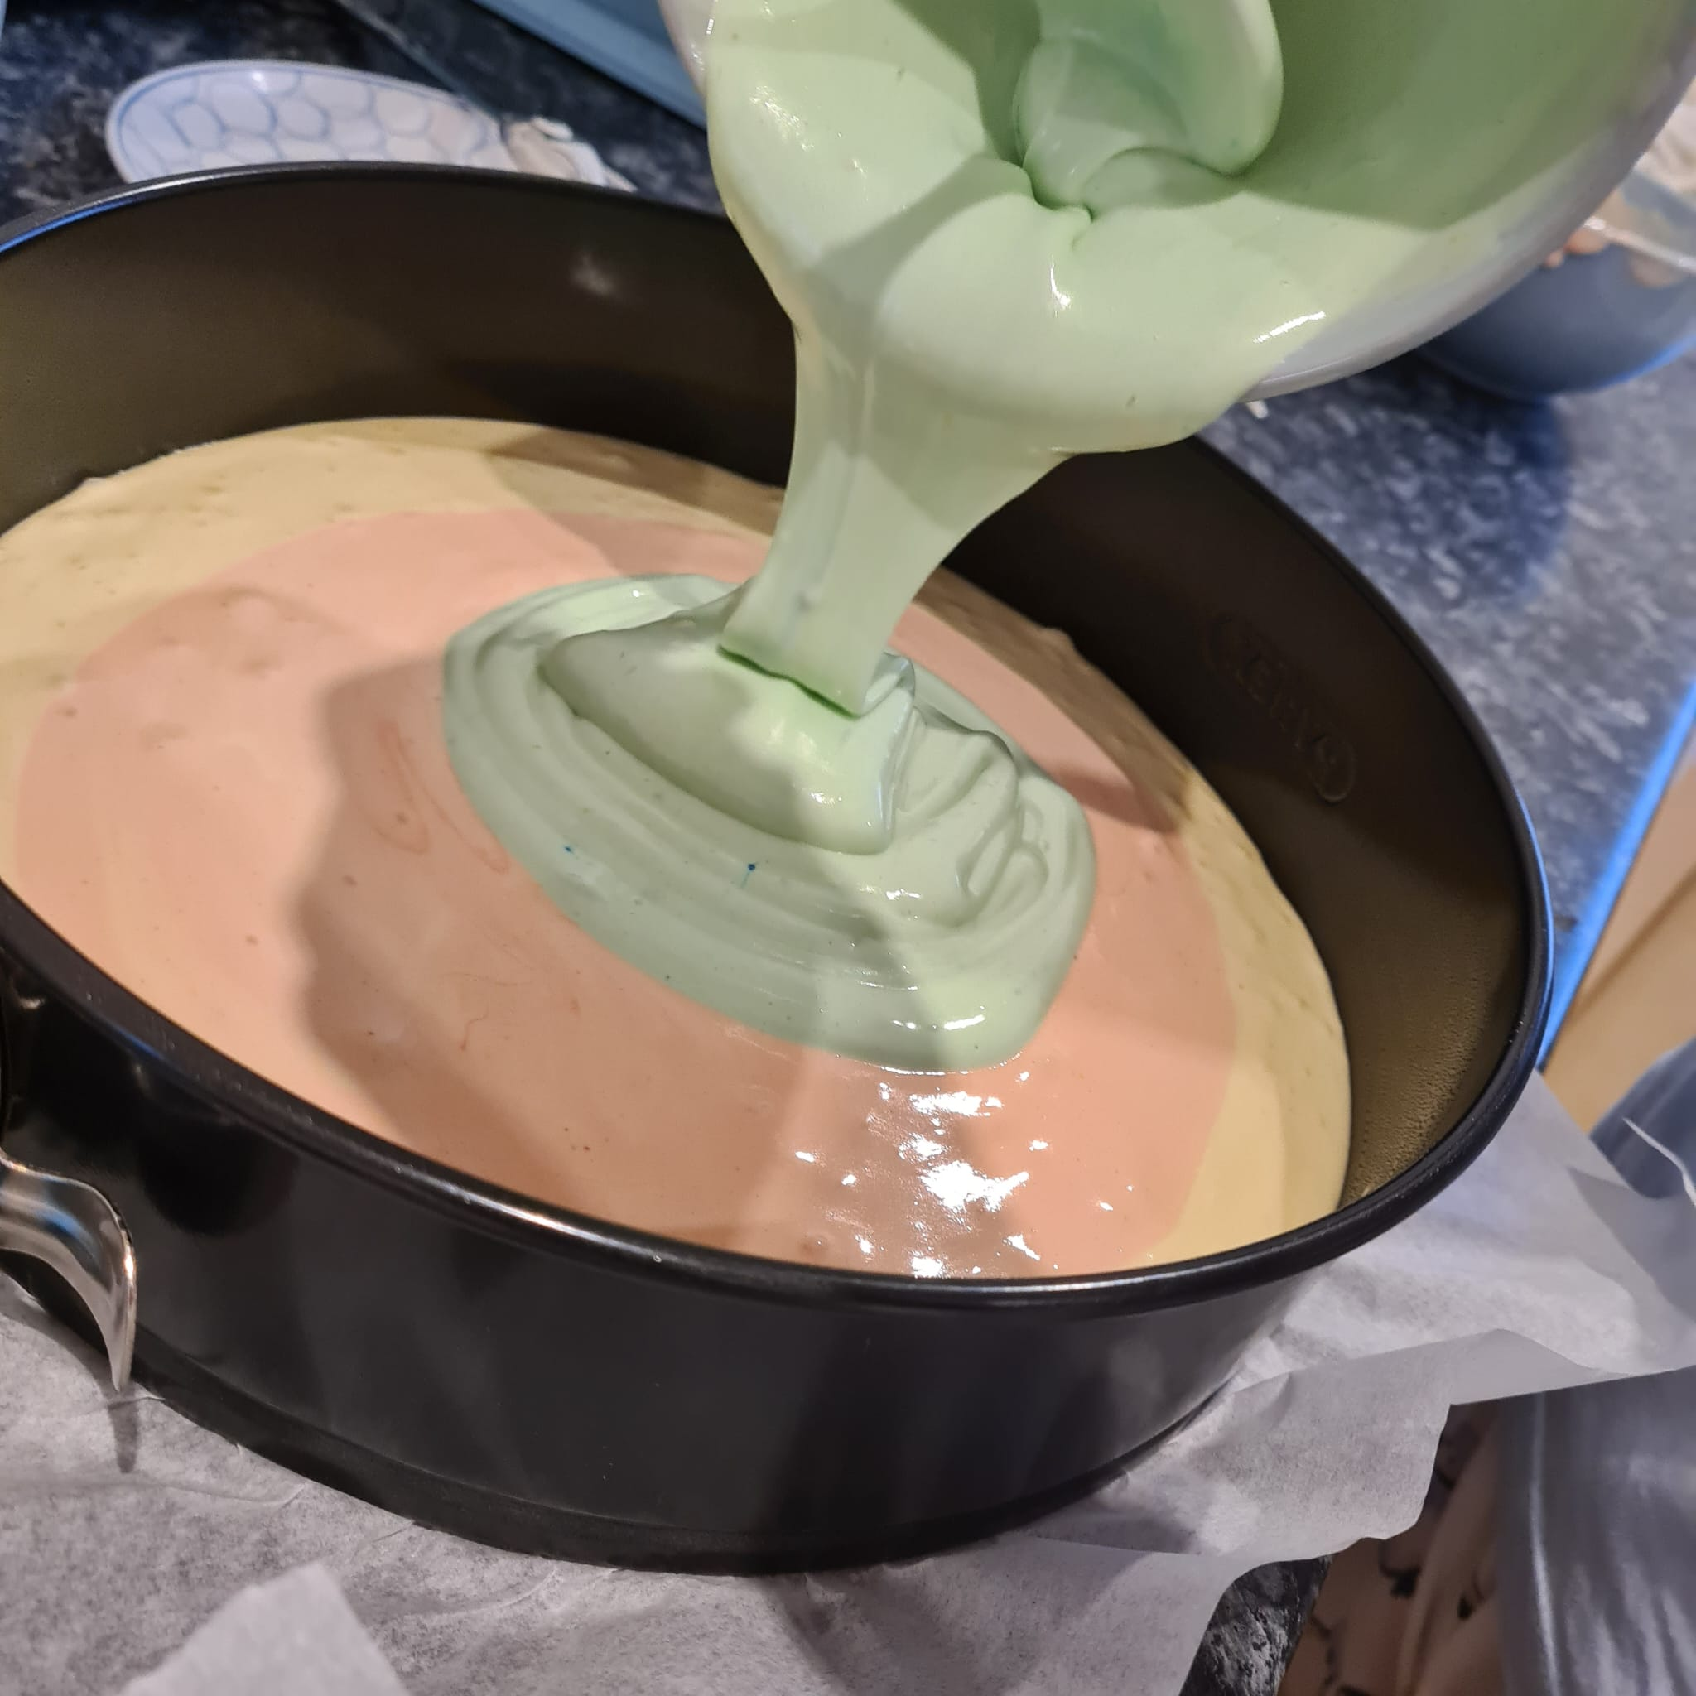
Separate mixture into 3 bowls and put a couple of droplets of red food colouring into one, a couple of droplets of blue into the other and leave the last one white.
Poor the white into a baking mould, then poor in the red and finally poor in the blue. Swirl around with a toothpick to create a tie e effect.
Bake at 170 ℃ on fan for 35-40 minutes until golden brown.

Slide 10
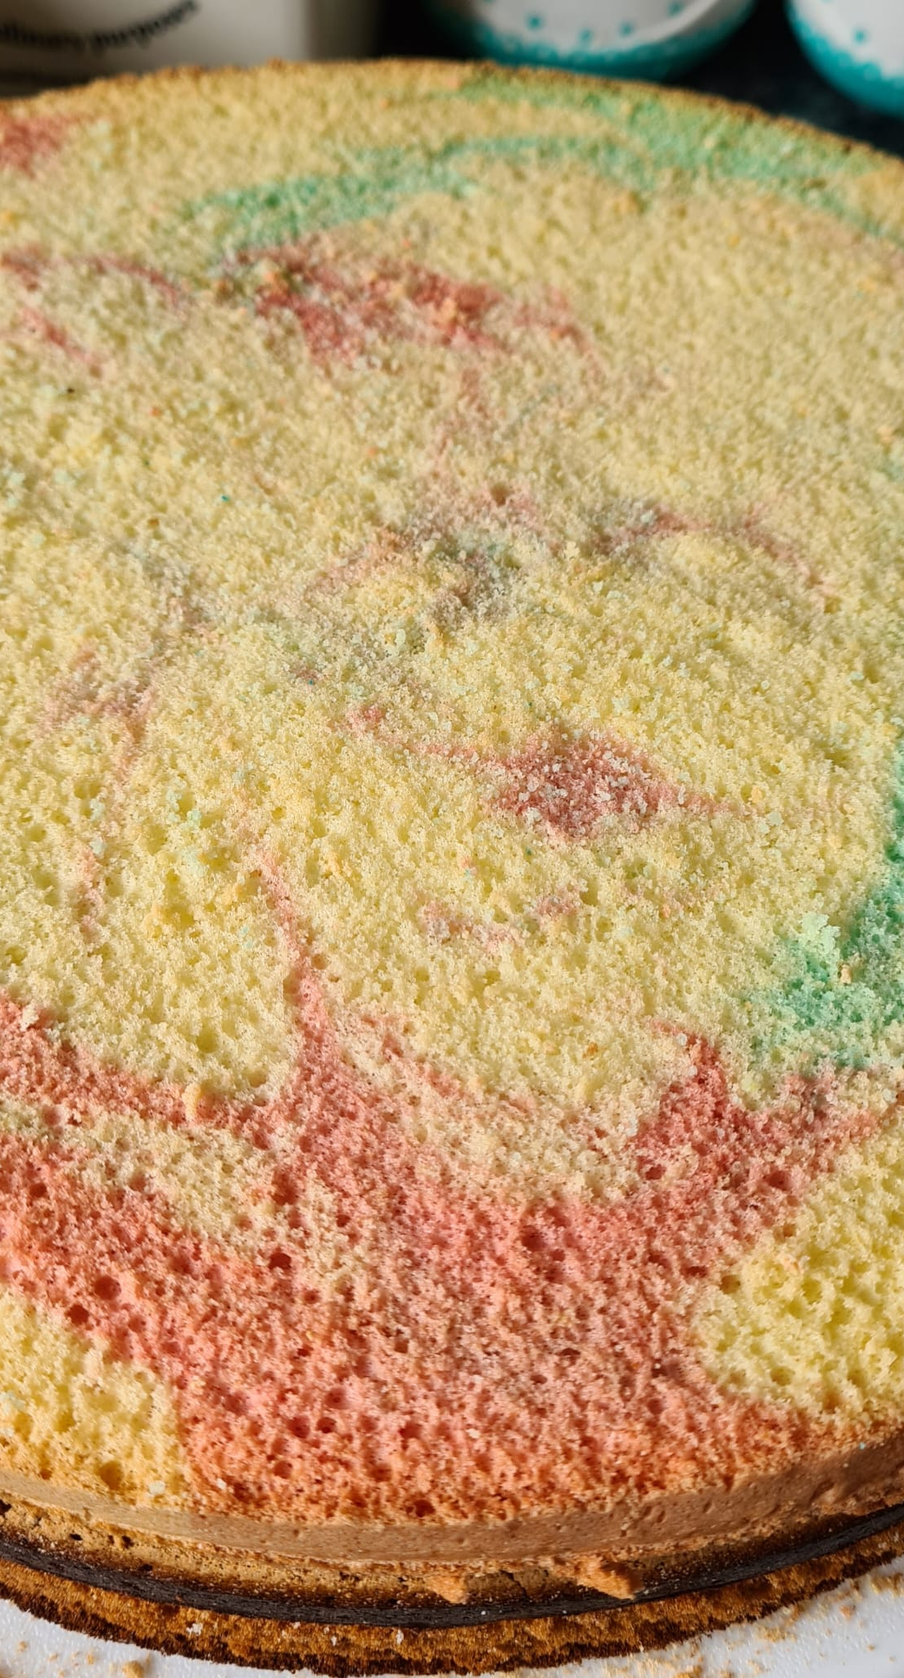
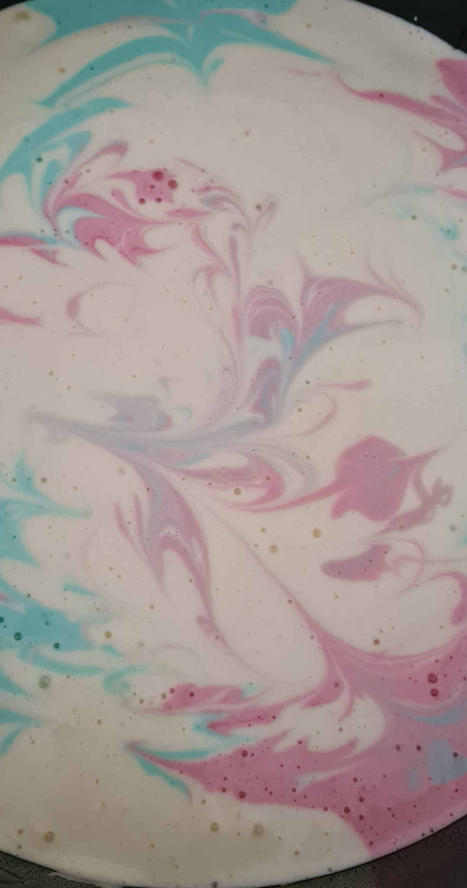
How to make the 1st layer
Use the remaining ingredients and follow the recipe of tear 2 and 3.
After separating and colouring the mixture, add separate spoonful's of each colour and then swirl around to create an effect like in the picture on the right.

Slide 11
What will I need:
White, blue and red fondant
Mascarpone cheese, whipping cream and powdered sugar to make the mascarpone cheese frosting
Water, powdered sugar and black food colouring for the writing icing.

Slide 12
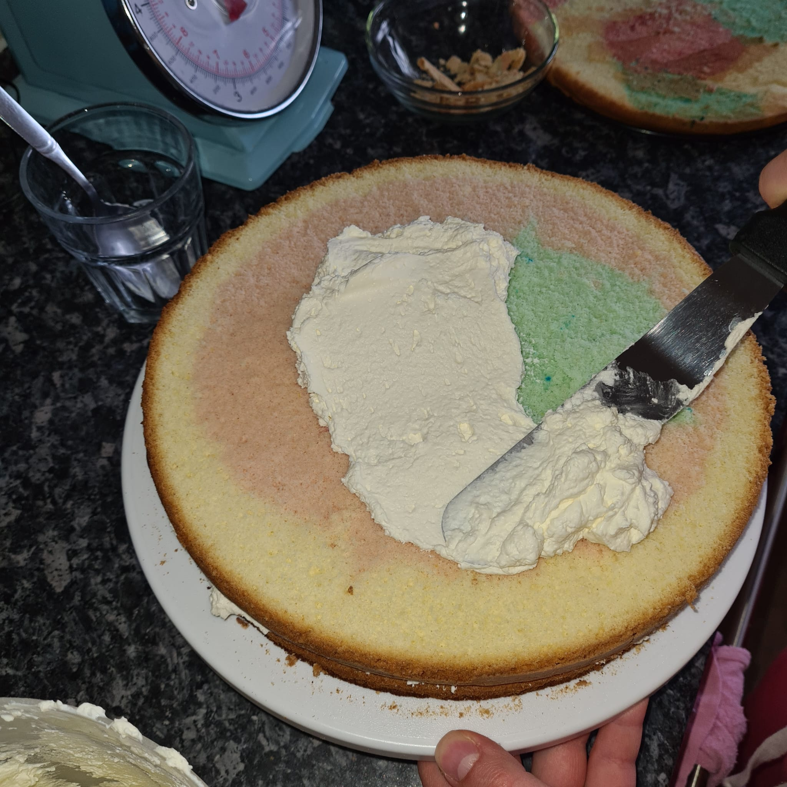
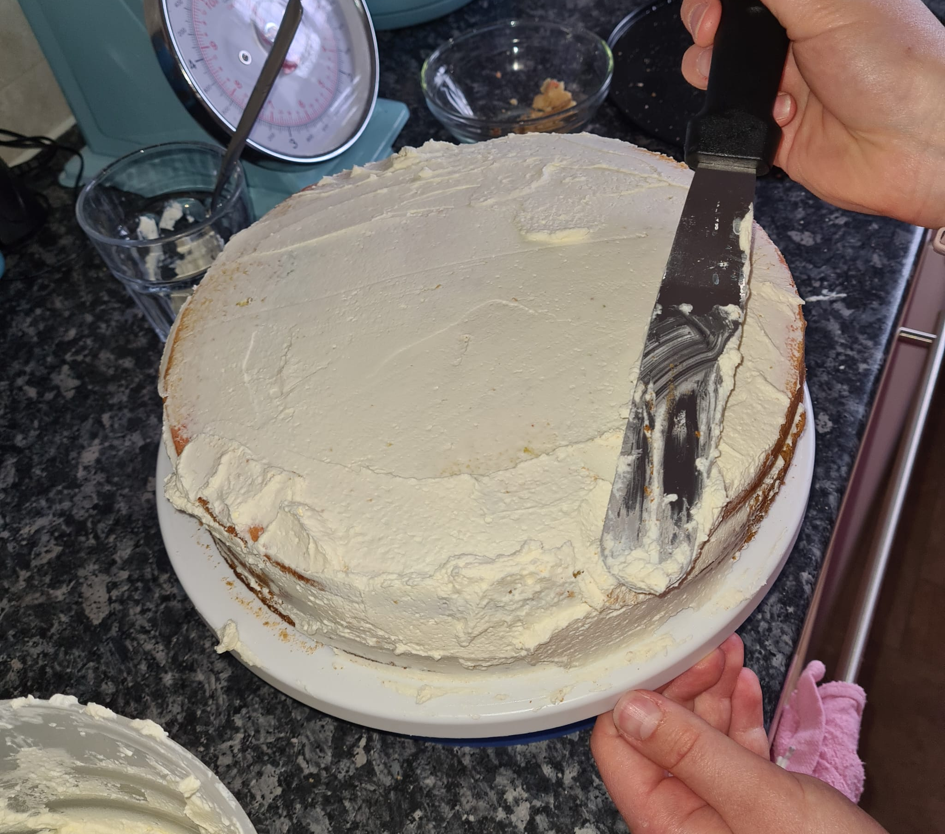
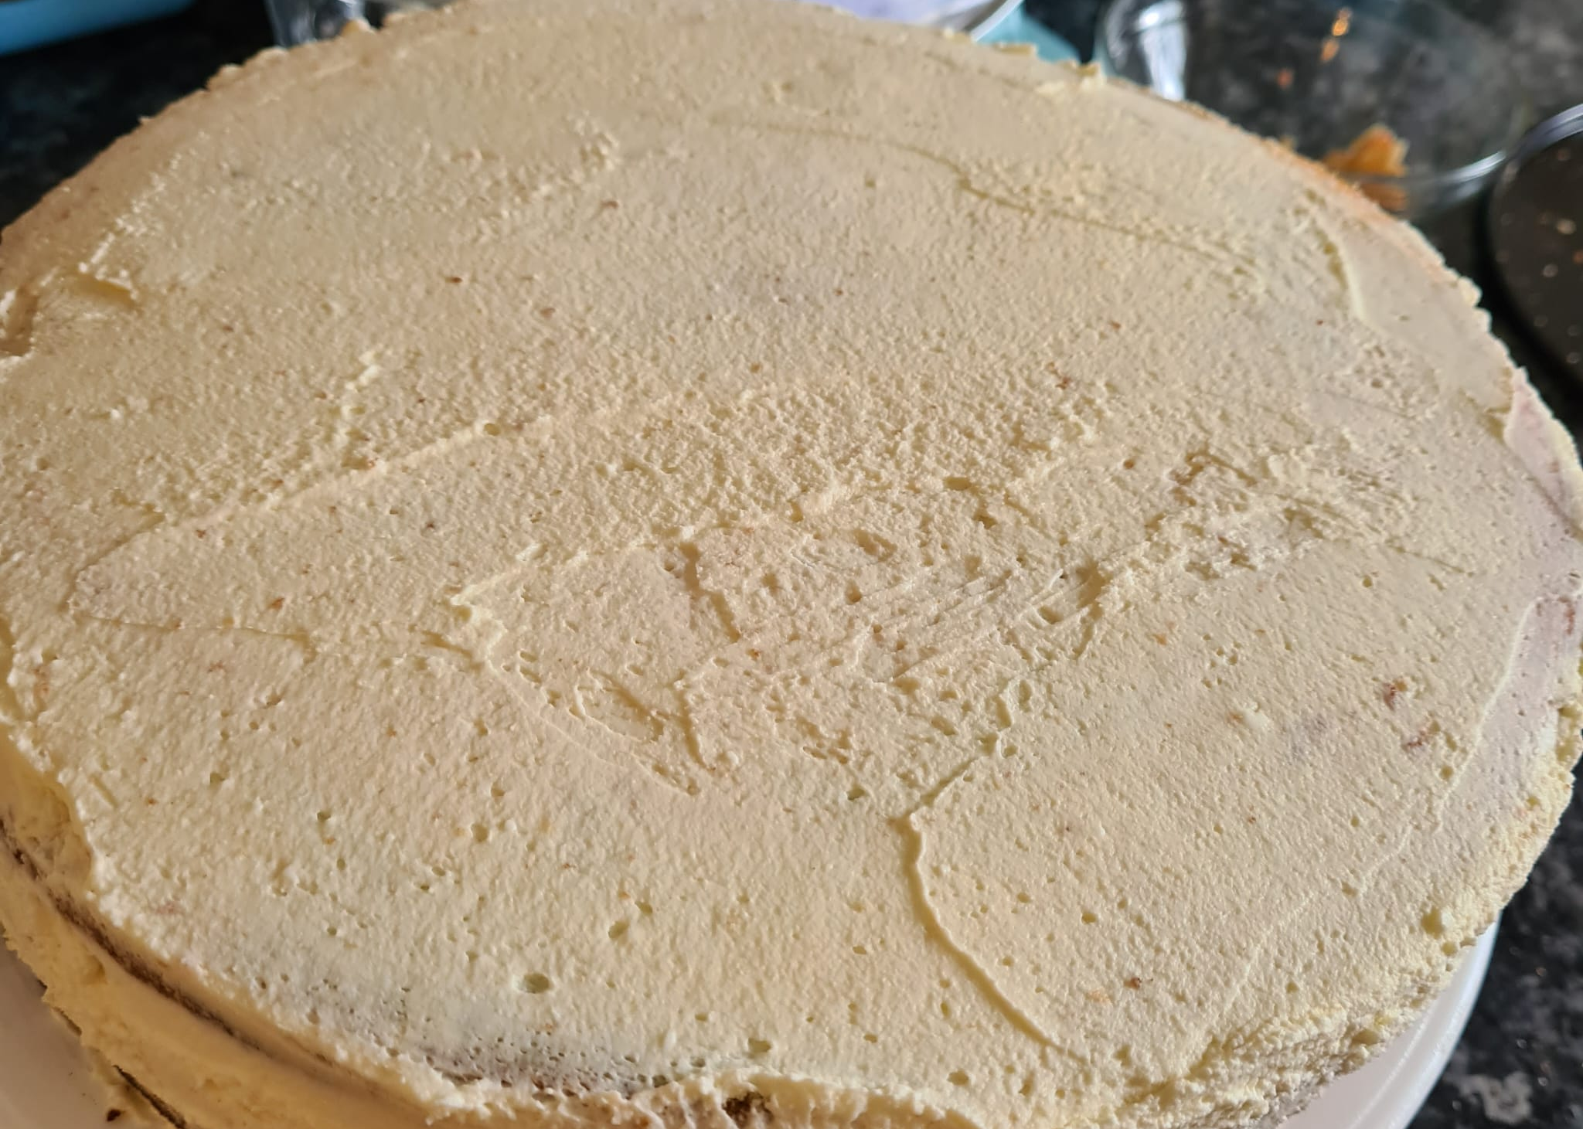
Make the mascarpone cheese frosting by mixing the whipping cream until stiff peaks then adding mascarpone cheese and powdered sugar and mix for a minute more.
Cut the bigger cake in half.
Spread one half of the cut cake with the mascarpone cheese frosting and put the other half onto the frosting. Then, cover that half with frosting and put the separate cake onto the cake.
Finally, cover the whole cake with the frosting and put it into the fridge.

Slide 13
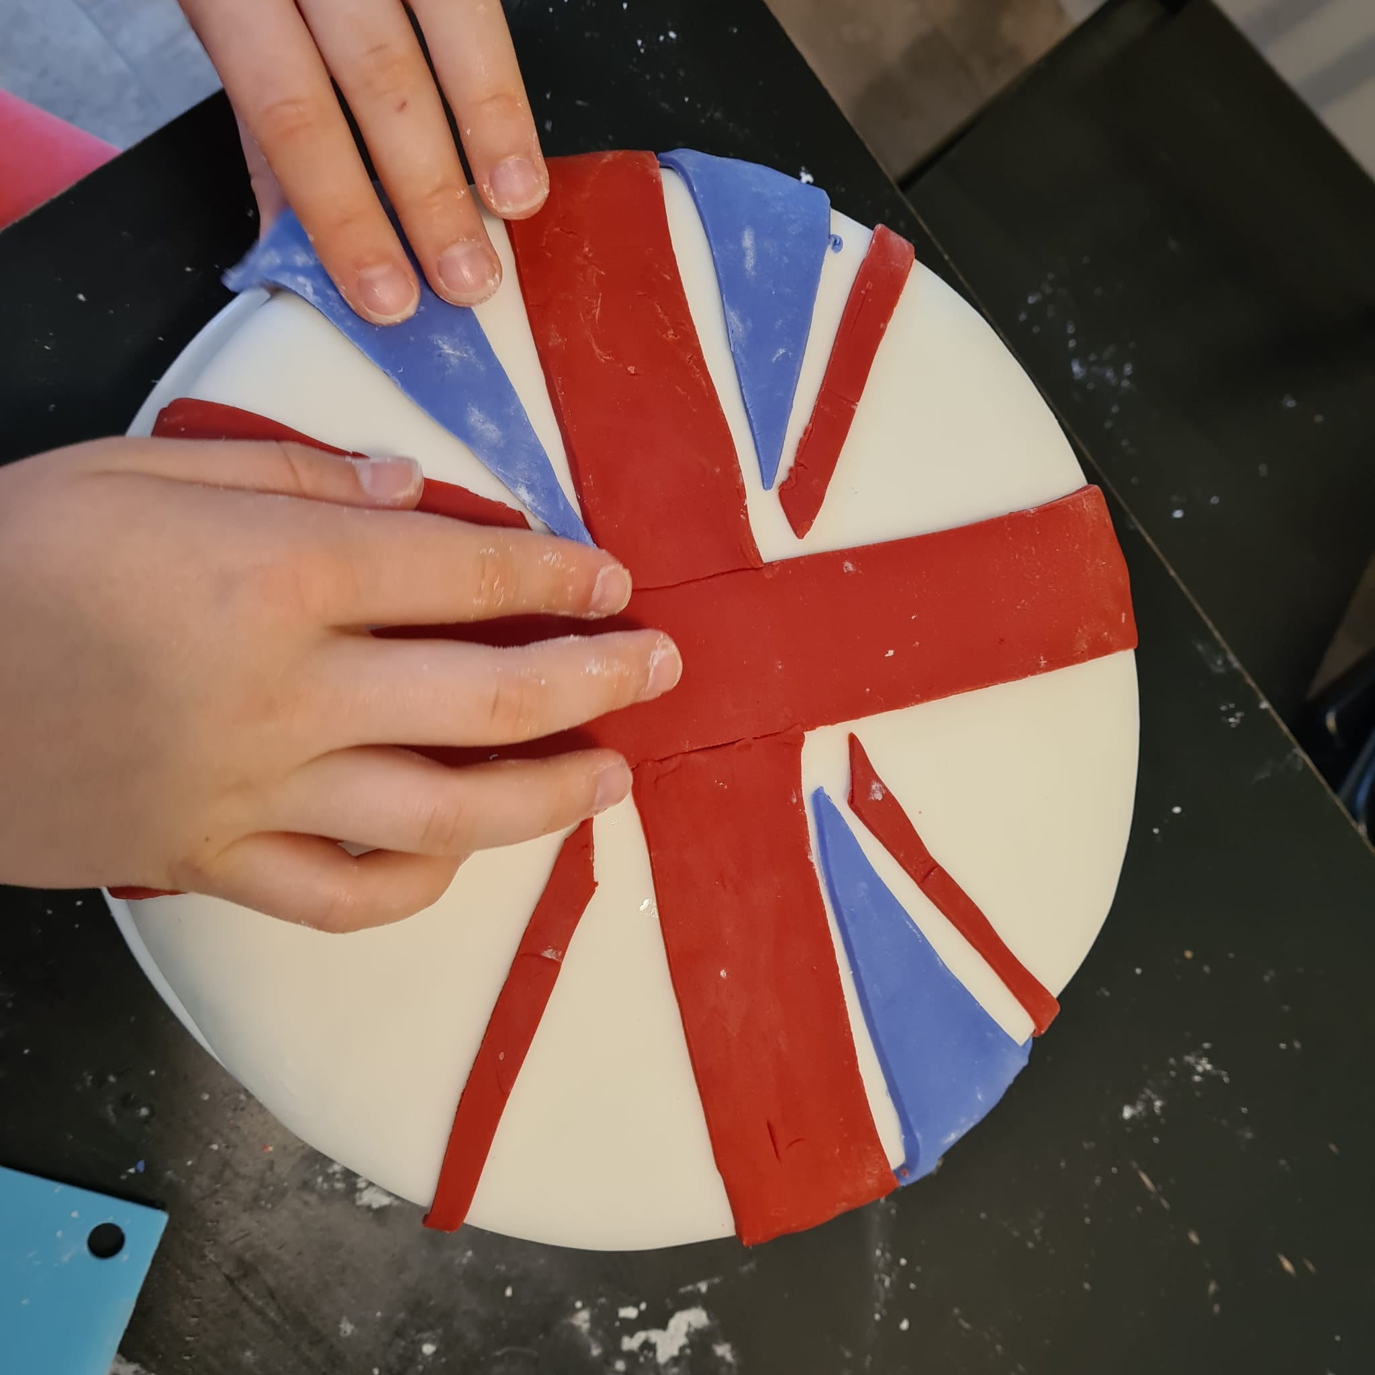
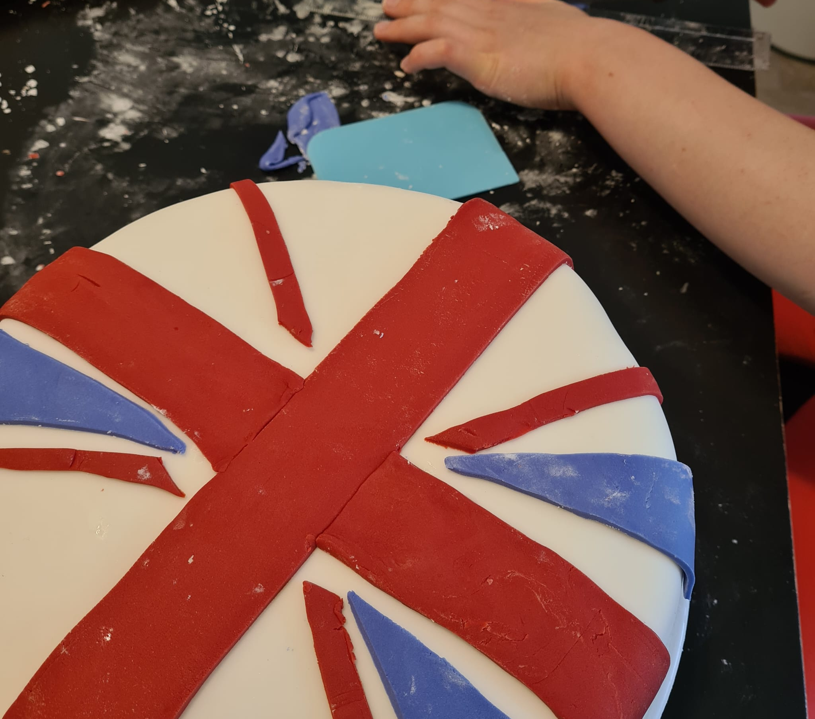
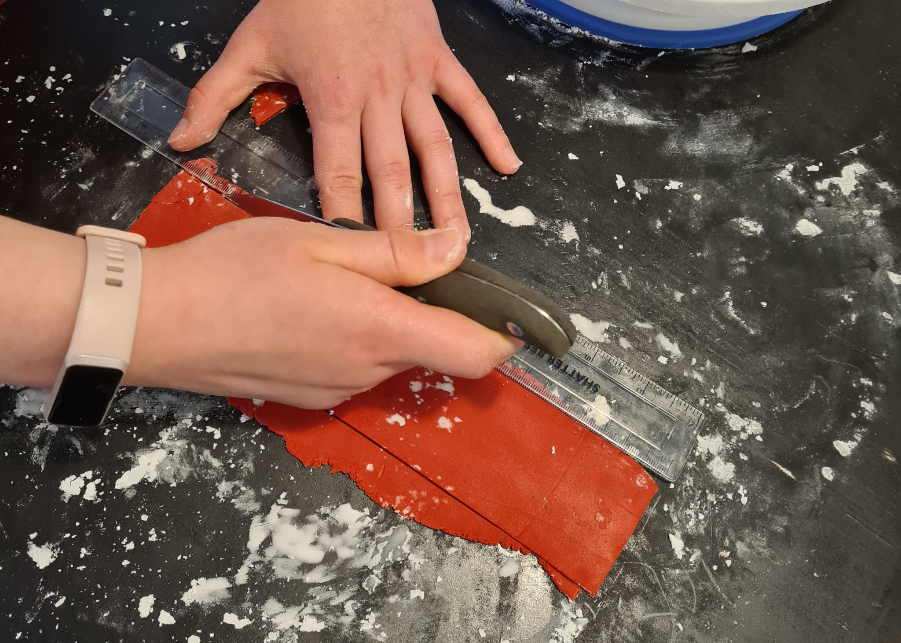
Roll out the white fondant until it is ½ a centimetre thick
Then cover the cake with it
Roll out the red and blue fondant
Cut the red and blue fondant into the correct shapes for the UK flag
Mix the black food colouring, some powdered sugar and a little bit of water to make writing icing.
Write Queen’s Jubilee onto the cake

Slide 14
Drum Roll For The Finished Cake!

Slide 15
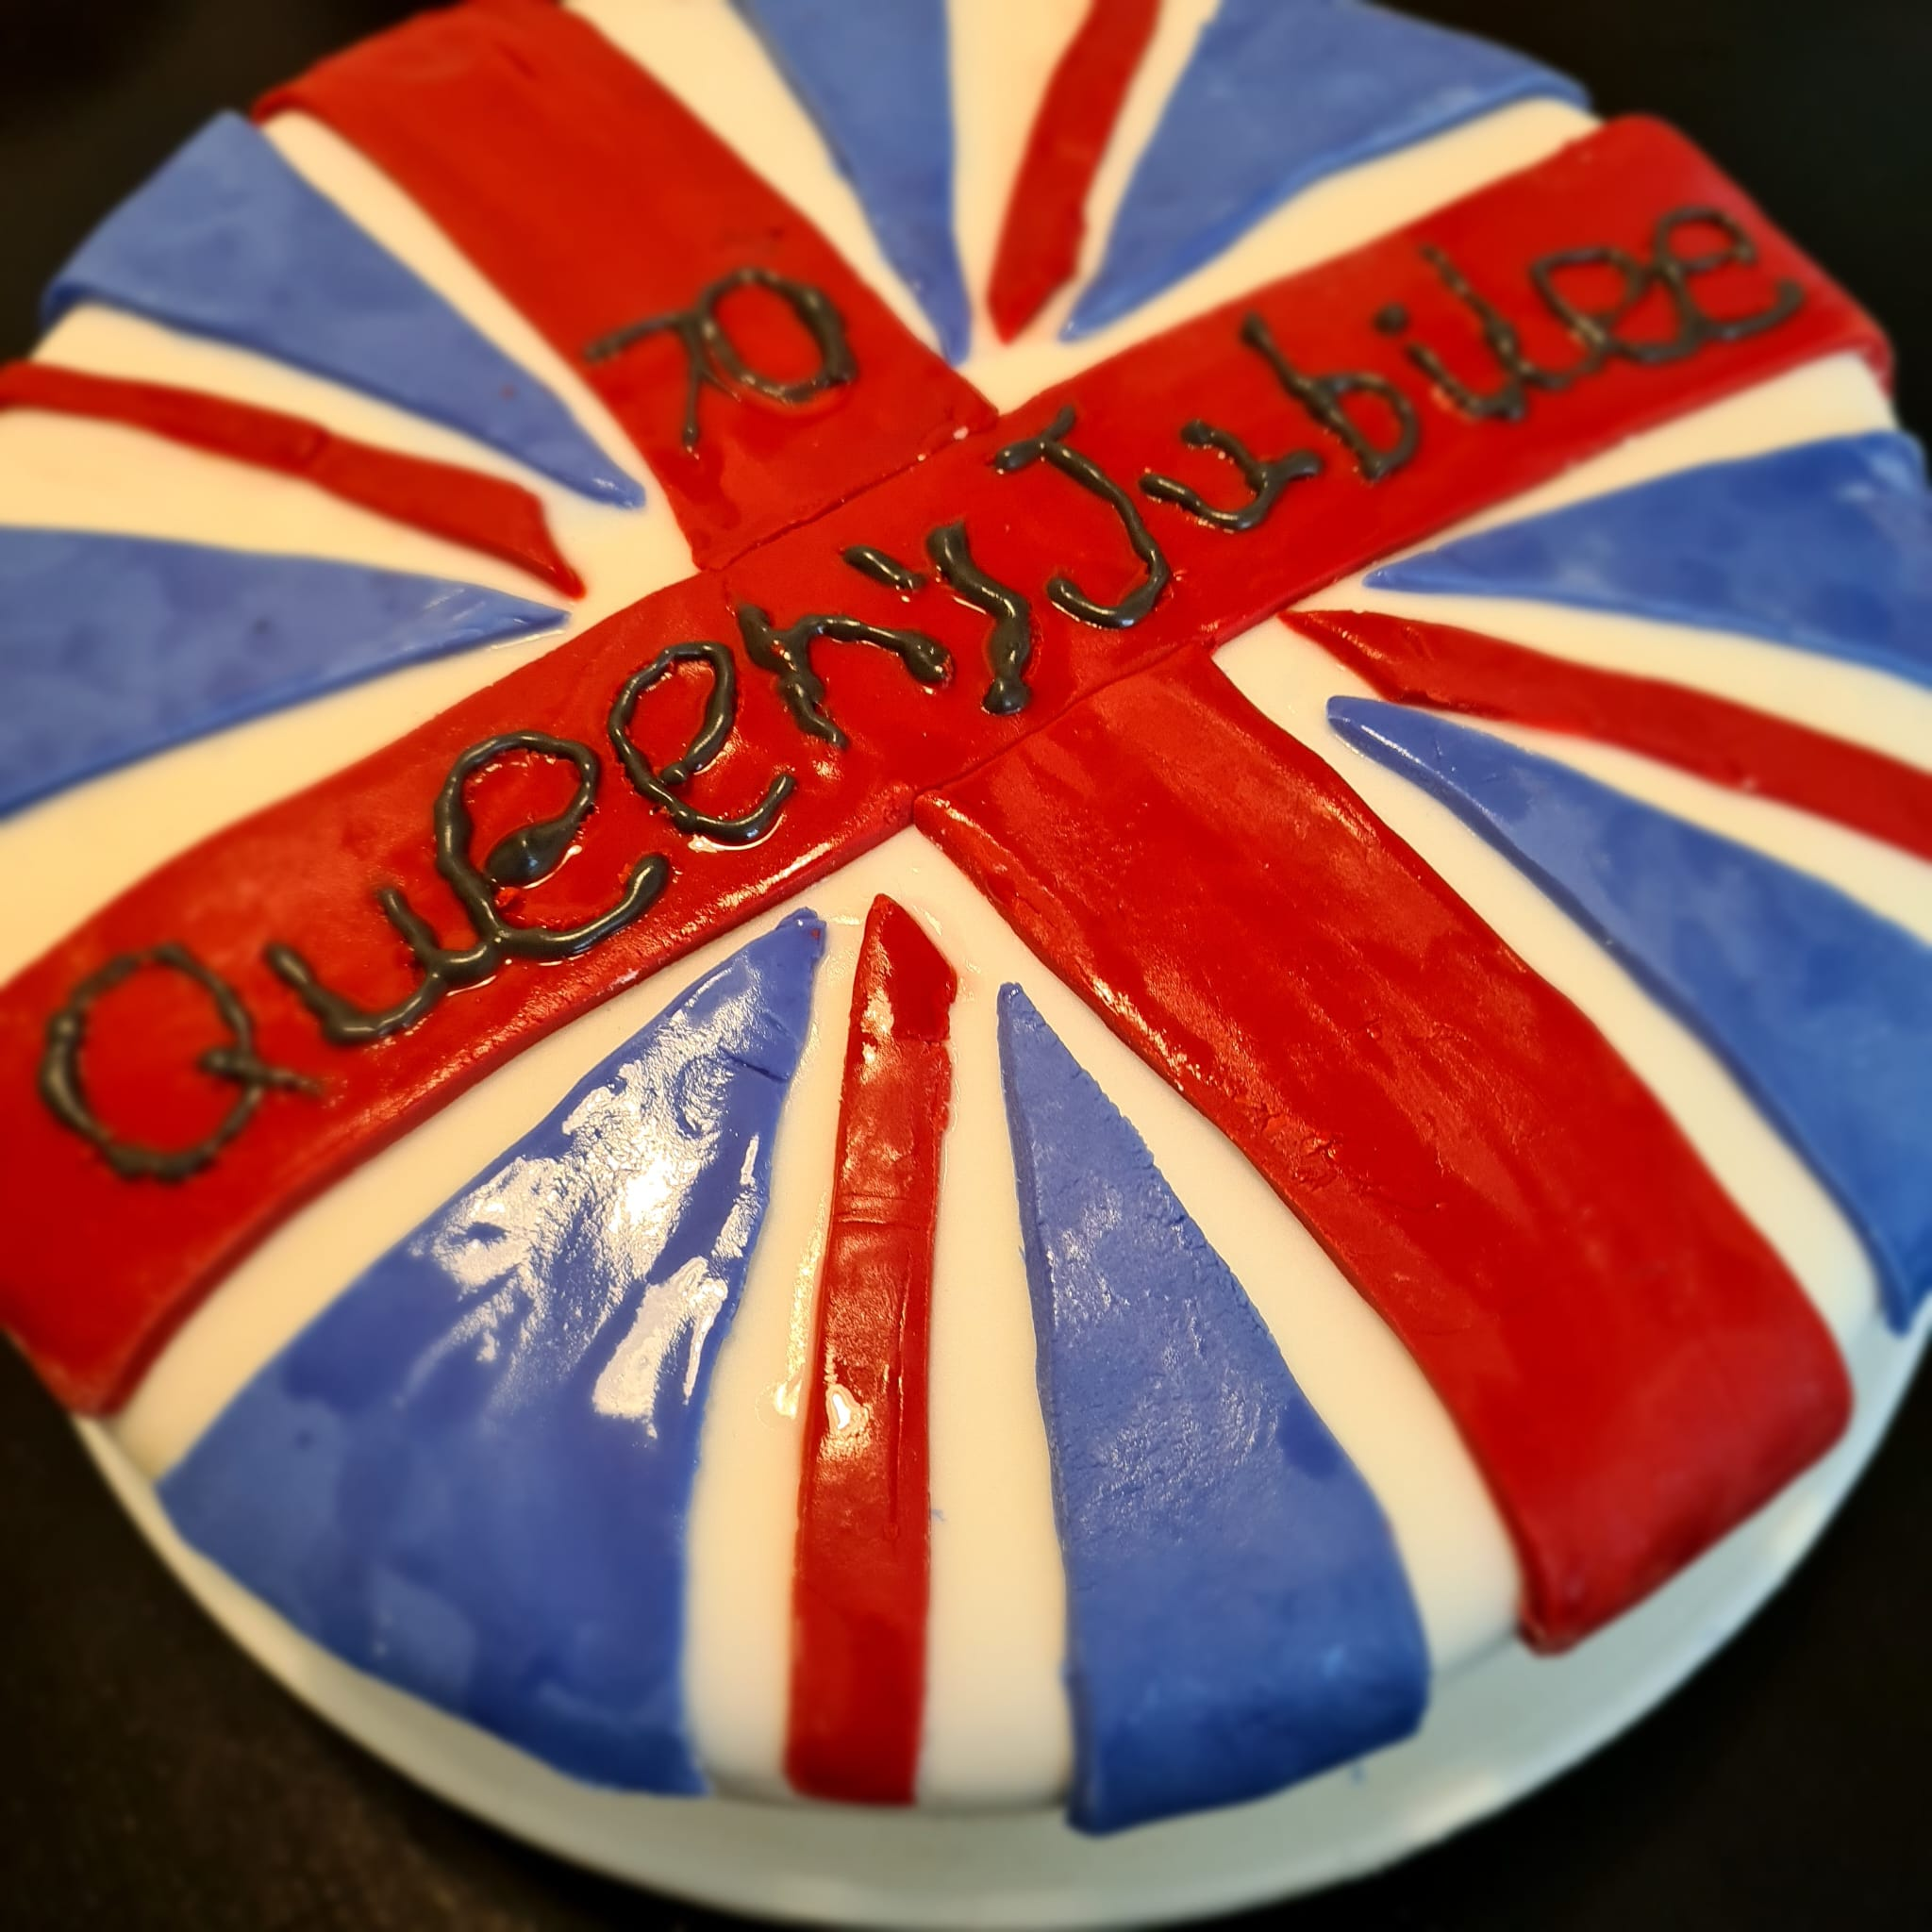
Next

Slide 16
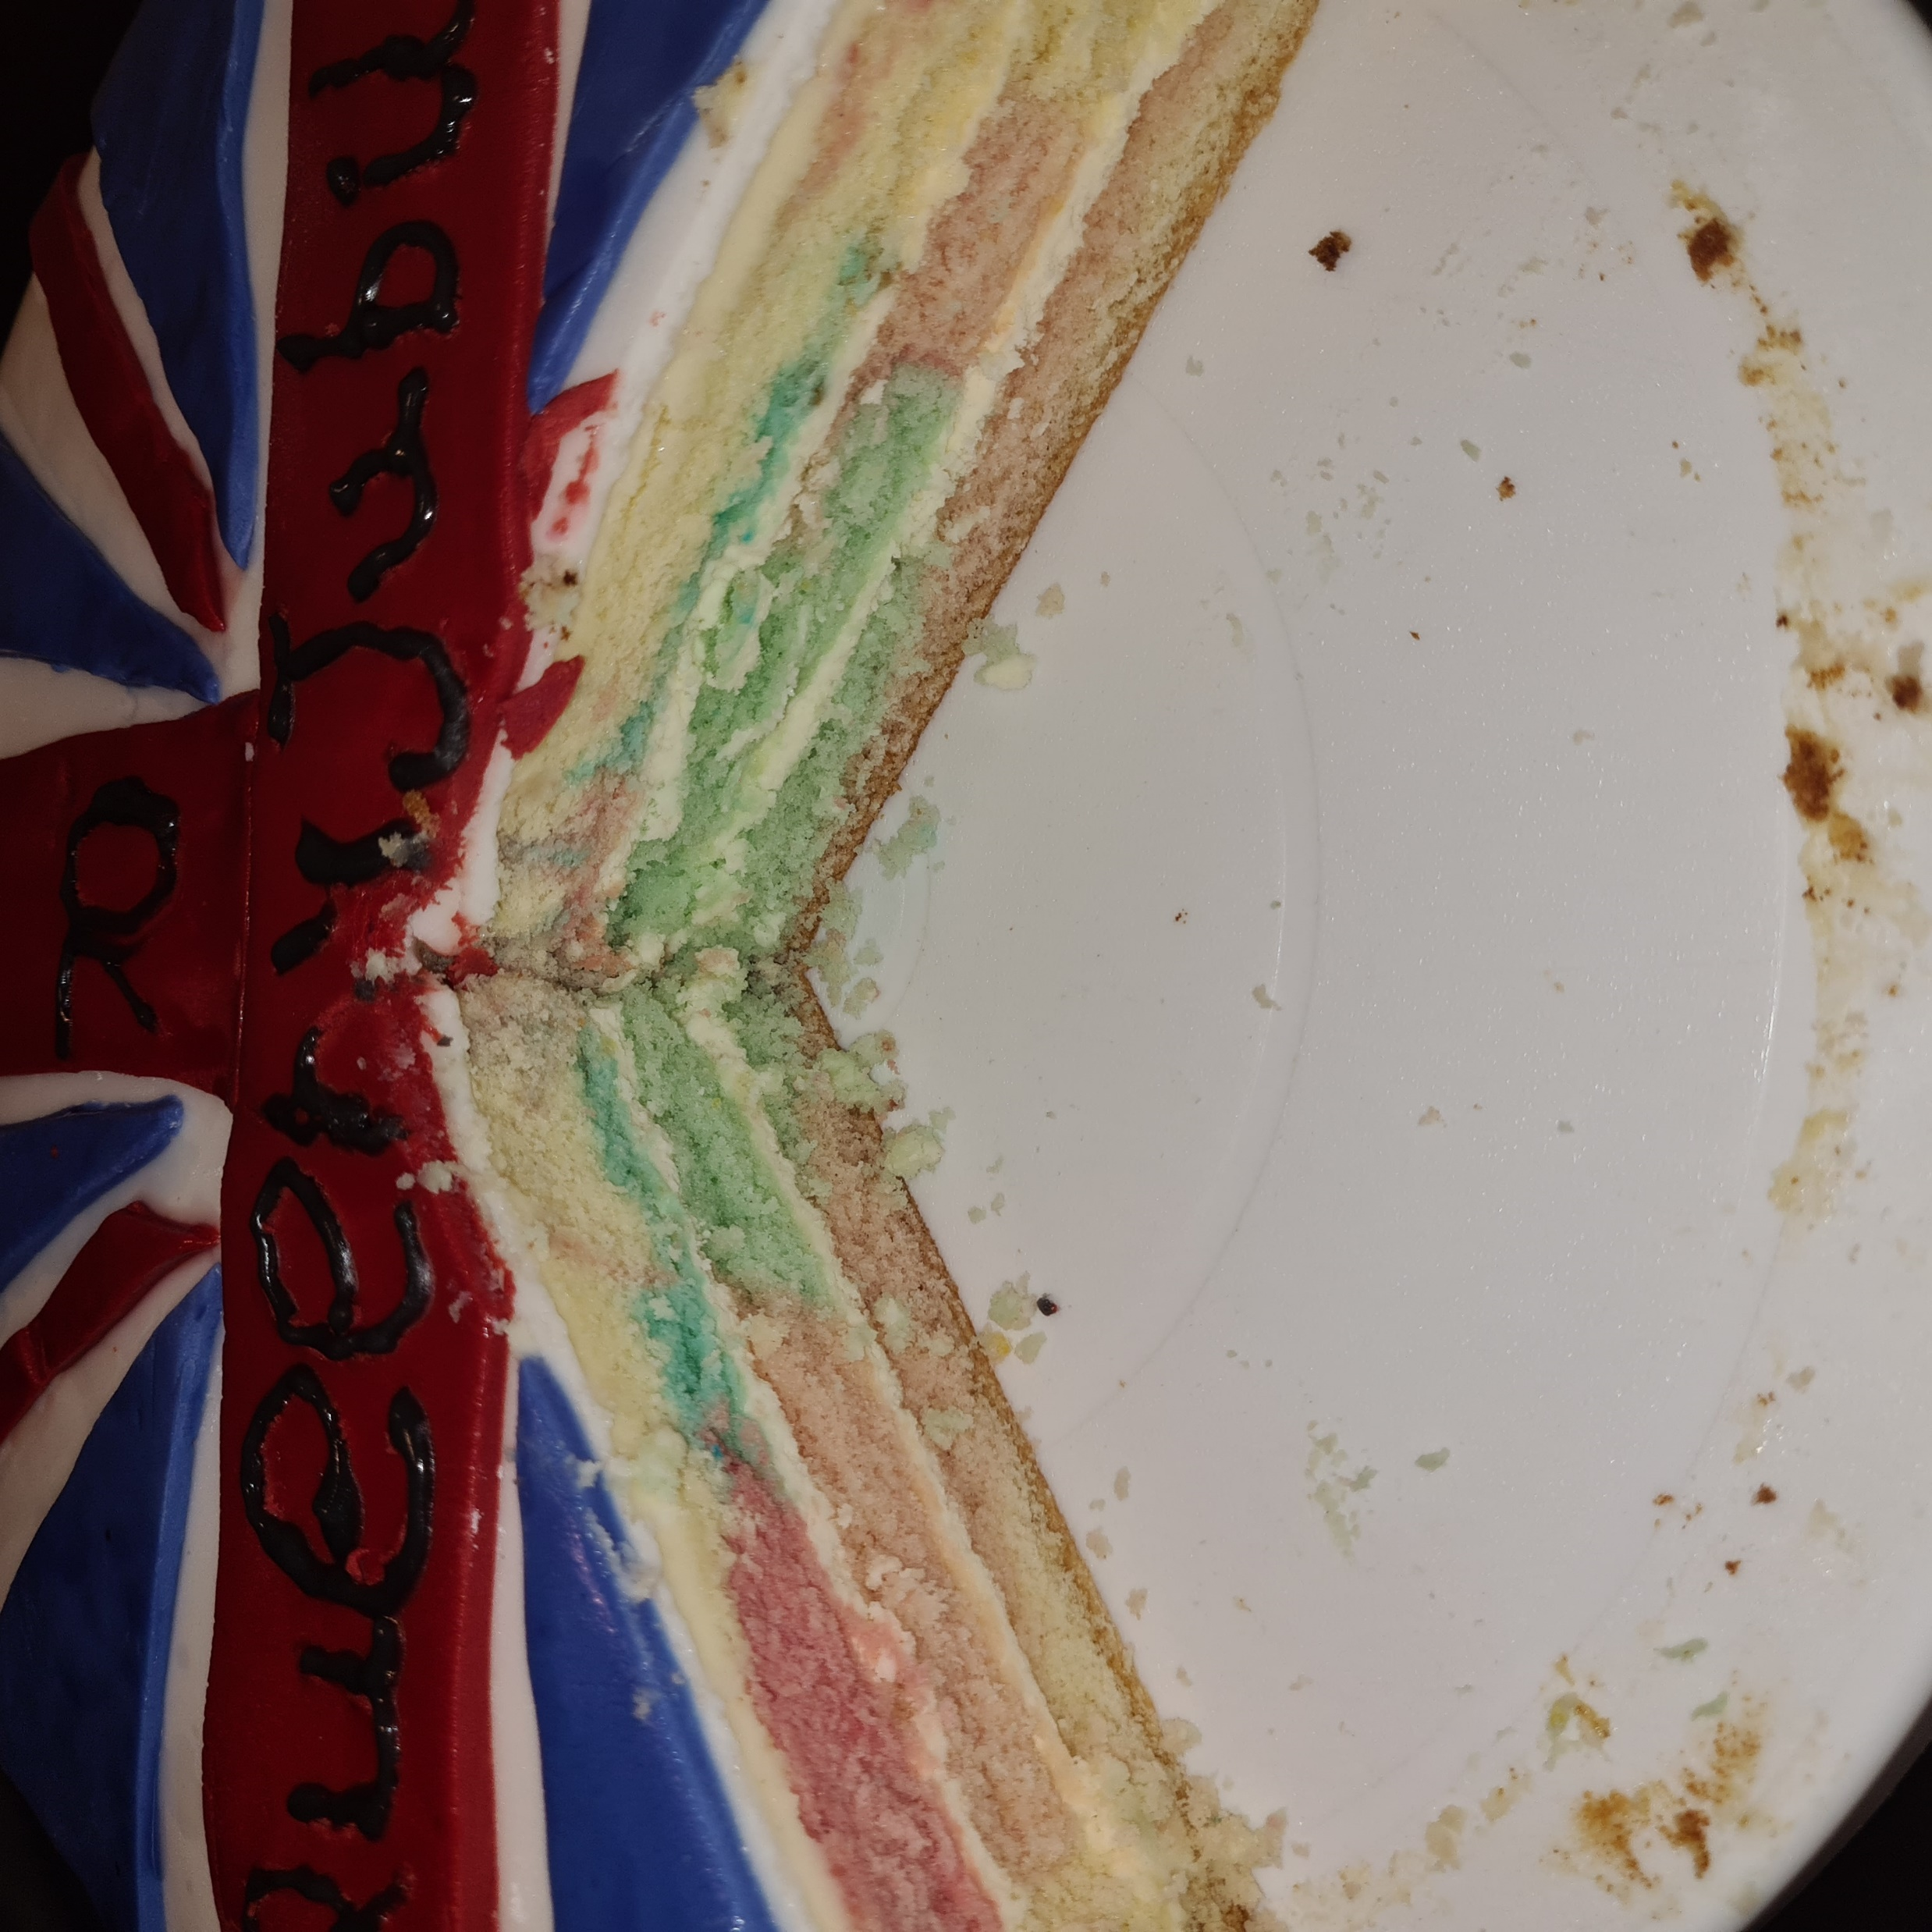
Next

Slide 17
