Slide 1
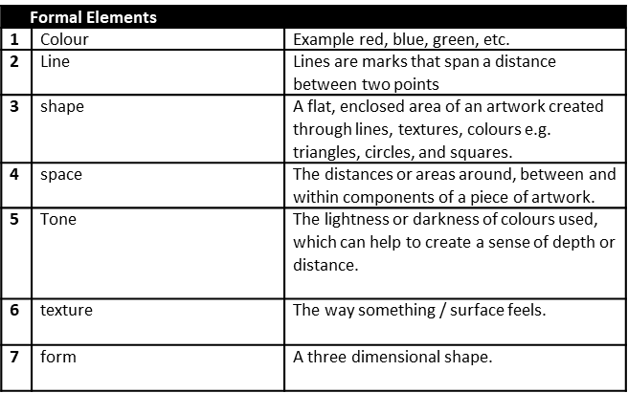
ART | Year 8 | SUMMER | Fantastical Architecture
Key Words
1 | Drawing | Making a mark on paper or other surface.
2 | Design | A plan, sketch, or preliminary drawing.
3 | Imagination | The act or power of forming a mental image of something not present to the senses or never before wholly perceived in reality.
4 | Composition | The arrangement of a piece of artwork or design.
 | Materials / Tools
1 | Watercolour Paint | Paints are made of pigments suspended in a water-based solution. Watercolour refers to both the medium and the resulting artwork.
2 | Fine liner | Thin tipped felt tip pen used to define images.
3 | Oil pastels | An oil pastel is a painting and drawing medium formed into a stick which consists of pigment mixed with a binder mixture of non-drying oil and wax
4 | Drawing Pencil | A tool used to create a range of lines and tones in a drawing. Eg. 2B, 4B, 6B
Theme: Fantastical Architecture
1. | Architecture | The designing of buildings and other physical structures.
2 | Hundertwasser | Austrian artist and Architect , famous for his organic shaped buildings.
3 | Gaudi | Spanish artist / architect famous for his modern organic style buildings.
4 | Gehry | Canadian American architect and designer whose original, sculptural, often adventurous/daring work won him worldwide renown.
Techniques / Processes
1 | Drawing | Making a mark on paper or other surface.
2 | Painting | Painting is the practice of applying paint or colour to a surface. The medium is most commonly applied with a brush.
3 | Mono printing | A monoprint is a form of printmaking where the image can only be made once.
4 | Designing | To create the plans, drawings, etc., that show how (something) will be made.
5 | One Point Perspective | A drawing method that shows how things appear to get smaller as they get further away, converging towards a single ‘vanishing point’ on the horizon line. It is a way of drawing objects upon a flat piece of paper (or other drawing surface) so that they look three-dimensional and realistic.
Command Words
1 | Name | Recall one or more pieces of information.
2 | Analyse | Looking at the work of other artists to see how they have created their work.
3 | Evaluate | To assess the successes and areas for improvement in work.
4 | Describe | Give an account in words of a piece of art work eg. Looking at how the artist has used colour.
5 | Present | To show work in progress or a finished piece to a group and to talk about it.
6 | How | Discuss the creation of a piece of artwork.
7 | Reflect | Think about your work as it progresses in order to make improvements.
8 | Discuss | Talk or write about a topic in detail.
 | Art History- Fantastical Landscape artists
1 | Hundertwasser
2 | Cecil Collins
3 | Gustav Klimt
4 | M C Escher
5 | Salvador Dali
6 | Umberto Boccioni

