Slide 1
THE BRIDGEWATER BATON
ART

Slide 2
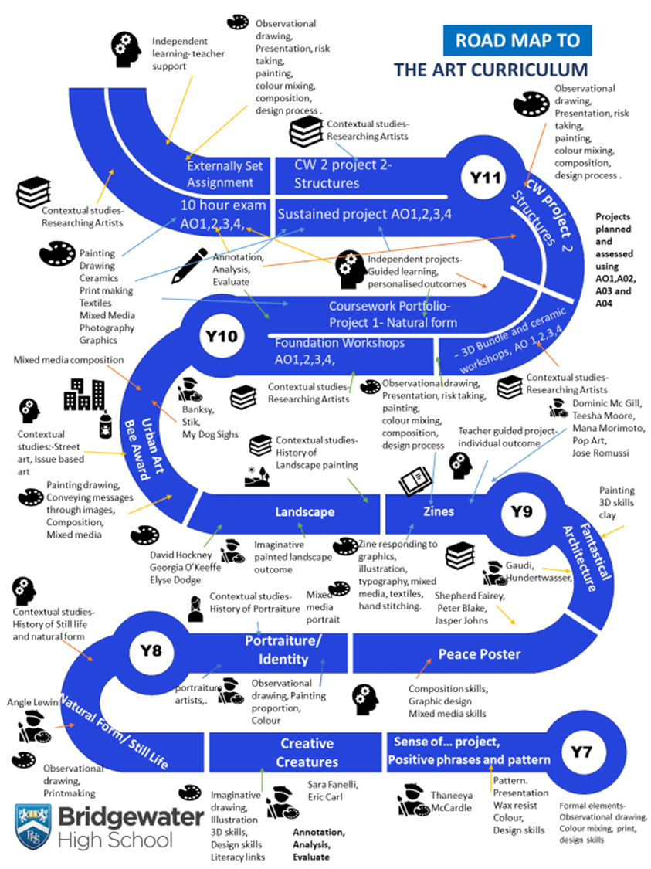
The Bridgewater journey in Art
Our “Roadmap” for this subject:

Slide 3
The Bridgewater journey in Art
KS3 in particular:

Slide 4
Further information for Art can be found at:
Within the CURRICULUM INFORMATION table there are links to each subject’s:
Curriculum Intent statement
Curriculum map
Road map
Assessment statements
https://bridgewaterhigh.org/key-stage-3-subjects/

Slide 5
The KS2 National Curriculum for Art states that:
Pupils should be taught to develop their techniques, including their control and their use of materials, with creativity, experimentation and an increasing awareness of different kinds of art, craft and design.
Pupils should be taught:
To create sketch books to record their observations and use them to review and revisit ideas.
To improve their mastery of art and design techniques, including drawing, painting and sculpture with a range of materials [for example, pencil, charcoal, paint, clay]
About great artists, architects and designers in history.

Slide 6
The KS3 National Curriculum for Art states that:
Pupils should be taught to develop their creativity and ideas, and increase proficiency in their execution. They should develop a critical understanding of artists, architects and designers, expressing reasoned judgements that can inform their own work.
Pupils should be taught:
to use a range of techniques to record their observations in sketchbooks, journals and other media as a basis for exploring their ideas
to use a range of techniques and media, including painting to increase their proficiency in the handling of different materials
to analyse and evaluate their own work, and that of others, in order to strengthen the visual impact or applications of their work
about the history of art, craft, design and architecture, including periods, styles and major movements from ancient times up to the present day.

Slide 7
In Art, it is particularly vital for us that pupils arrive with an experience of:
Be proficient at using a ruler to measure, to accurately draw borders and geometric shapes, and to divide up space.
Be proficient at using scissors to cut neatly and accurately.
Have an understanding of what neat presentation of their work looks like.
To be able to apply colour neatly, keeping within the lines.
To have an understanding of how to hold a pencil.
To have an understanding of how to create a range of tones using a pencil.
To know what a sketch is.
To have an understanding of how to hold a paint brush.

Slide 8
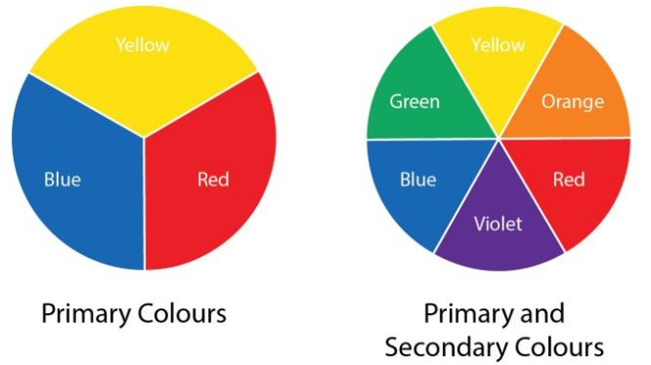
In Art, to truly succeed at Bridgewater, pupils should arrive with a knowledge of:
To have a basic understanding of the formal elements of art.
To have a basic understanding of colour theory.
To have an understanding of what the colour wheel is.
To have an understanding of what the primary and secondary colours are.
To have an understanding of how to make the secondary colours.
To have some understanding of the main 20th century Art Movements.

Slide 9
In Art, key vocabulary which we use at Bridgewater includes the following:
Art Vocabulary | Description and examples
Line | Lines are marks that span a distance between two points e.g. long and short lines.
Shape | A flat, enclosed area of an artwork created through lines, textures, colours or an area enclosed by other shapes such as triangles, circles, and squares.
Tone | The lightness or darkness of colours used, which can help to create a sense of depth or distance.
Pattern | A repeated decorative design.
Texture | How the surface would feel.
Primary colour | The first set of colours that are used to make all other colours; yellow, red and blue.
Secondary colour | The second set of colours that are made by mixing two primary colours together; orange, green and purple.
Sketch | A light rough drawing or painting in which an artist notes down his ideas for a work that will eventually be realized with greater precision and detail.
Composition | The layout or arrangement of a drawing or painting.

Slide 10
Further support for you in Art
We are pleased to offer the following to support your art provision and transition:
Teacher visits to meet with your staff
Teacher visits to deliver one-off lessons
Attendance at our extra-curricular groups
CONTACT – Amanda Silver, KS3 Co-ordinator Art & Design:
a.silver@bridgewaterhigh.com

