Slide 1
THE BRIDGEWATER BATON
DRAMA

Slide 2
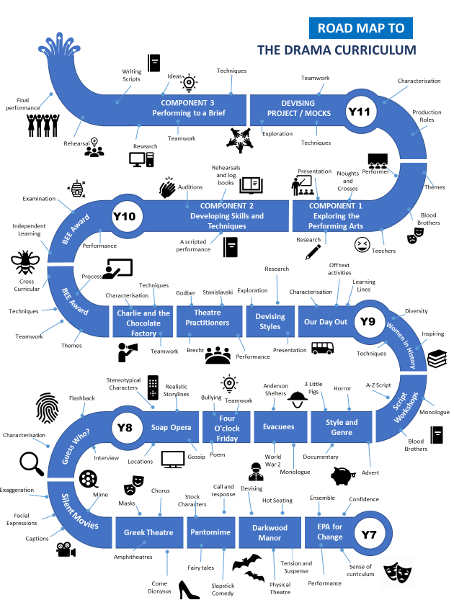
The Bridgewater journey in Drama
Our “Roadmap” for this subject:

Slide 3
The Bridgewater journey in Drama
KS3 in particular:

Slide 4
Further information for Drama can be found at:
Within the CURRICULUM INFORMATION table there are links to each subject’s:
Curriculum Intent statement
Curriculum map
Road map
Assessment statements
https://bridgewaterhigh.org/key-stage-3-subjects/

Slide 5
At KS1 & 2, Drama is taught through the English National Curriculum:
Pupils should be able to read aloud by the beginning of Year 5, with accuracy and at a reasonable speaking pace. They should be able to prepare readings, with appropriate intonation to show their understanding. In years 5 and 6, pupils’ confidence, enjoyment and mastery of language should be extended through public speaking, performance and debate.
Pupils should be taught to:
Prepare poems and plays to read aloud and to perform, showing understanding through intonation, tone and volume so that the meaning is clear to audience.
Participate in discussions about books that are read to them and those they can read for themselves, building on their own and others’ ideas and challenging views courteously.
Explain and discuss their understanding of what they have read, including through formal presentations and debates.
Perform their own compositions, using appropriate intonation, volume, and movement so that meaning is clear.
Read aloud and to understand the meaning of new words that they meet.
Bridgewater High School KS3 Drama curriculum is programmed to extend upon the English National Curriculum targets and aims, as it is taught as a bespoke, independent subject within the Expressive & Performing Arts Faculty.

Slide 6
At KS3, the English National Curriculum states that through Drama:
Pupils should build on their previous knowledge and skills and become competent in the arts of speaking and listening, making formal presentations, demonstrating to others and participating in debate. Spoken language continues to underpin the development of pupils’ reading and writing during key stage 3, allowing pupils’ confidence and competence in this area continue to develop.
Pupils should be taught to:
Speak confidently and effectively, using Standard English confidently in a range of formal and informal contexts, including classroom discussion.
Understand how the work of dramatists is communicated effectively through performance and how alternative staging allows for different interpretations of a play.
Give short speeches and presentations, expressing their own ideas and keeping to the point.
Improvise, rehearse and perform play scripts and poetry in order to generate language and discuss language use and meaning, using role, intonation, tone, volume, mood, silence, stillness and action to add impact.
Through Drama, we aim to develop the holistic Drama student. We promote the process and the performance to be equal. Within the process, we allow students to develop transferrable skills such as confidence, empathy and teamwork as well as Drama skills to allow students the understanding and appreciation of theatre. To embed this knowledge, we revisit and build upon these skills through different areas of the curriculum.

Slide 7
In Drama, it is particularly vital for us that pupils arrive being able to:
Speak confidently during formal and informal discussions.
Perform playscripts and/or poems using volume and tone to suit the style.
Showcase their own creative work through performance and/or class presentations.
In Drama, to truly succeed at Bridgewater, pupils should arrive with a knowledge of:
Live theatre – whether this be through a trip to the theatre or a visiting theatre group. Alternatively, via recorded live theatre. This allows pupils to see Drama in action, showcasing the end-product of the skills they will learn with us. Pupils will experience how Drama can be used to engage and entertain audiences, as well as displaying a range of emotions to connect with them.

Slide 8
In Drama, key vocabulary which we use at Bridgewater includes the following:
Drama Terminology | Description and examples
Narration | Used to tell the story and is spoken directly to the audience.
Freeze Frame | A frozen image of a scene to create focus and/or emphasis.
Physical Theatre | Using your body in a physical way to create shapes and/or objects.
Thought Tracking | Briefly speaking the characters thoughts aloud to the audience. Called an ‘aside’ in a play script.
Ensemble | A group of actors working together to create a scene.
Role on the Wall | A written task used to deepen your understanding of a character you are exploring.
Hot Seating | Asking questions to an actor in role as their character to develop a deeper understanding of them.
Monologue | An extended speech delivered by one actor to the audience.

Slide 9
Further support for you in Drama
We are pleased to offer the following to support your drama provision and transition:
Teacher visits to meet with your staff
Teacher visits to deliver workshop lessons
Invitation to watch our annual school production
Video recording of key skills that can be used in the classroom
CONTACT – Alison Swaffield, Head of Drama:
a.swaffield@bridgewaterhigh.com

