Slide 1
THE BRIDGEWATER BATON
MFL

Slide 2
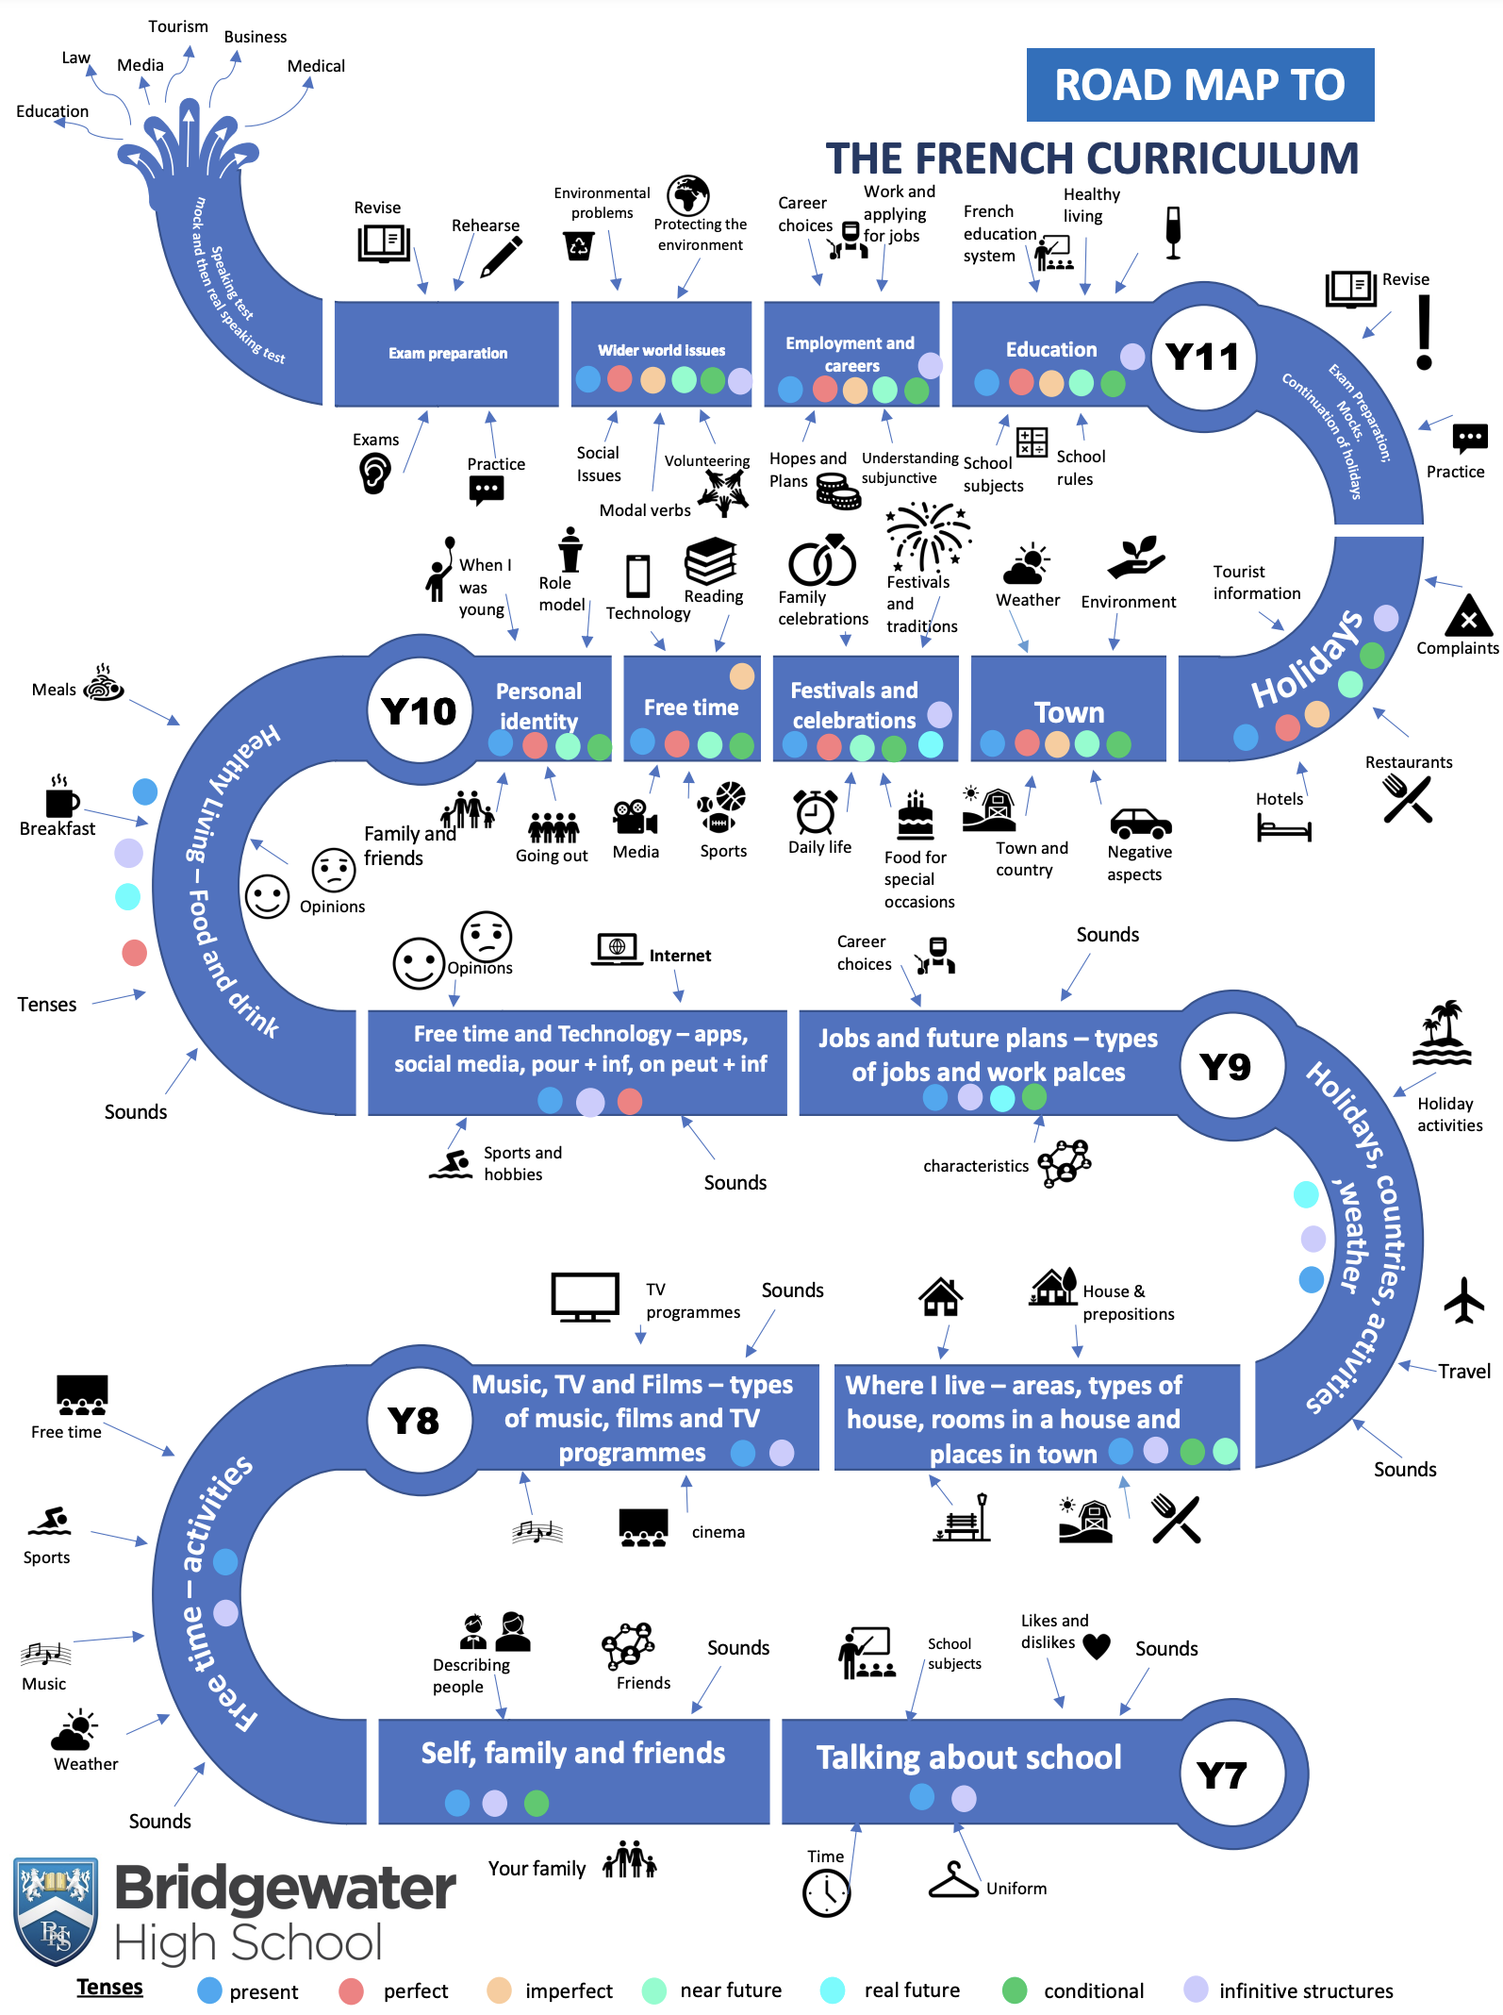
The Bridgewater journey in MFL
Our “Roadmap” for French:

Slide 3
The Bridgewater journey in MFL
Our “Roadmap” for French:
Focusing on KS3

Slide 4
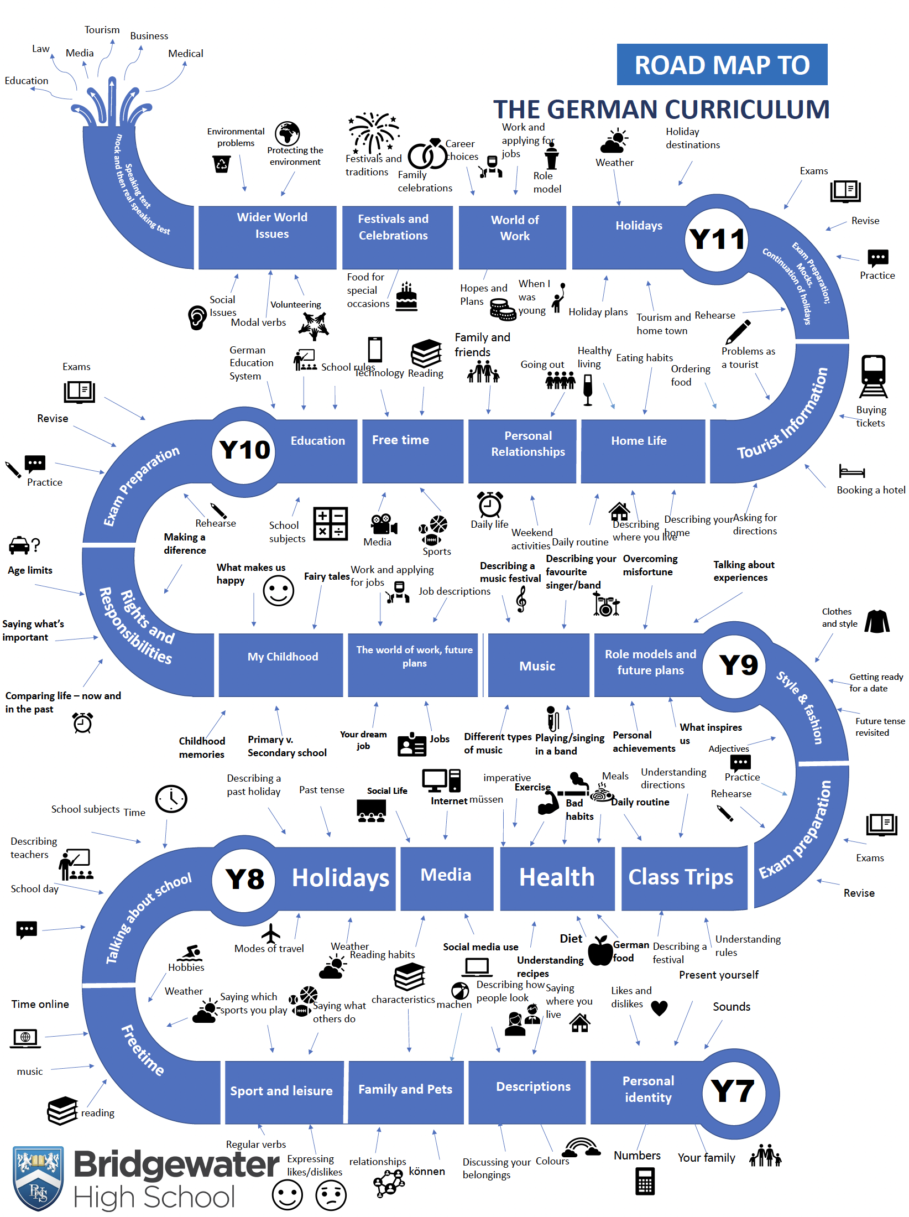
The Bridgewater journey in MFL
Our roadmap for German:

Slide 5
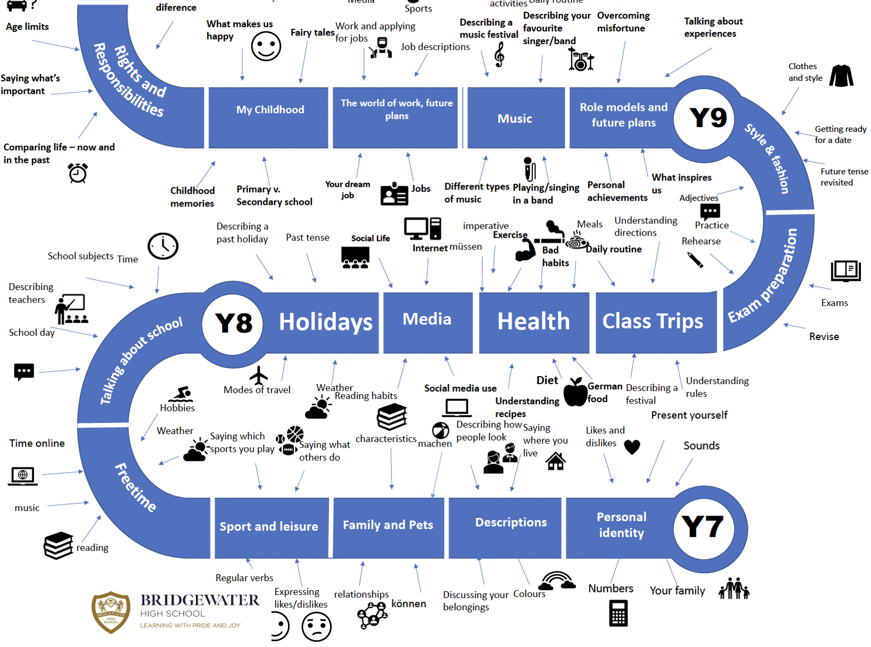
The Bridgewater journey in MFL
Our roadmap for German:
Focusing on KS3

Slide 6
Further information for MFL can be found at:
Within the CURRICULUM INFORMATION table there are links to each subject’s:
Curriculum Intent statement
Curriculum map
Road map
Assessment statements
https://bridgewaterhigh.org/key-stage-3-subjects/

Slide 7
The KS2 National Curriculum for MFL states that:
MFL teaching at KS2 should enable pupils to express their ideas and thoughts in another language and to understand and respond to its speakers, both in speech and in writing .
Pupils should be taught to:
Understand and respond to spoken and written language from a variety of different sources
Speak with increasing confidence and spontaneity, finding ways of communicating what they want to say, including through discussion and asking questions, and continually improving the accuracy of their pronunciation and intonation
Can write at varying length for different audiences, using the variety of grammatical structures they have learned
Discover and develop an appreciation of a range of writing in the language studied

Slide 8
The KS3 National Curriculum for MFL states that:
Teaching should build on the foundations of language learning laid at KS2. Teaching should focus on developing the breadth and depth of pupils’ competence in listening, speaking, reading and writing, based on a sound foundation of core grammar and vocabulary. It should enable pupils to understand and communicate personal and factual information that goes beyond their immediate needs and interests, developing and justifying points of view in speech and writing, with increased spontaneity, independence and accuracy.
Pupils should be taught to:
identify and use tenses or other structures which convey the present, past, and future as appropriate to the language being studied
use accurate grammar, spelling and punctuation.
listen to a variety of forms of spoken language to obtain information and respond appropriately
transcribe words and short sentences that they hear with increasing accuracy
express and develop ideas clearly and with increasing accuracy, both orally and in writing
speak coherently and confidently, with increasingly accurate pronunciation and intonation

Slide 9
In MFL, it is particularly vital for us that pupils arrive with an experience of: 1. Having explored the patterns and sounds of language through songs and rhymes and having linked the spelling, sound and meaning of words. 2. Having developed accurate pronunciation and intonation so that others understand when they are reading aloud or using familiar words and phrases 3. Having written phrases from memory, and adapted these to create new sentences, to express ideas clearly.
In MFL, to truly succeed at Bridgewater, pupils should arrive with a knowledge of:
Basic grammar appropriate to the language being studied, for example feminine, masculine or neuter forms
The conjugation of high-frequency verbs, for example “avoir” and “être”.
The culture of the language being studied, for example festivals or celebrations, which may be different to our own.

Slide 10
In MFL, key vocabulary which we use at Bridgewater includes the following:
We describe our approach to language learning using the following headings – we refer to this using the acronym MARSEARS.
Linguistic Element | Description/explanation
Modelling | Learning activities show you a lot of the language being used correctly and teach correct pronunciation.
Awareness raising | Practice using new vocabulary and grammar so that you are aware of the correct usage.
Receptive Processing | Lots of reading and listening to improve the accuracy of the language being learned.
Structured production | Learning activities make you write and speak the new language in a very supportive way, with knowledge organisers always available
Expansion | The vocabulary and grammar you have seen in context are explained in further detail, and the previous stages mean you recognize and can use lots of examples.
Autonomy | The learning activities start to move you away from the support of the knowledge organizer, and you begin to be able to use the new vocabulary and grammar as and when you need.
Routinisation | The learning activities build in more of the vocabulary and grammar from previous topic areas to ensure they stay in your useable memory.
Spontaneity | The overall aim of your language learning, which may need study of lots of different modules and may take the whole time you are in school-you start to speak the language in the way you need, when you need it.

Slide 11
Further support for you in MFL
We are pleased to offer the following to support your music provision and transition
Teacher visits to meet with your staff
Teacher visits to deliver one-off lessons
Attendance at our extra-curricular groups
CONTACT – Rob Glew, Head of MFL:
r.glew@bridgewaterhigh.com

