Slide 1
THE BRIDGEWATER BATON
MUSIC

Slide 2
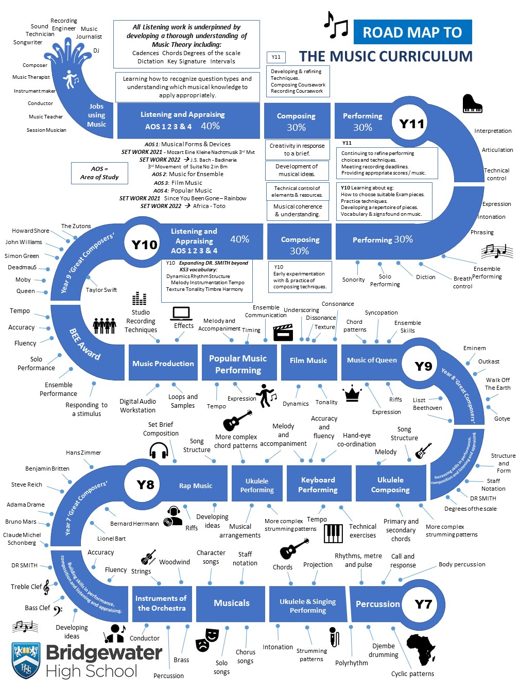
The Bridgewater journey in Music
Our “Roadmap” for this subject:

Slide 3
The Bridgewater journey in Music
KS3 in particular:

Slide 4
Further information for Music can be found at:
Within the CURRICULUM INFORMATION table there are links to each subject’s:
Curriculum Intent statement
Curriculum map
Road map
Assessment statements
https://bridgewaterhigh.org/key-stage-3-subjects/

Slide 5
The KS2 National Curriculum for Music states that:
Pupils should be taught to sing and play musically with increasing confidence and control. They should develop an understanding of musical composition, organising and manipulating ideas within musical structures and reproducing sounds from aural memory.
Pupils should be taught to:
play and perform in solo and ensemble contexts, using their voices and playing musical instruments with increasing accuracy, fluency, control and expression
improvise and compose music for a range of purposes using the inter-related dimensions of music
listen with attention to detail and recall sounds with increasing aural memory
use and understand staff and other musical notations
appreciate and understand a wide range of high-quality live and recorded music drawn from different traditions and from great composers and musicians
develop an understanding of the history of music.

Slide 6
The KS3 National Curriculum for Music states that:
Pupils should build on their previous knowledge and skills through performing, composing and listening. They should develop their vocal and/or instrumental fluency, accuracy and expressiveness; and understand musical structures, styles, genres and traditions, identifying the expressive use of musical dimensions. They should listen with increasing discrimination and awareness to inform their practice as musicians. They should use technologies appropriately and appreciate and understand a wide range of musical contexts and styles.
Pupils should be taught to:
play and perform confidently in a range of solo and ensemble contexts using their voice, playing instruments musically, fluently and with accuracy and expression
improvise and compose; and extend and develop musical ideas by drawing on a range of musical structures, styles, genres and traditions
use staff and other relevant notations appropriately and accurately in a range of musical styles, genres and traditions
identify and use the inter-related dimensions of music expressively and with increasing sophistication, including use of tonalities, different types of scales and other musical devices
listen with increasing discrimination to a wide range of music from great composers and musicians
develop a deepening understanding of the music that they perform and to which they listen, and its history.

Slide 7
In Music, it is particularly vital for us that pupils arrive with an experience of:
Having performed music together as a group, both on voice and at least one instrument (percussion preferred).
Having composed music of their own, even if having worked on this as a group activity.
Having listened to and discussed music in a variety of styles and from different times.
In Music, to truly succeed at Bridgewater, pupils should arrive with a knowledge of:
How to read basic notation – this includes note lengths as well as notes on the stave in treble clef (see below – we use Every Green Bus Drives Fast for notes on the line and FACE in the spaces – and next slide).

Slide 8
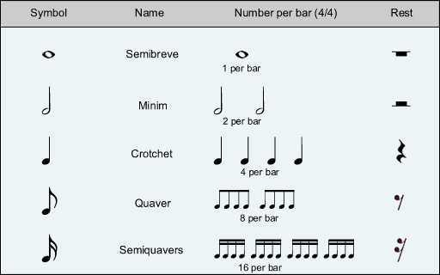
In Music, to truly succeed at Bridgewater, pupils should arrive with a knowledge of:

Slide 9
In Music, key vocabulary which we use at Bridgewater includes the following:
We describe music using the following headings - we refer to this using the acronym DR B SMITH.
Musical Element | Description and examples
Dynamics | How loud or soft, e.g. forte (loud) or crescendo (getting louder)
Rhythm | To do with the beat, e.g. how many beats in a bar
Background | Context, e.g. when the piece was written and for what purpose
Structure | The order of the sections, e.g. verse/chorus or binary form
Melody | The top line of the music, e.g. moving in steps (conjunct)
Instrumentation | What instruments are being used and how are they played
Texture & Tempo | Texture = layers of sound, e.g. thick or thin Tempo = the speed of the music, e.g. adagio (slow) or allegro (fast)
Harmony | To do with chords or keys, e.g. major (happy) or minor (sad)

Slide 10
Further support for you in Music
We are pleased to offer the following to support your music provision and transition:
Vocal workshops here at Bridgewater
Teacher visits to meet with your staff
Teacher visits to deliver one-off lessons
Attendance at our extra-curricular groups
CONTACT – Ritchie Bradbury, Head of Music:
r.bradbury@bridgewaterhigh.com

