Slide 1
THE BRIDGEWATER BATON
PHYSICAL EDUCATION

Slide 2
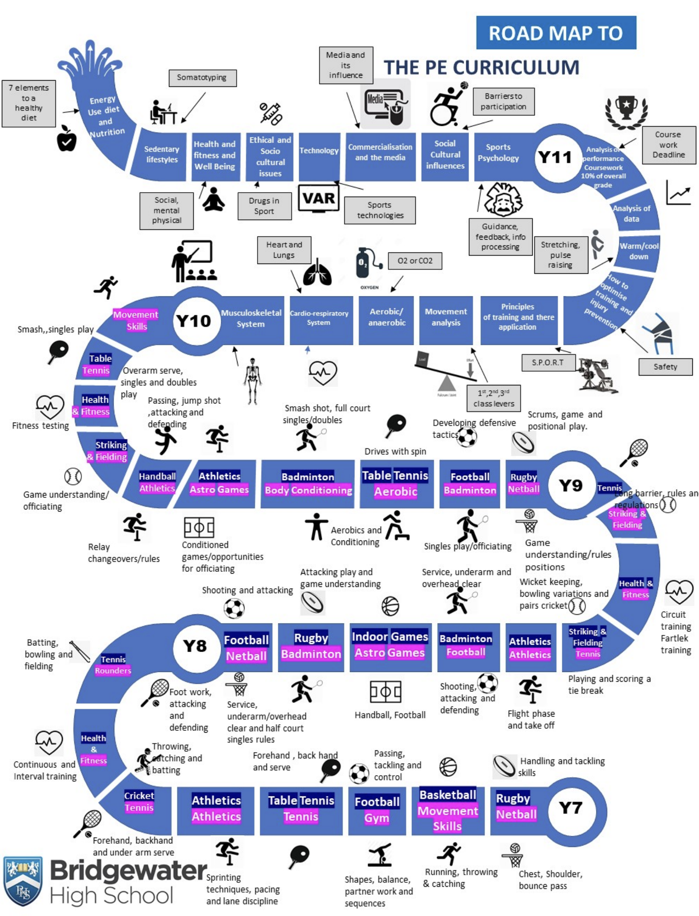
The Bridgewater journey in PE
Our “Roadmap” for this subject:

Slide 3
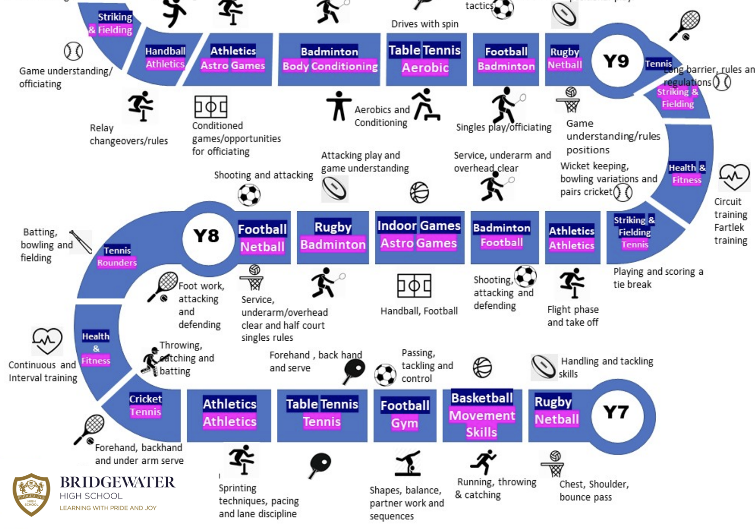
The Bridgewater journey in PE
KS3 in particular:

Slide 4
Further information for PE can be found at:
Within the CURRICULUM INFORMATION table there are links to each subject’s:
Curriculum Intent statement
Curriculum map
Road map
Assessment statements
https://bridgewaterhigh.org/key-stage-3-subjects/

Slide 5
The KS2 National Curriculum for PE states that:
Pupils should continue to apply and develop a broader range of skills, learning how to use them in different ways and to link them to make actions and sequences of movement. They should enjoy communicating, collaborating and competing with each other. They should develop an understanding of how to improve in different physical activities and sports and learn how to evaluate and recognise their own success.
Pupils should be taught to:
use running, jumping, throwing and catching in isolation and in combination
play competitive games, modified where appropriate [for example, badminton, basketball, cricket, football, hockey, netball, rounders and tennis], and apply basic principles suitable for attacking and defending
develop flexibility, strength, technique, control and balance [for example, through athletics and gymnastics]
perform dances using a range of movement patterns
take part in outdoor and adventurous activity challenges both individually and within a team
compare their performances with previous ones and demonstrate improvement to achieve their personal best.

Slide 6
The KS3 National Curriculum for PE states that:
Pupils should build on and embed the physical development and skills learned in key stages 1 and 2, become more competent, confident and expert in their techniques, and apply them across different sports and physical activities. They should understand what makes a performance effective and how to apply these principles to their own and others’ work. They should develop the confidence and interest to get involved in exercise, sports and activities out of school and in later life, and understand and apply the long-term health benefits of physical activity.
Pupils should be taught to:
use a range of tactics and strategies to overcome opponents in direct competition through team and individual games [for example, badminton, basketball, cricket, football, hockey, netball, rounders, rugby and tennis]
develop their technique and improve their performance in other competitive sports [for example, athletics and gymnastics]
take part in outdoor and adventurous activities which present intellectual and physical challenges and be encouraged to work in a team, building on trust and developing skills to solve problems, either individually or as a group
analyse their performances compared to previous ones and demonstrate improvement to achieve their personal best
take part in competitive sports and activities outside school through community links or sports clubs.

Slide 7
In PE, it is particularly vital for us that pupils arrive with an experience of:
Running, jumping, throwing and catching in isolation and are able to combine these actions.
Modified/conditioned games and are able to apply the basic principles of attack and defence.
Working individually and within a team.
Comparing their performances with previous ones and demonstrating improvement.
In PE, to truly succeed at Bridgewater, pupils should arrive with an experience of:
Playing competitive games in at least a minimum of two sports (for example netball, football, rugby, badminton, table-tennis, handball, rounders, cricket and tennis).
Competing as an individual in athletics or cross country activities within school.
Being able to apply and being knowledgeable of the basic rules of games and athletic activities.

Slide 8
In PE, to truly succeed at Bridgewater, pupils should arrive with a level of:
Core Values
Honesty
Resilience
Integrity
Self-discipline
Responsibility
Courage
Self-motivate
Self-belief

Slide 9
In PE, key vocabulary which we use at Bridgewater include the following:
PE Vocabulary | Description and examples
Heart rates | The speed at which the heart beats. "the average heart rate is 72 beats a minute"
Training methods | Different types of training including continuous, circuit, interval and fartlek.
Fitness Testing | are a series of tests that measures and monitors students' physical fitness levels including the multi-stage fitness test and cooper test.
Warm up | is a short activity or exercise undertaken prior to a more intensive exercise or activity.
Attacking | An attempt to score a goal or point or otherwise gain an advantage against an opposing team or player.
Defending | When a team is trying to prevent the other team from scoring.
Track & Field | A sport that includes athletic contests based on running, jumping, and throwing skills.
Core Values | Participation in any activity should be played under the values of Honesty, Courage, Self-motivate, Responsibility, Resilience, Integrity, Self-discipline and Self-belief.
Tactics/Strategies | are plans which are set up for a specific purpose during a performance or match.
Rules/Regulations | are enforced to ensure that pupils play correctly, safely and fairly.

Slide 10
Further support for you in PE
We are pleased to offer the following to support your PE provision and transition:
PE taster sessions on transition days
Teacher visits to deliver one-off lessons
Opportunities to meet Bridgewater leaders at various sporting competitions throughout the year.
CONTACT – Paul Mackay, Head of PE:
p.mackay@bridgewaterhigh.com

