Slide 1
THE BRIDGEWATER BATON
RELIGIOUS EDUCATION

Slide 2
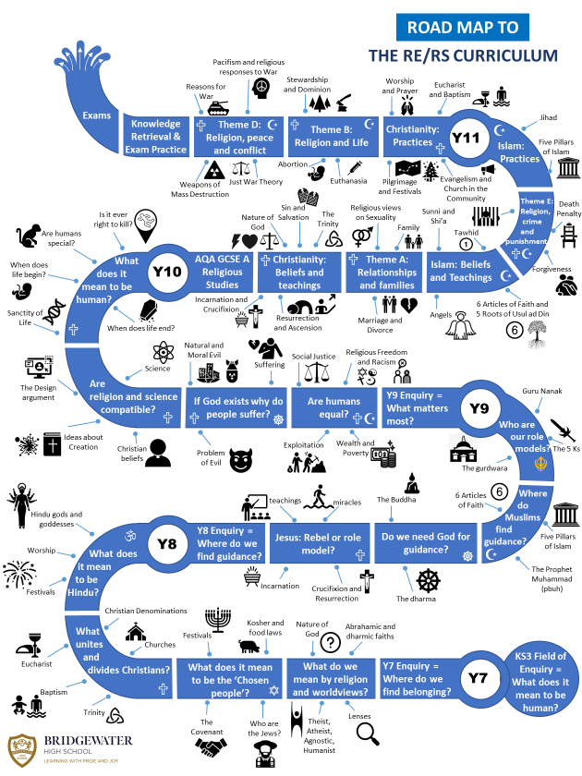
The Bridgewater journey in Religious Education
Our “Roadmap” for this subject:

Slide 3
The Bridgewater journey in Religious Education
KS3 in particular:

Slide 4
Further information for Religious Education can be found at:
Within the CURRICULUM INFORMATION table there are links to each subject’s:
Curriculum Intent statement
Curriculum map
Road map
Assessment statements
https://bridgewaterhigh.org/key-stage-3-subjects/

Slide 5
The Locally Agreed Syllabus for KS2 for Religious Education states that:
Christianity should be taught within three strands: God, Jesus and Church.
Christianity, Islam and Hindu Dharma should be taught progressively across all year groups.
By the end of KS2 pupils should also have opportunities to encounter Buddhism, Judaism, Sikh Dharam and non-religious world views such as Humanism. This model meets legal requirements and ensures that pupils have an in-depth progressive knowledge of three religions whilst also learning about the other principle religions represented in Great Britain.
It is also essential that RE enables pupils to share their own beliefs, viewpoints and ideas without embarrassment or ridicule. Many pupils come from religious backgrounds, but others have no attachment to religious beliefs and practices.
The questions of enquiry for KS2 are:
Year 3: Who should we follow?
Year 4: How should we live our lives?
Year 5: Where do we find guidance about how to live our lives?
Year 6: Is life like a journey?

Slide 6
Our KS3 Curriculum Intent for Religious Education states that:
Religious Education at Bridgewater High School is a rigorous academic subject delivered to all students in the school. Religious Education and our Religious Education provision at the school enables students to respond to personal, spiritual and moral questions that face us all as human beings. The department aims to engender mutual tolerance, understanding, openness and an appreciation of diversity. Religious Education deals with the deeper issues of life and helps students to become more adept at independent thinking and encourages them to think critically, creatively and with sensitivity.
Teaching and learning in Religious Education aims to deepen students’ knowledge and understanding of religion and world views and to explore challenging questions about the ultimate meaning and purpose of life, beliefs about God, the self and the nature of reality and moral issues. By exploring issues within and across faiths, students learn to understand different religions, beliefs, values and traditions and their influence on individuals, societies, communities and cultures.
The questions of enquiry for KS3 are:
Year 7: Where do we belong?
Year 8: Where can we find guidance?
Year 9: What really matters?

Slide 7
In Religious Education, it is particularly vital for us that pupils arrive:
Knowing about and understanding religions and worldviews, including beliefs and values and living religious traditions
Being able to express and communicate ideas related to religions and worldviews, including our shared human experience and a search for personal meaning
In Religious Education, to truly succeed at Bridgewater, pupils should arrive with a knowledge of:
The basics of the six major world religions, such as founder, holy book(s), place of worship, name of followers, names of key festivals
The features and layout of a synagogue and a church.

Slide 8
In Religious Education, key vocabulary which we use at Bridgewater includes the following:
Key Words
agnostic | someone who is unsure whether God exists
atheist | someone who believes that God does not exist
belief | an acceptance that something exists or is true, without proof
deity | a god or goddess
denomination | the different groups within a religion, especially Christianity
dharma | ‘duty’ or ‘righteousness’
monotheism | belief in one God
polytheism | belief in many gods
rite of passage | time in a person’s life when change takes place, usually marked by a celebration
theist | someone who believes that God exists

Slide 9
Further support for you in Religious Education
We are pleased to offer the following to support your religious education provision and transition:
Teacher visits to meet with your staff
Teacher visits to deliver one-off lessons
Religious artefacts can be loaned out to support learning
CONTACT – Pamela Griffiths, Head of RS:
p.griffiths@bridgewaterhigh.com

