Slide 1
Cycle Safety

Slide 2
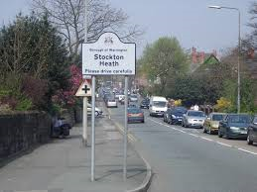
Why do we worry?
Safety of our pupils is our number 1 priority
Busy High School with in excess of 600 students
140 adults (many of whom commute)
Taxis, minibuses and parents using Hall Drive
One of the busiest roads in the local area, M56 junction, access to the M6/M62, busy bus route, busy village centre etc..

Slide 3
Safety
Several ‘near misses’ in and around school site
Bikes that are not road worthy
Helmet use
Dangerous cycling
Many concerned parents and residents
Anti-social road use
‘Wheelies’
Slowing traffic down
‘Handbar’ passengers

Slide 4
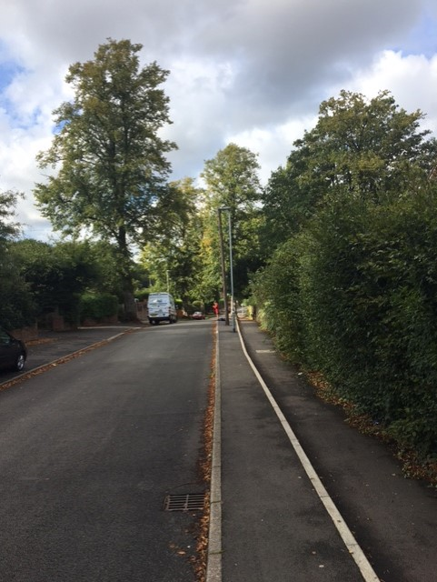
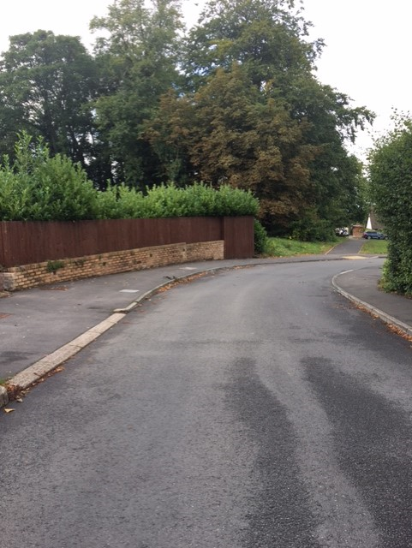
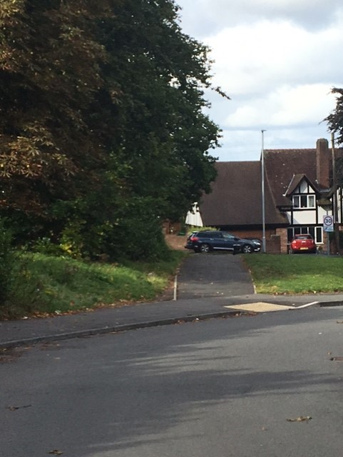

Slide 5
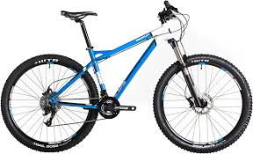
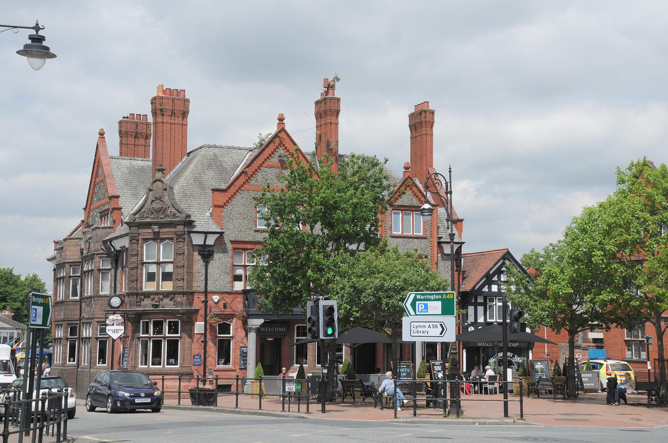
What Do We Expect?

Slide 6
The Bike

Slide 7
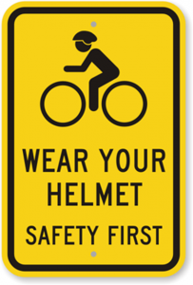
Cycle Safety and Conduct on the Road

Slide 8
The Permit
Please complete and return
Students will need a permit to bring their bikes on school premises
Please go through the rules and regulations for cycle/road safety
Decide whether or not you are going to use a cycle helmet. Indicate this on the form
Help us keep our students safe

Slide 9
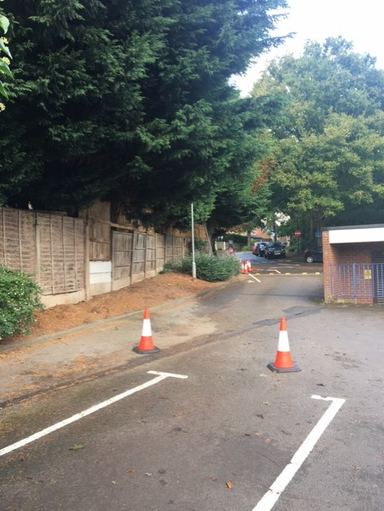
Get off your bike at the top of Hall Drive

Slide 10
What Next?
If you intend to bring a bike to school you must collect a cycle permit from reception this week
You must ask your parents to sign it and return it by Friday to your form tutor during PD.
If you have a signed permit you may bring your bike to school on Monday 9th October.
If you have any concerns or enquiries please contact Head of Year, Miss Howard j.howard@bridgewaterhigh.com or Assistant Head of Year, Mrs Boden v.boden@bridgewaterhigh.com

