Slide 1
THE BRIDGEWATER BATON
DESIGN & TECHNOLOGY

Slide 2
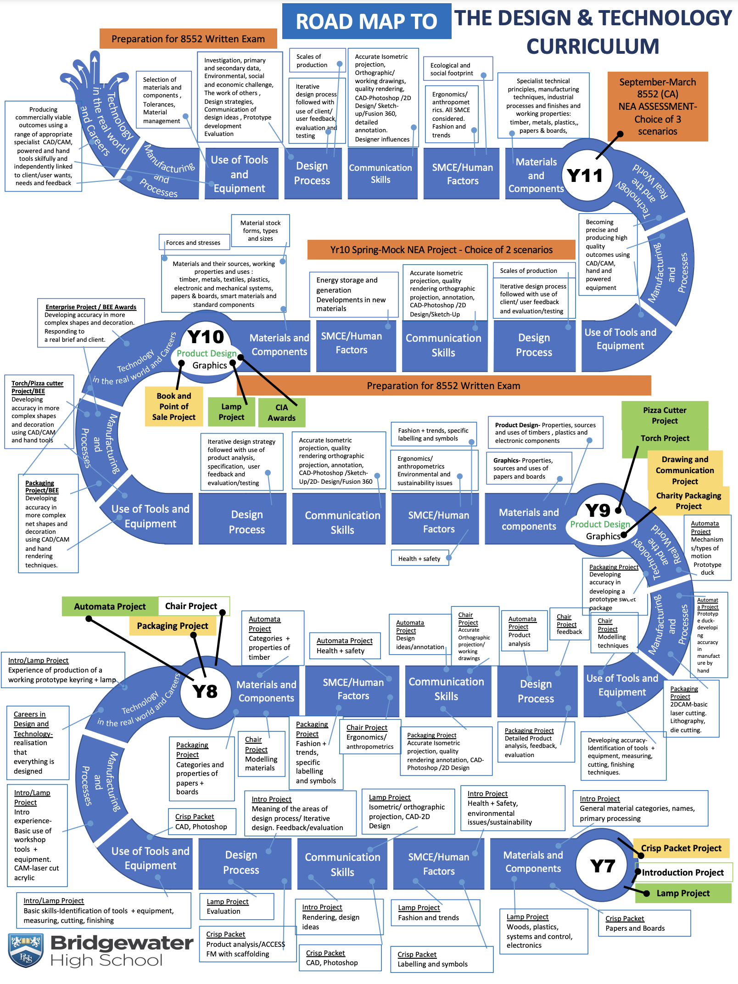
The Bridgewater journey in Design & Technology
Our “Roadmap” for this subject:

Slide 3
The Bridgewater journey in Design & Technology - Food
Our “Roadmap” for this subject:

Slide 4
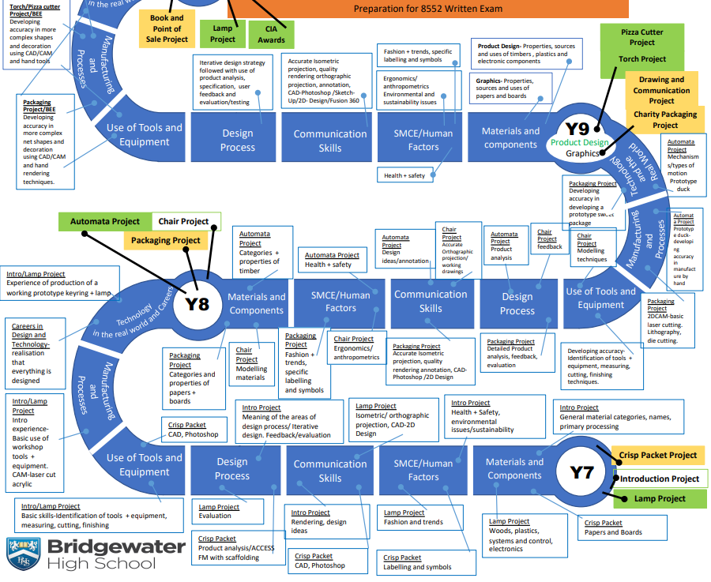
The Bridgewater journey in Design & Technology
KS3 in particular:

Slide 5
The Bridgewater journey in Design & Technology – Food
KS3 in particular:

Slide 6
Further information for Design & Technology can be found at:
Within the CURRICULUM INFORMATION table there are links to each subject’s:
Curriculum Intent statement
Curriculum map
Road map
Assessment statements
https://bridgewaterhigh.org/key-stage-3-subjects/

Slide 7
The KS2 National Curriculum for Design & Technology states that:
Through a variety of creative and practical activities, pupils should be taught the knowledge, understanding and skills needed to engage in an iterative process of designing and making. They should work in a range of relevant contexts [for example, the home, school, leisure, culture, enterprise, industry and the wider environment].
When designing and making, pupils should be taught to:
Design
use research and develop design criteria to inform the design of innovative, functional, appealing products that are fit for purpose, aimed at particular individuals or groups
generate, develop, model and communicate their ideas through discussion, annotated sketches, cross-sectional and exploded diagrams, prototypes, pattern pieces and computer-aided design
Make
select from and use a wider range of tools and equipment to perform practical tasks [for example, cutting, shaping, joining and finishing], accurately
select from and use a wider range of materials and components, including construction materials, textiles and ingredients, according to their functional properties and aesthetic qualities
Evaluate
investigate and analyse a range of existing products
evaluate their ideas and products against their own design criteria and consider the views of others to improve their work
understand how key events and individuals in design and technology have helped shape the world
Technical knowledge
apply their understanding of how to strengthen, stiffen and reinforce more complex structures
understand and use mechanical systems in their products [for example, gears, pulleys, cams, levers and linkages]
understand and use electrical systems in their products [for example, series circuits incorporating switches, bulbs, buzzers and motors]
apply their understanding of computing to program, monitor and control their products.

Slide 8
The KS2 National Curriculum for Design & Technology states that:
Food [Cooking and nutrition] As part of their work with food, pupils should be taught how to cook and apply the principles of nutrition and healthy eating. Instilling a love of cooking in pupils will also open a door to one of the great expressions of human creativity. Learning how to cook is a crucial life skill that enables pupils to feed themselves and others affordably and well, now and in later life.
Pupils should be taught to:
understand and apply the principles of a healthy and varied diet
prepare and cook a variety of predominantly savoury dishes using a range of cooking techniques
understand seasonality and know where and how a variety of ingredients are grown, reared, caught and processed.

Slide 9
The KS3 National Curriculum for Design & Technology states that:
Through a variety of creative and practical activities, pupils should be taught the knowledge, understanding and skills needed to engage in an iterative process of designing and making. They should work in a range of domestic and local contexts [for example, the home, health, leisure and culture], and industrial contexts [for example, engineering, manufacturing, construction, food, energy, agriculture (including horticulture) and fashion]. When designing and making, pupils should be taught to:
Design
use research and exploration, such as the study of different cultures, to identify and understand user needs
identify and solve their own design problems and understand how to reformulate problems given to them
develop specifications to inform the design of innovative, functional, appealing products that respond to needs in a variety of situations
use a variety of approaches [for example, biomimicry and user-centred design], to generate creative ideas and avoid stereotypical responses
develop and communicate design ideas using annotated sketches, detailed plans, 3-D and mathematical modelling, oral and digital presentations and computer-based tools
Make
select from and use specialist tools, techniques, processes, equipment and machinery precisely, including computer-aided manufacture
select from and use a wider, more complex range of materials, components and ingredients, taking into account their properties Evaluate
analyse the work of past and present professionals and others to develop and broaden their understanding
investigate new and emerging technologies
test, evaluate and refine their ideas and products against a specification, taking into account the views of intended users and other interested groups
understand developments in design and technology, its impact on individuals, society and the environment, and the responsibilities of designers, engineers and technologists
Technical knowledge
understand and use the properties of materials and the performance of structural elements to achieve functioning solutions
understand how more advanced mechanical systems used in their products enable changes in movement and force
understand how more advanced electrical and electronic systems can be powered and used in their products [for example, circuits with heat, light, sound and movement as inputs and outputs]
apply computing and use electronics to embed intelligence in products that respond to inputs [for example, sensors], and control outputs [for example, actuators], using programmable components [for example, microcontrollers]

Slide 10
The KS3 National Curriculum for Design & Technology states that:
Food [Cooking and nutrition] As part of their work with food, pupils should be taught how to cook and apply the principles of nutrition and healthy eating. Instilling a love of cooking in pupils will also open a door to one of the great expressions of human creativity. Learning how to cook is a crucial life skill that enables pupils to feed themselves and others affordably and well, now and in later life.
Pupils should be taught to:
understand and apply the principles of nutrition and health
cook a repertoire of predominantly savoury dishes so that they are able to feed themselves and others a healthy and varied diet
become competent in a range of cooking techniques [for example, selecting and preparing ingredients; using utensils and electrical equipment; applying heat in different ways; using awareness of taste, texture and smell to decide how to season dishes and combine ingredients; adapting and using their own recipes]
understand the source, seasonality and characteristics of a broad range of ingredients

Slide 11
In Design & Technology, it is particularly vital for us that pupils arrive with:
Tech
Technical knowledge of the sources/raw materials and primary processing for wood, metal, plastics & papers and boards.
Knowledge of how the manufacture and use of products impact the environment.
Experience of generating creative ideas in response to research and/or design criteria.
Measuring accurately with a ruler and converting cm to mm
Experience of manufacturing a range of outcomes using wood and paper/board materials where some focus on realising a creative idea, others, on accuracy.
Food
Knowledge of the food groups that make up a varied diet. [5 Nutrients-Protein, fats, carbohydrates, vitamins and minerals]
Practical experience of working hygienically in terms of personal & kitchen protocols.
Practical experience of preparing [measuring/chopping], mixing & cooking ingredients.

Slide 12
In Design & Technology, key vocabulary which we use at Bridgewater includes the following:
Tech Terminology | Description and examples
Sustainability | the extent to which we can continue to use/do something at the same rate without using up all natural resources.
Primary Processing | How raw materials are changed into usable materials i.e. Fractional Distillation - Crude oil into plastics, Seasoning - trees into wood, Smelting - ores into metal, Pulping plants into paper/card
Aesthetics | Using adjectives to describe the look/style of the product (bright, dull, functional, decorative, textured, smooth, shiny, modern, traditional etc)
Specification | A list of measurable design criteria, that the design must, should or could do.
Food terminology | Description and examples
Bridge | This hold is used to protect your fingers when cutting. Pass the knife through the bridge made by your fingers and thumb.
Claw | This hold is used to protect your fingers when cutting. Curl fingers together into a claw shape and tuck fingers in.
Seasonality | Eating and buying foods that are growing/are in season now.
Healthy balanced Diet | Eating a range of foods including consideration of healthy food swaps. E.g white bread to brown bread, coco pops to Weetabix, full sugar cola-diet cola

Slide 13
Further support for you in Design & Technology
We are pleased to offer the following to support your D&T provision and transition:
Consultation on project ideas
Experience for staff to develop practical teaching skills.
CONTACT –
Jacqui Thompson, KS3 Co-Ordinator
j.thompson@bridgewaterhigh.com
Jo Garry, Head of Design & Technology
j.garry@bridgewaterhigh.com

