Slide 1
Year 11 Information Evening
Mr .Smith : Pastoral Support
Mr. Lambrianides : Assessment
Miss Beswick : Maths
Miss Jones : English
Mr. McMahon : Science
Mr. Knight : Careers

Slide 2
Year 11 2023-24
YEAR 11 PARENTS INFORMATION EVENING
Monday 12th October 2023
SUPPORTING STUDENTS THROUGH EXAMS
Mr. Smith

Slide 3
You have 5 weeks to go before your 1st set of mock GCSEs and it isn't too late to change your approach.
We all make mistakes, and we all have regrets but NOW is the time to put them right.

Slide 4

What ensures students make progress?
  Spending the time on the right things
  Checking you are learning and not just DOING work(Revision Techniques)
  Developing helpful habits around re-visiting

Slide 5

What CAN’T you control?
What question will come up in the exam
How the examiner might mark it
If your subject examination board changes the grade boundaries
Notes:
Explain that it is important to focus on what you can control and stop worrying about the things that you can’t. Remind students that there’s more you can control than can’t control.

Slide 6
What CAN you control?
  What revision you do
  What intervention you attend
  Understanding where your gaps are
  How you switch off
  Making sure you have exercise in your life
  Getting the balance right
  Recognising the signs of stress or fatigue
Notes:
Explain that this list of factors relates to students’ preparation for their exams. If time, ask them for other suggestions of things they can control in the lead up to the exam period.

Slide 7

The upcoming weeks…
are all about YOU!
  Finishing off your subject content
  Planning your revision
  Going through the routines you are already using
  Keeping focused
  Looking after yourself

Slide 8
During PD tutorials at the start of the day we have covered/offered:
Study and revision skills:
Pupils have been given core PLC’s. This is all the subject content in Maths, English and Science, to start planning revision using a RAG rating.
Revision timetables
How to revise
Post 16 options – Every Wednesday morning, Warrington’s local colleges and post 16 providers have presented what they can offer in regard to A Levels, T Levels, Apprenticeships and BTEC’s
Career advice using the SMART app. Pupils will continue to work on their personal statement and CV’s, to help them apply to their post 16 options.
There is a full ‘after school’ intervention timetable. If your child needs additional help, please encourage them to go to these sessions.
Early mornings revision rooms with refreshments from 8am during mock and GCSE examinations.

Slide 9
Week Beginning 4th April 2022 | Mon | Tue | Wed | Thu | Fri | Sat | Sun
PERIOD 1 (08:45 – 09:50) | History –Northern Ireland
PERIOD 2 (09:50 – 10:55) | Physics – P4: Electrostatics
PERIOD 3 (11:10 – 12:20) | English – Writing to argue, persuade & advise
PERIOD 4 (12:20 – 1:20) | Chemistry – C4: Periodic Table
PERIOD 5 2:00 – 3:00
3:00 – 4:30
4:30 – 6:00
6:00 – 7:00
7:00 – 7:50 |  |  |  |  | Cinema with friends
8:00 – 8:50
9:10 – 10:00

Slide 10
KEY DATES
20th – 1st Dec Y11 Mock exams
22nd Dec - 8th Jan Christmas
9th – 19th Feb Half term
4th – 12th March Easter mocks exams
28th Mar – 15th April Easter
13th May GCSE’s starts
24th May – 4th June Half-Term
21st June Last GCSE exams
Wednesday 26th June PROM

Slide 11
Finding Help in School
For pastoral support and if you have any general questions, please contact the Head of Year, Ms Betts, or the Assistant Head of Year, Mr Smith.
t.betts@bridgewaterhigh.com
m.smith@bridgewaterhigh.com
There are also additional pastoral staff who work with the year group to provide support for pupils including form tutors, Mrs Harmer and Mrs Ward (Mental Health Lead)
For subject specific support, you would be best advised to speak to your child’s class teacher. Bridgewater staff emails all follow the format:
Initial.surname@bridgewaterhigh.com
such as with the two examples above.

Slide 12
Resources
9 x document wallets (one for each GCSE)
Exam board approved, transparent pencil case including black pens, pencils, 30cm ruler and a pair of compasses
Highlighter pens
Notepad
Post-it notes
Blank flash cards and A3 paper for posters
A4/A3 document, including revision timetable pages for mock exams
CGP How to Revise for GCSE, Study Skills & Revision Planner
PLC’s

Slide 13
Assessment
Mr. Lambrianides

Slide 14
Y11 Autumn Mock Examinations
20th November - 1st December
Take place in formal examination venues/exam invigilators
Timetable and subject revision information will be posted on satchel one and e-mailed to parents/carers.
Results e-mailed home in week beginning 18th December

Slide 15
Y11 Spring Mock Examinations
4th – 15th March
Take place in formal examination venues/exam invigilators
Timetable and subject revision information will be posted on satchel one and e-mailed to parents/carers.
Results e-mailed home in week beginning 25th March.

Slide 16
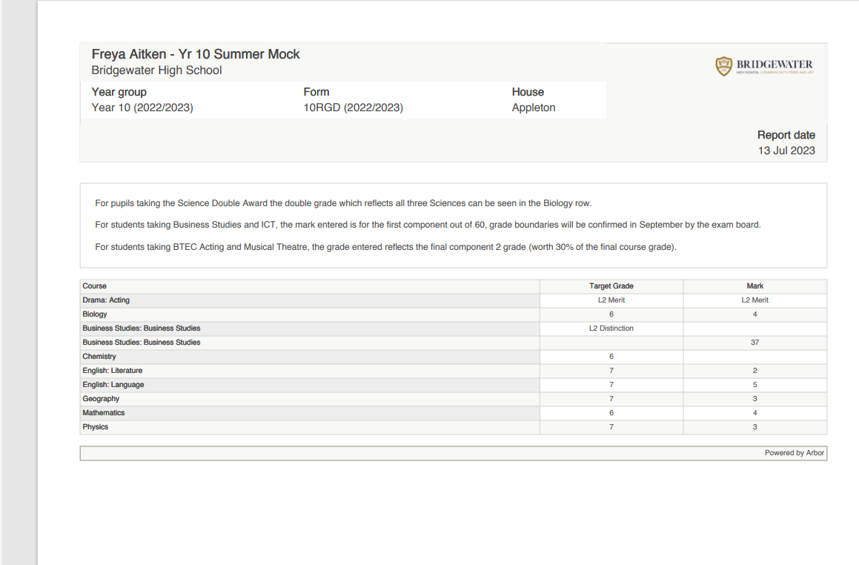
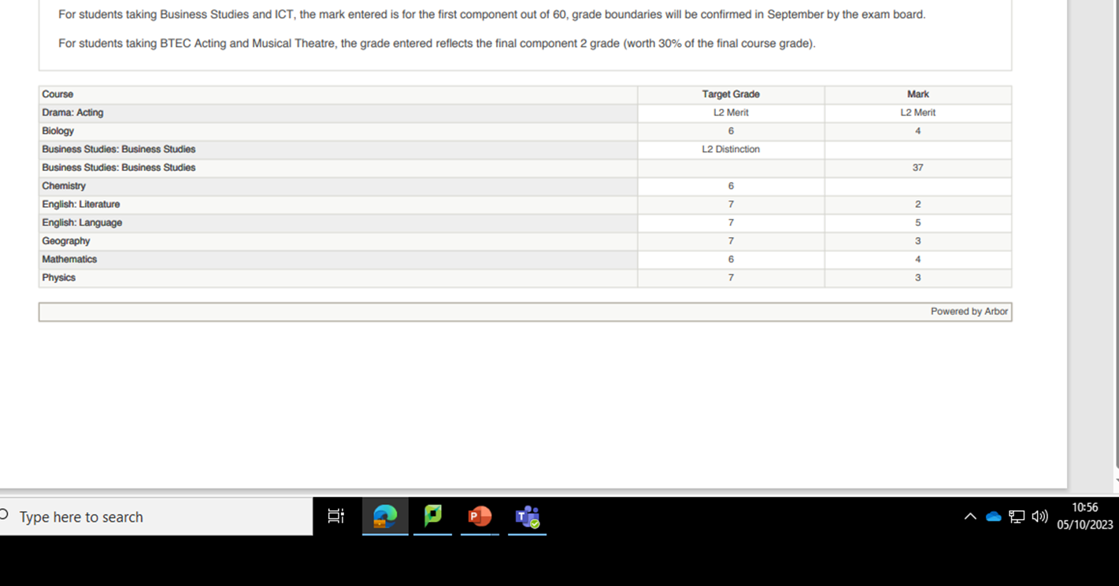
Mock Results Report

Slide 17
Interim Reports
Interim Reports
emailed home in week beginning 18th December and week beginning 25th March
E- mailed home in week beginning 18th December and week beginning 25th March

Slide 18

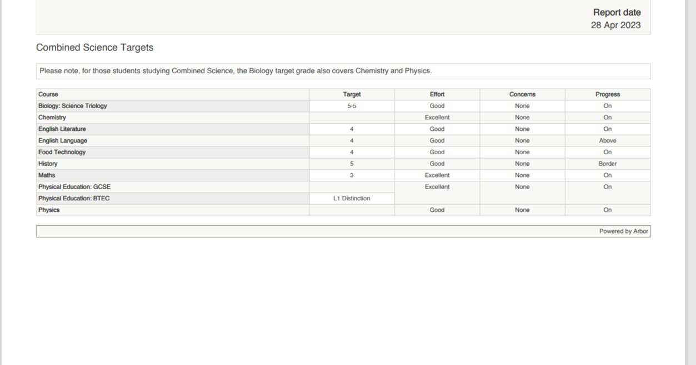
Interim Report

Slide 19
Revision Tips
PLCs
Revision Timetables
Flash cards
Mind Maps
Active Revision

Slide 20

What is a PLC?
A Personal Learning Checklist (PLC) contains a list of all the topics you need to know about a unit of study.
You can access a PLC for each subject you study on the school website. (see image below)
What you should already know.

Slide 21
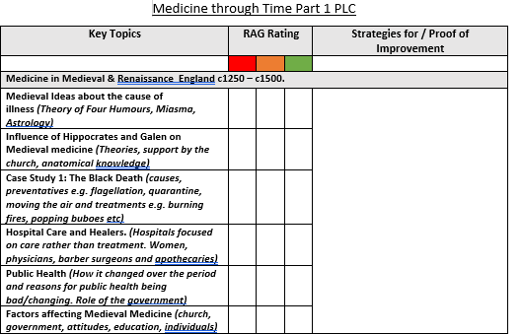
How to use a PLC
As you can see below, next to each topic is a space where you can evaluate your confidence level:
Red – I don’t understand
Amber – I understand a little
Green – I completely understand
Evaluate your own learning.

Slide 22
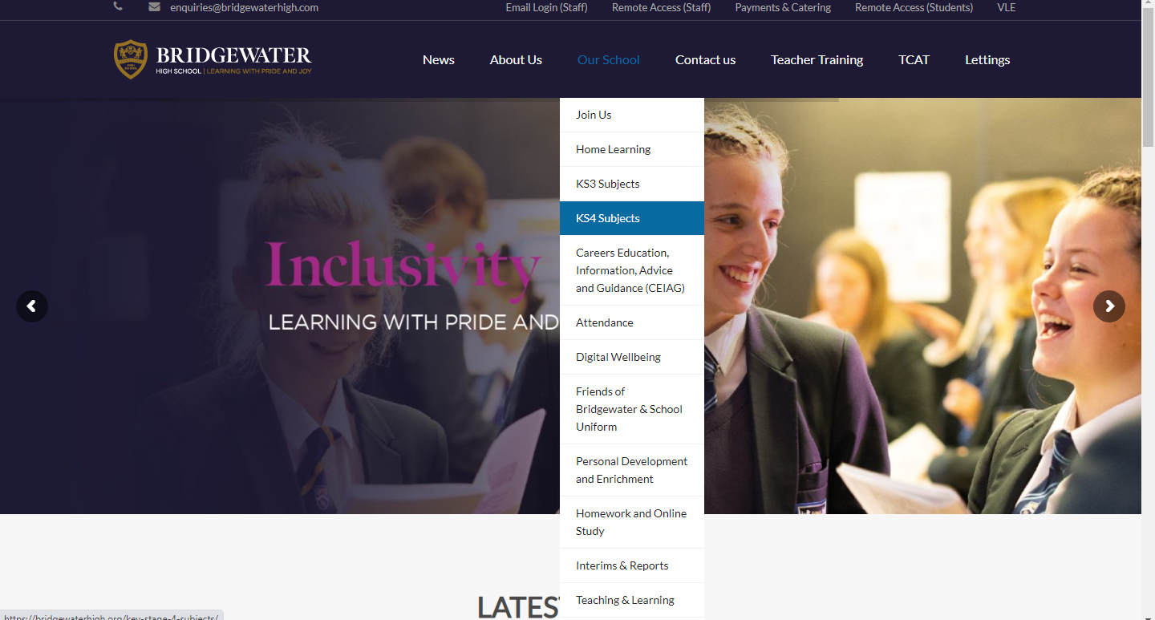
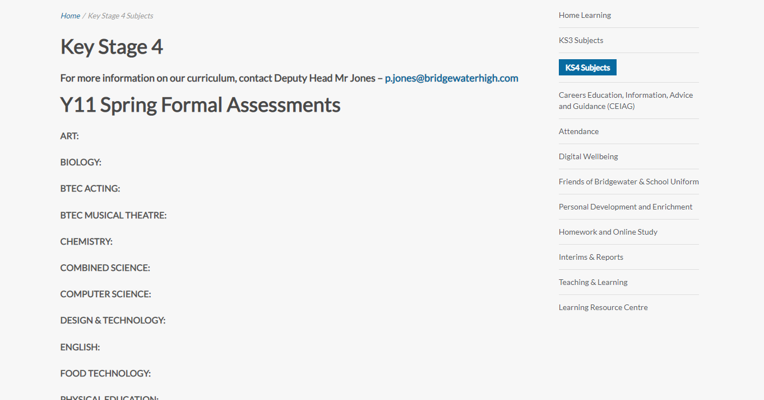
Where can you find all your PLCs and other revision aids?
On the school website click on ‘our school’ and then ‘KS4 subjects’.
On the KS4 page, you will see a list of all the subjects. Underneath each subject will be the PLC link.

Slide 23
GCSE MATHEMATICS
Miss Beswick
How you can support your child

Slide 24
Things to know
EDEXCEL exam board
Two tiers
  Foundation
  Higher
Three exam papers
  Paper 1 non-calculator
  Paper 2 calculator
  Paper 3 calculator

Slide 25
How to revise maths
Know what is on the curriculum
Identify strengths and areas for improvement
Focus on areas for improvement
Find out about those topics
Make revision notes on key facts and formulae
PRACTISE questions
CHECK answers
Find out how to do the questions you got wrong

Slide 26
How NOT to revise maths
Only practise questions you already know how to do and leave questions you can’t do
Spend too much time making revision notes

Slide 27
Using sparx to revise
All students have been given a checklist
Each topic is linked to sparx
Help videos
Practise questions

Slide 28
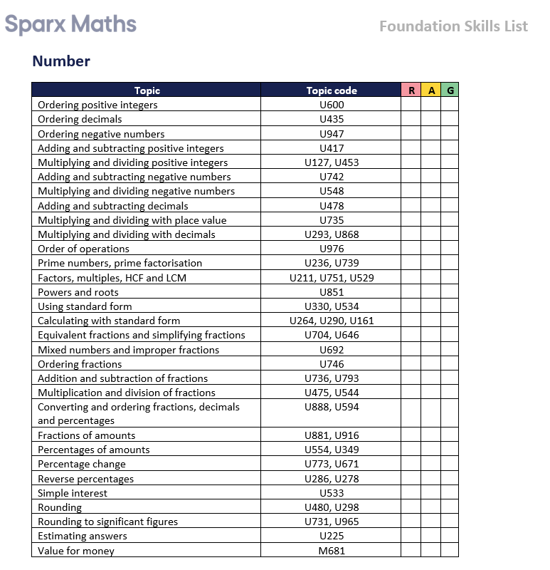
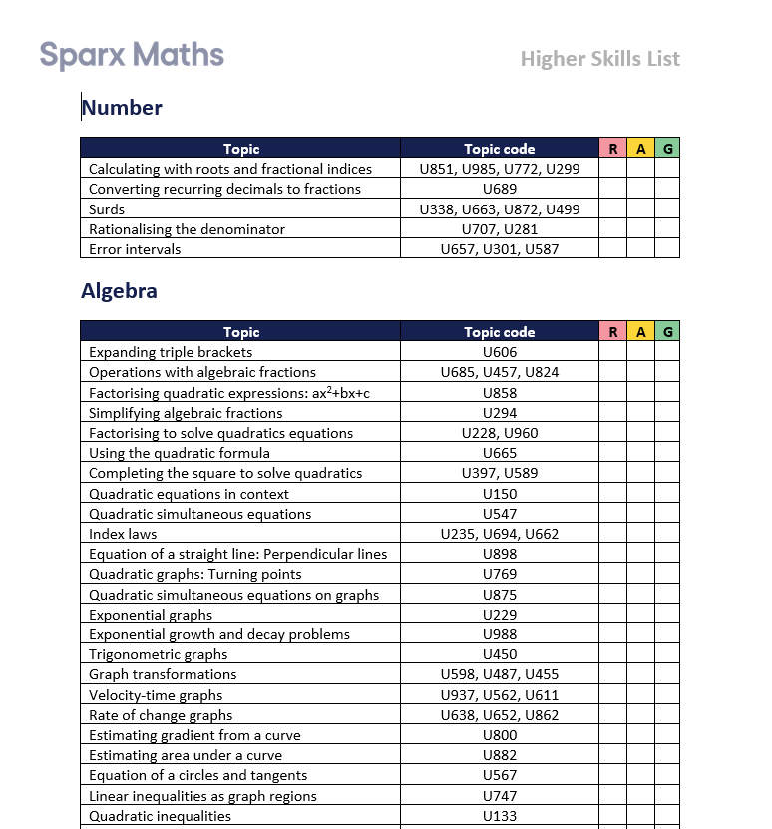
Checklist for sparx

Slide 29
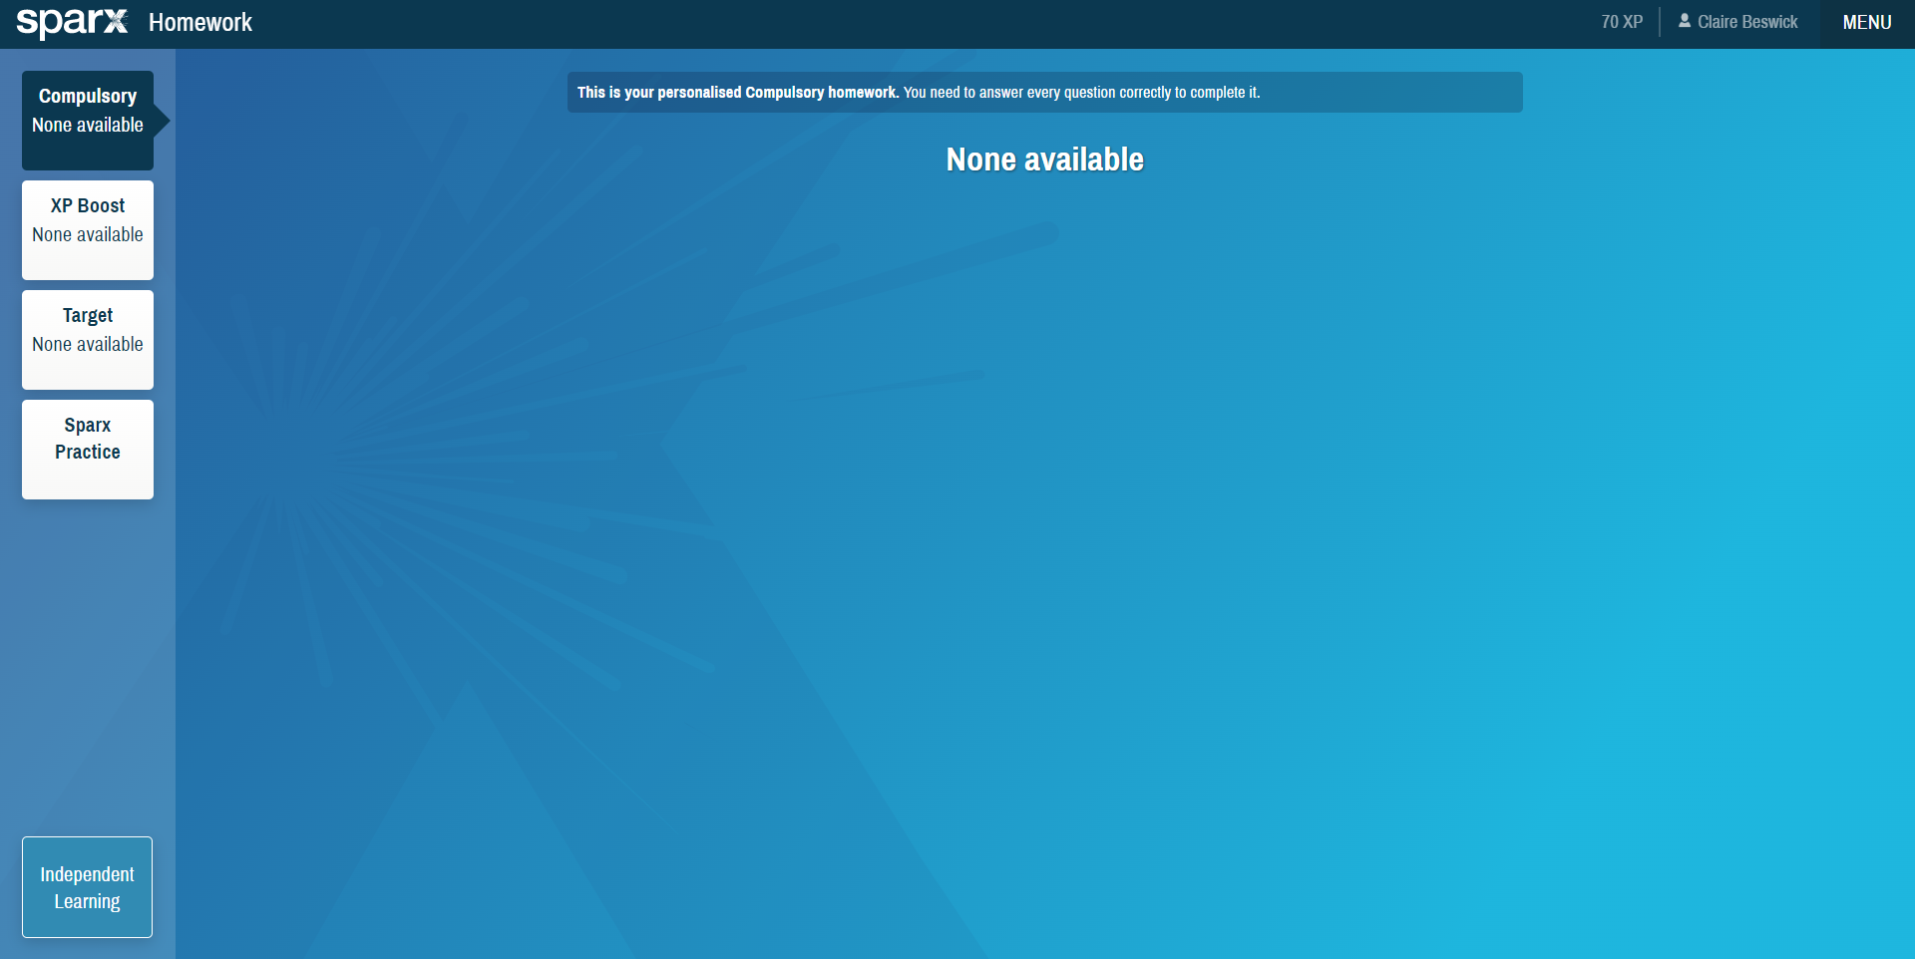
Using sparx to revise
Click independent learning

Slide 30
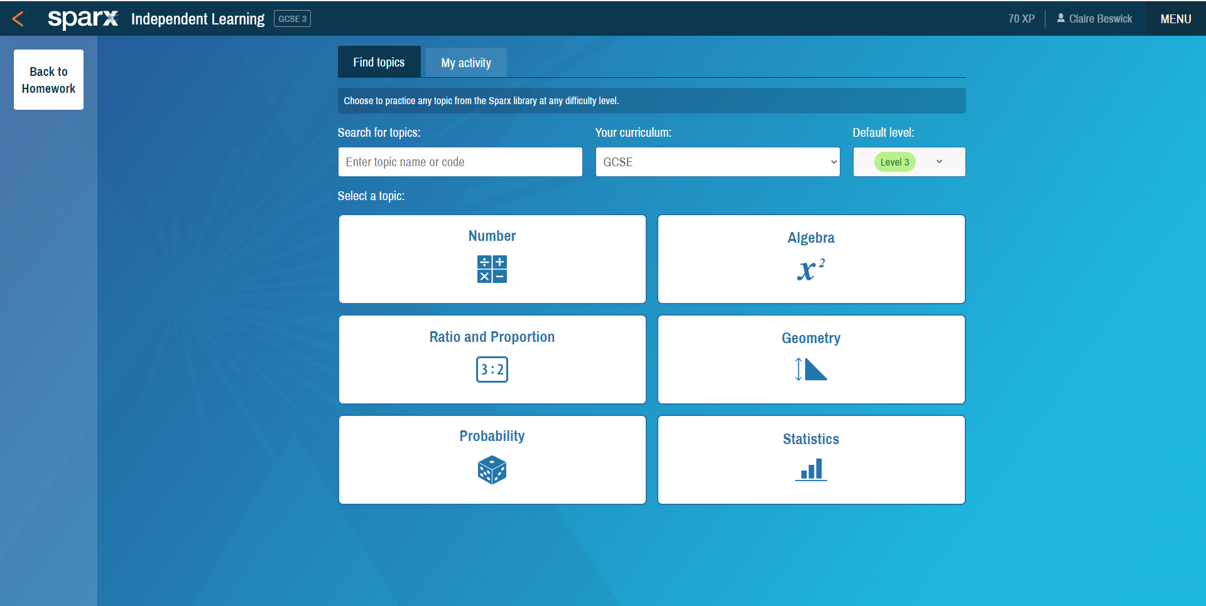
Using sparx to revise
2) Select GCSE
3) Choose a level
1) Enter the topic code here

Slide 31
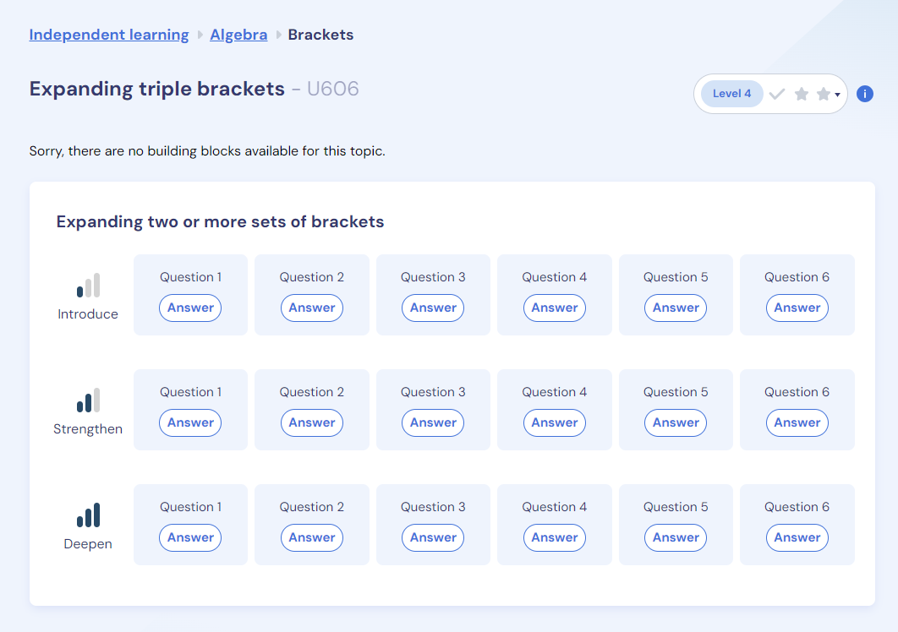
Have a go at the questions
Use the help videos

Slide 32
Using mathsgenie to revise
Past paper questions
You can have a go at a past paper
You can try past paper questions on a particular topic

Slide 33
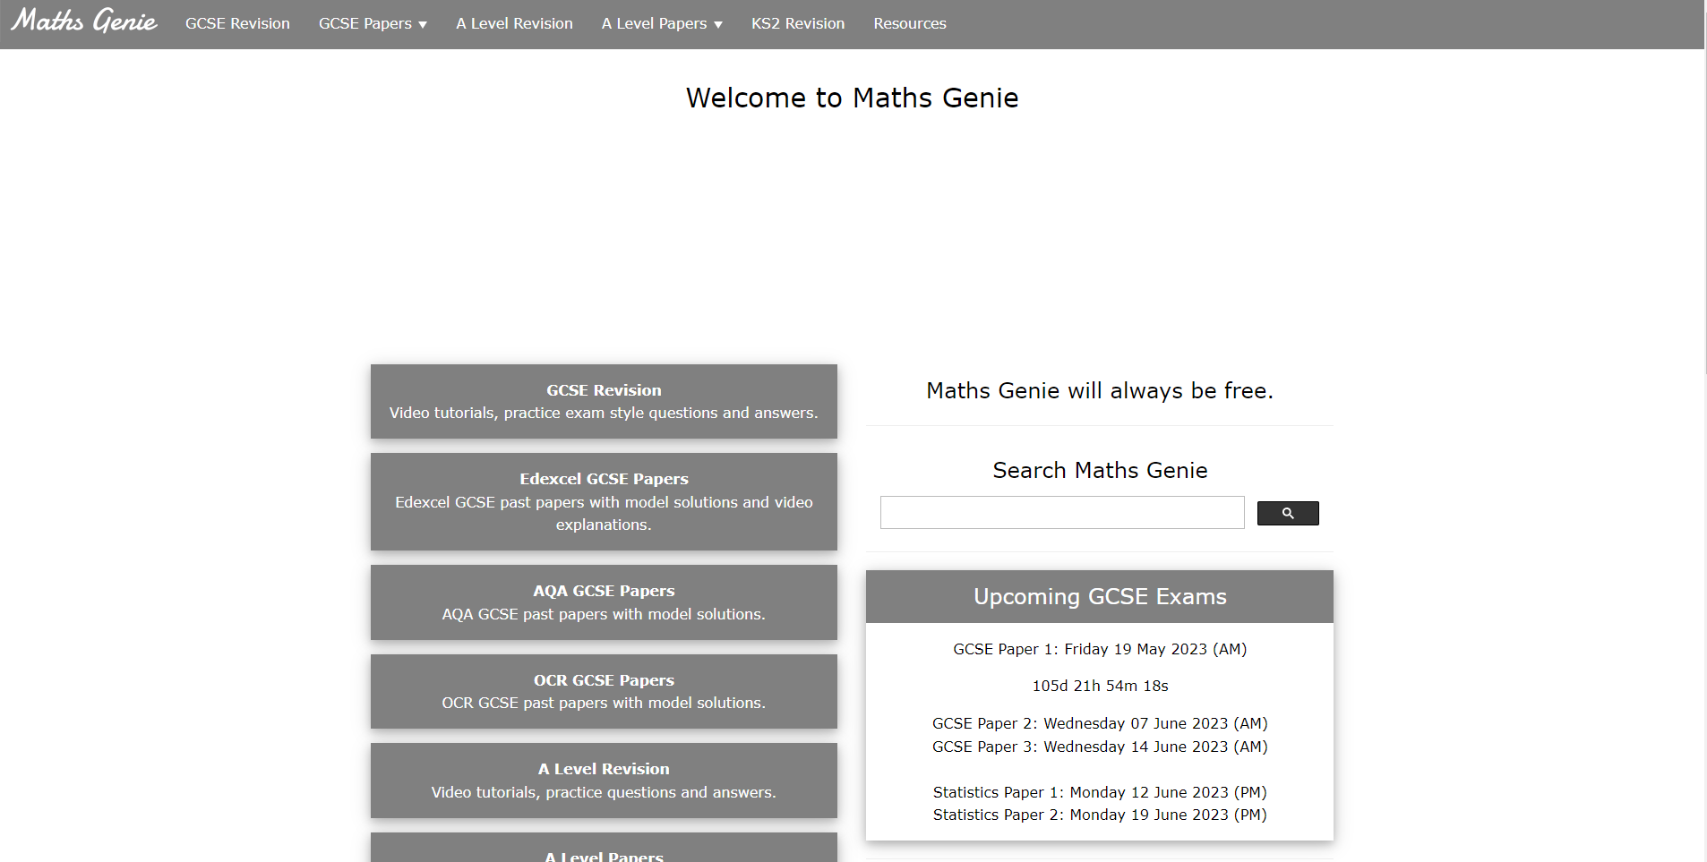
Mathsgenie homepage
Choose EDEXCEL
GCSE Papers

Slide 34
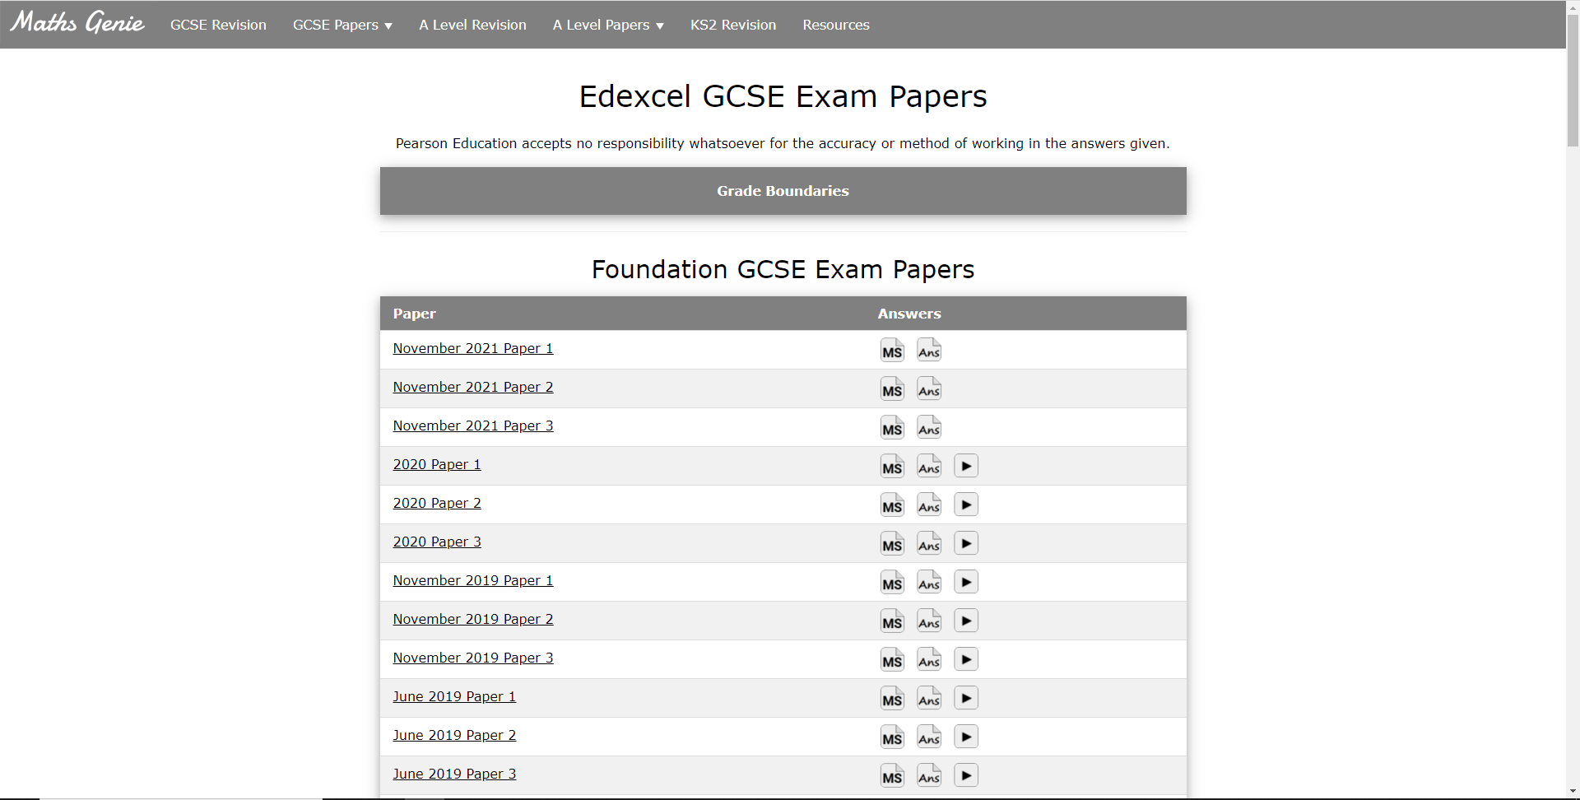
Click on a past paper

Slide 35
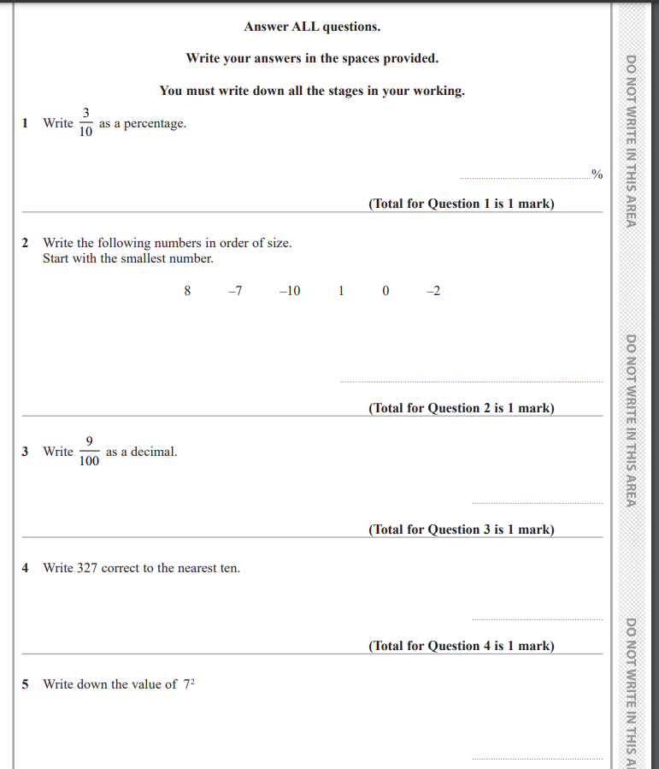
Answer the questions

Slide 36
Check your answers
(click ‘ans’)

Slide 37
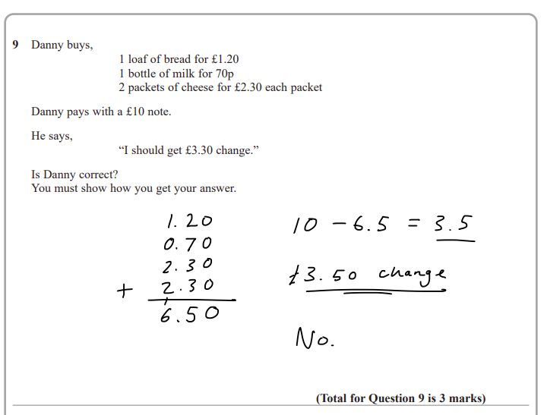
Use the answers to find out how to do questions you can’t do

Slide 38
How you can help
Encourage your child to identify areas for improvement and practise questions on sparx in the ‘independent learning’ section
Show an interest in the progress they are making – introduce a rewards system?
Encourage your child to watch the help video or seek help if they need it

Slide 39
How you can help
Test their memory from any revision cards or notes they make
Even 3 cards a day will make a difference

Slide 40
How you can help
Encourage your child to have a go at a past paper (3 questions a night?)
Mark it for them – use the solutions to find out how to do questions they got wrong

Slide 41
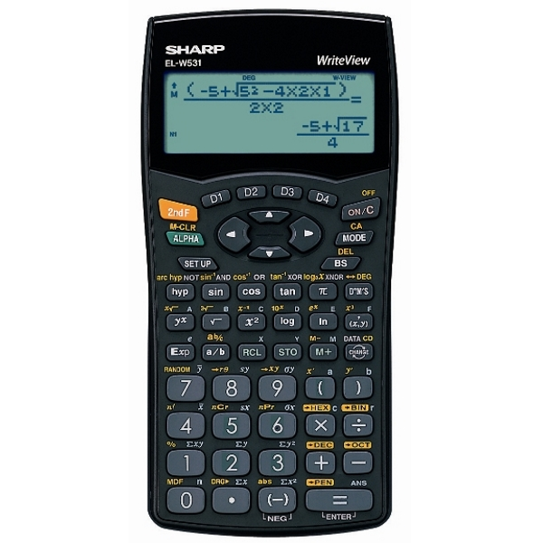
How you can help
Make sure that your child brings a scientific calculator to every Maths lesson

Slide 42
Maths intervention
  Monday and Wednesday after school (room 20)
  Students can complete sparx or work on past papers and get help from a Maths teacher

Slide 43
Thankyou
  Thankyou for all your support – it is much appreciated

Slide 44

GCSE
English Language
&
English Literature
Miss Jones

Slide 45
GCSE ENGLISH LANGUAGE
Paper 1 | Fiction Comprehension Creative Writing 1 hour 45 minutes
Paper 2 | Non-Fiction Comprehension (including a 19th century text) Transactional Writing 2 hours
100% Examination.
No tiering – all students take the same examinations.

Slide 46
GCSE English Language.
How you can support your child.
Ensure that homework tasks are completed fully.
Encourage private reading. This will help develop inference skills and awareness of how writers shape narratives.
Being familiar with ‘real-life’ texts will help. Reading newspaper articles, reviews, letters in the local newspaper, will all help to build their repertoire.
There are past papers available from the Eduqas website.

Slide 47
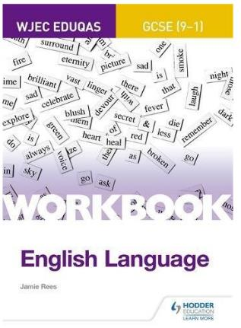
Revision Workbook
The best way to revise for English Language is to practise answering specific types of questions.
The Eduqas Workbook is a useful way for students to complete ‘active’ revision meaning they answer questions and can track their progress.
This workbook can be purchased from school if you feel this would be beneficial. The cost is £6.

Slide 48
GCSE ENGLISH LITERATURE
Paper 1 | Romeo and Juliet Poetry Anthology 2 hours
Paper 2 | An Inspector Calls The War of the Worlds Unseen Poetry 2 hours 30 minutes
100% Examination. 2 exam papers.
No tiering – all students take the same examinations.

Slide 49
GCSE English Literature
How can you support your child?
Ensure that they have re-read their set texts and caught up on any work missed due to absence.
Test their knowledge of key quotations for each text, including the poetry. Knowing five quotations per character or poem would be a suitable number to aim for.
Condensing notes and revision materials into manageable diagrams or flash cards is best practice.
Encourage the use of GCSE Pod to revise the characters and themes for each text.

Slide 50
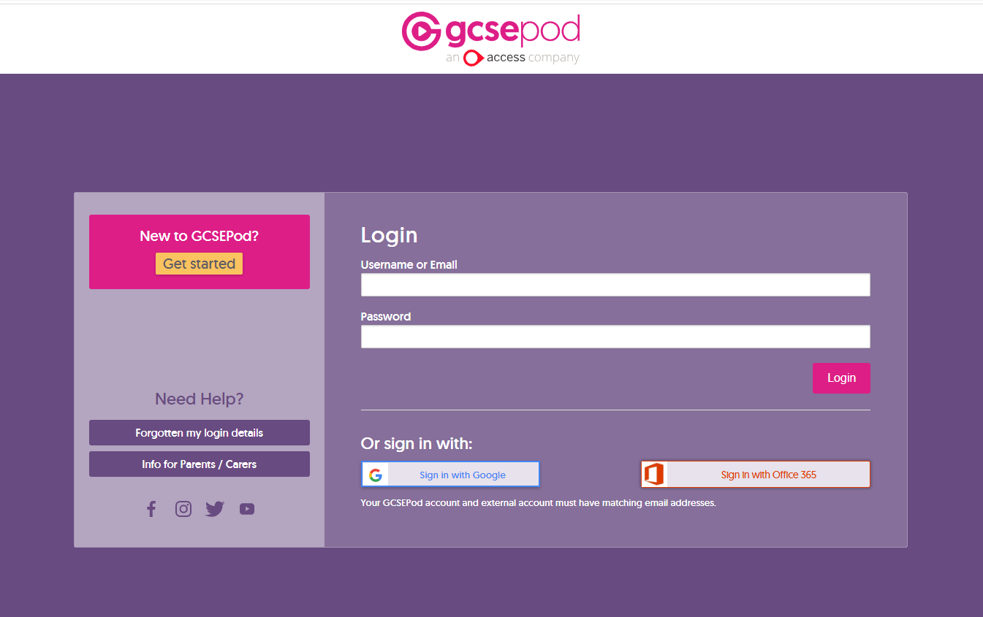
gcsepod.com
All students have received a login for this online resource.
Click ‘Forgotten my login details’ if the password has been forgotten and a reminder will be sent to their school email.

Slide 51
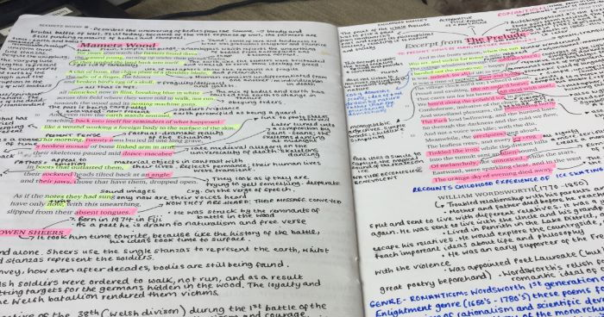
Poetry Anthology
There are revision videos available via the VLE
There are 18 poems in the collection. Students need to know what each poem is about and approximately four or five quotations for each poem.
This amount of annotation is unhelpful.
Notes need to be reduced to manageable chunks

Slide 52
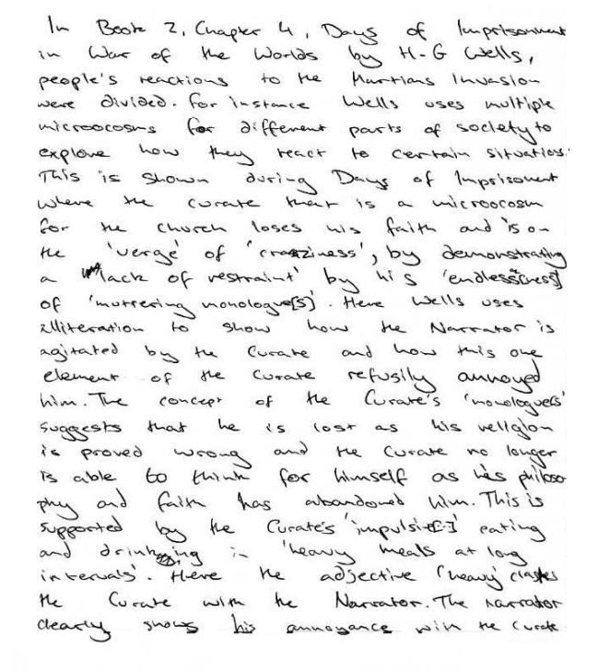
Literature Essays
The essay questions are based on characters or themes.
As part of the revision process, students should plan a response for each character and theme so they know what they intend to write before starting their essays.
Four main ideas which are then developed in detail.

Slide 53


Using Flashcards
Retrieve the knowledge
Shuffle the pack
Repeat
Sibilance (‘s’ sounds) mimics the sound of the ice-skates.
Freedom / adventure
“All shod with steel, we hissed along the polished ice”
Need more revision
Correct
Incorrect

Slide 54




What about revision guides?
We sell the ‘Study and Revise’ guides from Hodder Education (£9 each) and CGP flashcards (£5 each).
If you feel your child would benefit from these, they can be ordered via ScoPay.

Slide 55
Further sources of support:
Eduqas website for past papers:
www.eduqas.co.uk
Email contact:
Miss A Jones (Acting Head of English) a.jones@bridgewaterhigh.com

Slide 56
GCSE SCIENCE : Mr. McMahon
How you can support your child

Slide 57
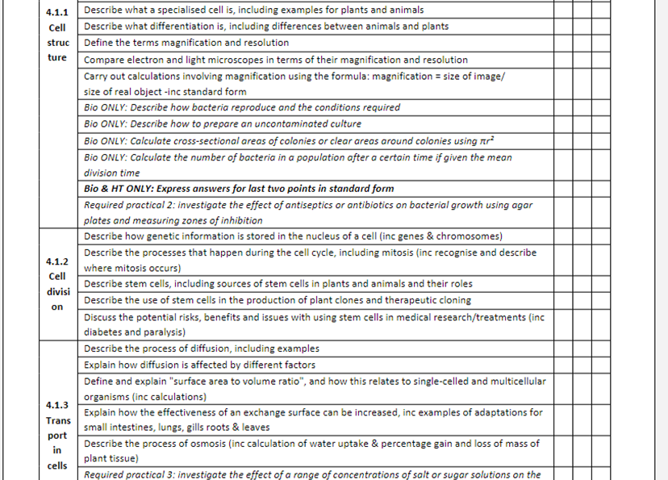
Preparing for Science GCSE
Question 1
What do I need to know for my science exams? Is there anything I can use to help me, like a revision list?
Answer
You should use the PLCs – Personalised Learning Checklists -found at the back of your knowledge Organisers.
You need to tick parts that you are happy with and highlight parts you may need to do more work on…..or you could RAG rate each area

Slide 58
Preparing for Science GCSE
Question 2
How should I focus my revision so that I work on the things that I am unsure on?
Answer:
1. Use your Knowledge Organisers as a starting point. eg I f you don’t know about Osmosis use the knowledge Organisers to recap then Read over > Cover>Self test what you know or create Flashcards for the areas you forget easily.
It is IMPORTANT to self quiz at this stage and whilst you are revising.
You can also choose whole topics on Tassomai to focus your revision on particular topics.
Your teacher can show you how to do this if you don’t know

Slide 59
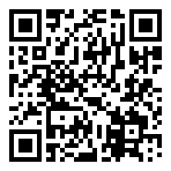
Preparing for Science GCSE
Question 3
How could I check how strong my knowledge is currently?
Answer
TASSOMAI is really good for this. Lots of questions that cover the entire course for GCSE science….getting everything correct, your on the right track!!!
Exam practice- at this stage the largest effect on performance will be due to practising exam questions. Visit www.aqa.org.uk to find past papers and mark schemes

Slide 60

4. We introduced TASSOMAI a few years ago year.
(tass – oh – my)

Slide 61

Really useful additional support
1 Intervention OPEN TO ALL- every Wednesday all sciences Rooms N4,5 and 6
2 Revision guides- excellent resources!
3 Use your Mastery booklets to recap….

Slide 62
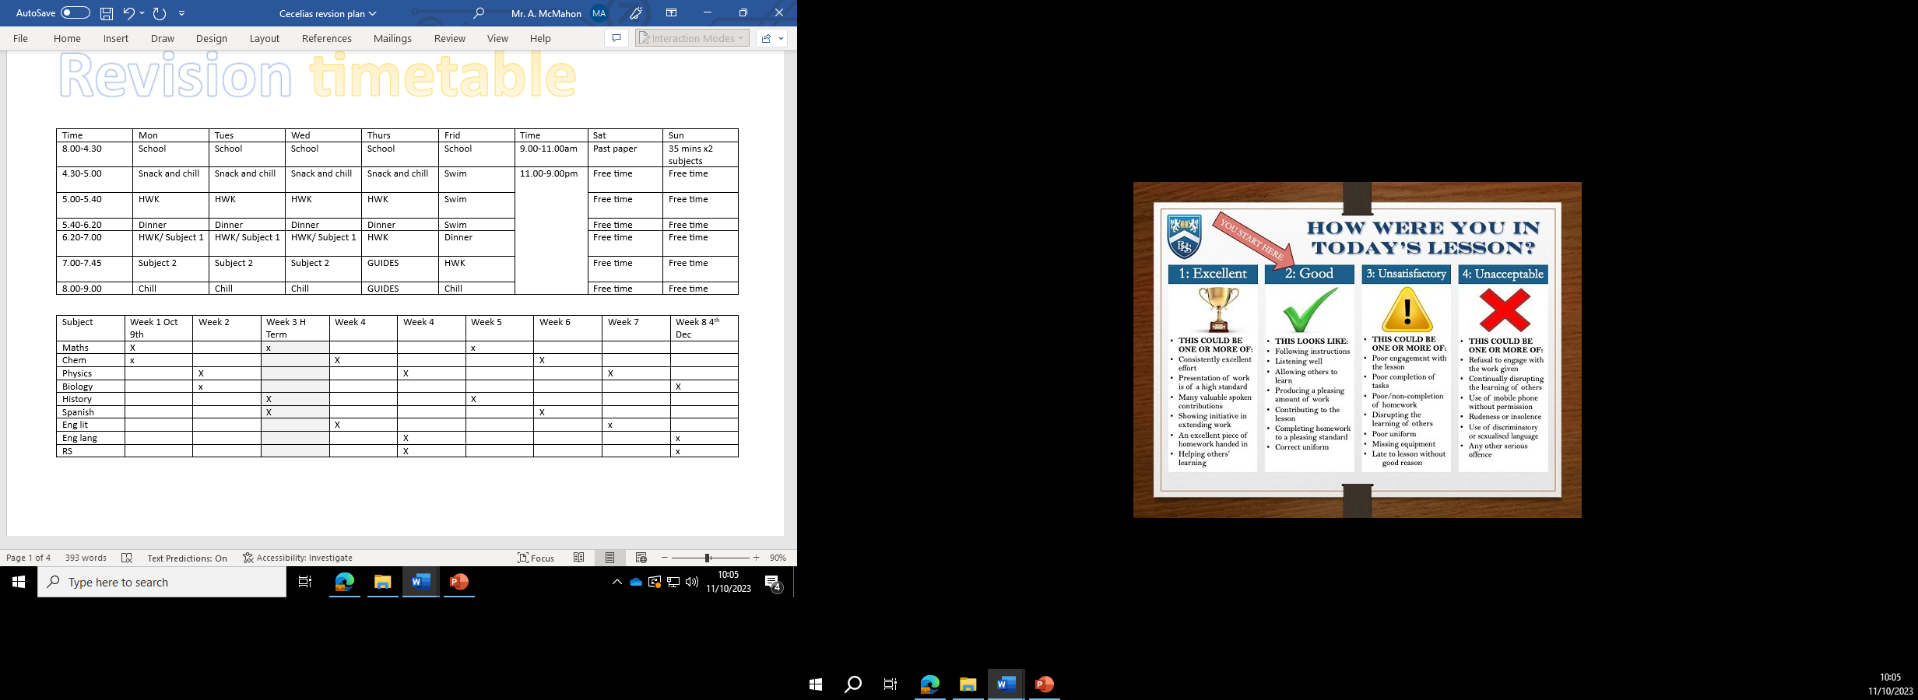
GCSE SCIENCE

Slide 63
GCSE SCIENCE

Slide 64

GCSE

Slide 65


Year 11 Careers Information
Mr. Knight

Slide 66


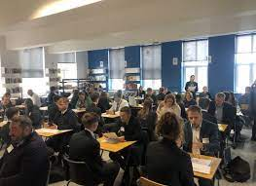
Yr 11 Careers Program
During Year 11 the Careers Team
Post 16 destination Assemblies
Mock Interviews – preparing
Individual Career Interviews with Career Advisor

Slide 67

What is the Careers program at Bridgewater this year?
  Bridgewater’s Careers Week (Oct)
  Encounters with Employers
  Encounters with Higher & Further Education
  Career & Labour Market Information
  National Apprenticeship Week (Feb)
  Linking Careers to Subjects
  National Careers Week (March)
  Linking Careers to Subjects
  IT Careers Lessons – START
  Yr 11 College Assemblies, Mock Interviews & Career Interview with Career Advisor

Slide 68

COLLEGE APPLICATION PROCESS
Within the first half-term during assembly time on a Wednesday, 6 different colleges are coming to present to the students about what their college is like and what you can study there. It’s important for students to be in those assemblies to get an idea about what you can study at the various colleges. Students quite often have a college in mind without knowing what they want to study and quite often it is not always to study what they want at a particular college.
Students/parents /carers should attend open evenings for colleges as soon as possible to be able to visit and get the opportunity to talk to course tutors and get a feel for the college environment.
Students should apply online to the colleges, parents/carers often help and Mrs Winstanley can help too.

Slide 69

Post 16 destination Assemblies
During the autumn term, up to half term, a different post 16 provider will present their college to year 11 in an assembly each week.
This allows all students to get a broad understanding of the main destinations that most students from Bridgewater High School go to.
  BUT …. there are many other possible destinations offering different opportunities. Please make sure your child researches a range of destinations to find the one that will suit them most

Slide 70


Research the 3C’s
College /Course /Careers
Look at the online prospectus of various colleges so you can see all the different courses and types of courses that are on offer and how suitable they are for the student eg A levels, T Levels, Vocational ,Foundation etc.
Look at the various courses that are on offer and what appeals.
Look at the various careers that are out there. Some you will need to study certain subjects and you need to check you are choosing the right courses if you have one in mind. Use START (careers package) or look at https://www.priestley.ac.uk/explore-career-paths/.

Slide 71
COLLEGE APPLICATION PROCESS
We give the deadline for applying as Christmas because after Christmas students are focussing on revision and then exams. If the college applications are out of the way then it is one less thing to be concerned about at what is a very busy time.
As soon as students have applied then the college will generally ask for students to attend a meeting at the college to discuss the application. The earlier the application the earlier the request and then an offer can be sent to the student. Late applications generally have much later in the term meetings and dependent upon course availability etc.
Students should apply online to the colleges, parents/carers often help and Mrs Winstanley can help too.

Slide 72

Bridgewater’s Careers Week (23rd-27th Oct 2023)
  Encounters with Employers
  Encounters with Higher & Further Education
  Career & Labour Market Information
  Mock Job Interview

Slide 73

Mock Job Interviews
During the Bridgewater Careers Week all year 11 students have the opportunity to have a mock interview. These interviews are with individuals who volunteer from the world of work. This is a fantastic opportunity for students to prepare and experience an interview.
Through the autumn term during Form Time (Student Agency) students will prepare for the interview by completing :-
Personal statement ( students are expected to bring a completed PS with them to the interview)
Communication skills
Question Preparation

Slide 74

Individual Careers Interview
All students receive a Careers Interview with a Careers Advisor in Year 11
This interview will be with a professional Career Advisor
The School uses Career Connect as the company that delivers this

Slide 75

Individual Careers Interview
This will consist of a 30 minute 1:1 appointment with a Careers Advisor upon return in September. All appointments will be completed by Christmas.
Each student must understand the importance of Careers Advisor Appointment. This is their opportunity to ask questions about careers/courses and should prepare for it in advance.
Given the tight turnaround for the 320+ appointments, the students must ensure they are available and punctual. Those students who miss their appointments will be added to the end of the list and it cannot be guaranteed they will get one before the deadline for college applications which is Christmas.

Slide 76
Individual Careers Interview
All students receive a Careers Interview with a Careers Advisor in Year 11
Each student should prepare for the appointment by:
Completing the Careers Interview Form and returning to m.winstanley@bridgewaterhigh.com – this form asks for basic details and is used as the basis for the Careers Advisor Appointment.
  What you want for the future:
  Do you have any job or career ideas at the moment? What are they and why?
  What subjects would you like to study and why?
  Your choices after Year 11: What are you considering?
  Interested in Apprenticeships?
IMPORTANT – for students to get the most out of their limited time with a careers advisor they need to have thought through all of these questions. Please help them to complete this form and go to the interview with questions.

Slide 77
Individual Careers Interview
Students and Parents/Carers will receive a copy of the completed - “A Careers Advisor Report/Action Plan”
  Includes comments on:-
    Discussions on particular career/course/college?
    Advice Given:
    Personalised Action Plan for student/parent to use:
Please go through this with your child
If you require any further help, information or are unsure on anything then please do not hesitate to contact m.winstanley@bridgewaterhigh.com

Slide 78

Apprenticeships
Students who are considering apprenticeships in a particular industry should still apply to college for a course eg An electricians course at one of the colleges who provide it and the student can then transfer to an apprenticeship position when one becomes available. Apprentices attend college generally on one day a week.
Once students are in Year 11 then a weekly list of local apprenticeships /traineeships that are available in the local area is put on Show My Homework for students to look at. Obviously, they can only apply later on in the year after exams.
Some large organisations advertise Apprenticeship schemes on their own websites and these are generally opened up well in advance for applications but for a September start. If there is a particular type of apprenticeship you want then researching the leading companies in that market place is a good idea to learn when their apprenticeship schemes open.

Slide 79

Apprenticeships
All students who are thinking of apprenticeships must also apply for college places as apprenticeships can be very competitive and employers obviously will choose the best on offer. If students do not have an apprenticeship lined up then they will already have offers from colleges as a backup plan.

Slide 80

CEIAG
Careers Education Information & Guidance
We need and are looking for parents who will support CEIAG in school
From Mentoring to Encounters with Employers, Virtual Work Experience to Labour Market Information, Mock Interviews to Understanding Work Demands and Expectations.
  You will receive an email from the CEIAG team with more details. What ever you do
  - self employed, part time, CEO, management, shop floor or working in HR we would like to use you and your experience to improve what we offer so students are more prepared for the world of work and so more successful!

