Slide 1
Decision Making
Preparing to make your GCSE/BTEC choices
Preparing to be successful in making good decisions
List the decisions you have made today
Discuss - How important were those decisions? Are all decisions as important as others?

Slide 2
Today’s Session
This is what we are covering today
Why do we need to look at decision making?
What are the different types of decisions
7 effective steps of decision making
What will we be looking at over the next 5 weeks

Slide 3
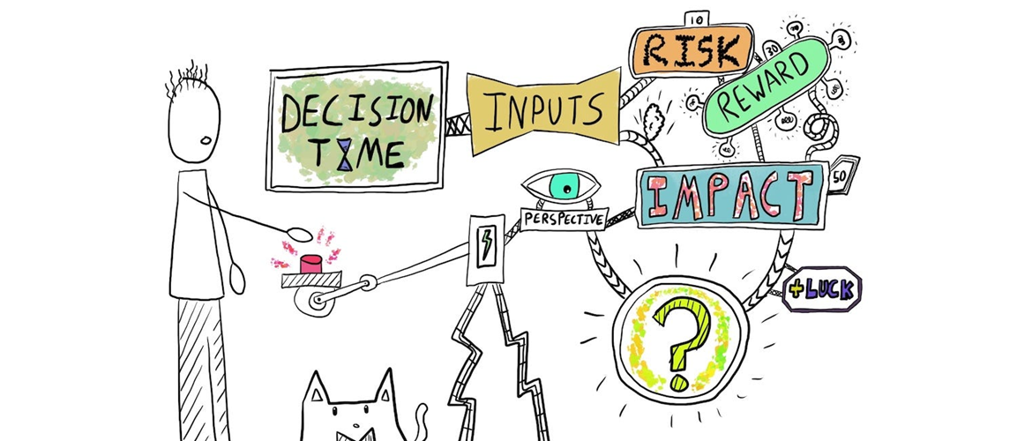
Why do we need to look at decision making?
Making decisions can be scary and stressful, as you know they might have life long consequences and you want to make the RIGHT CHOICE
Is there such a thing as the RIGHT CHOICE?
There isn’t such a thing as the RIGHT CHOICE – there are good choices and bad choices, there are better and worse choices
You need to learn how to make GOOD CHOICES
By looking at how you can make decisions you can empower yourself to make better decisions which in turn should give you a better quality of life.
This should also take a lot of the stress out of making a decision as you now have the understanding of how to make better decisions.

Slide 4
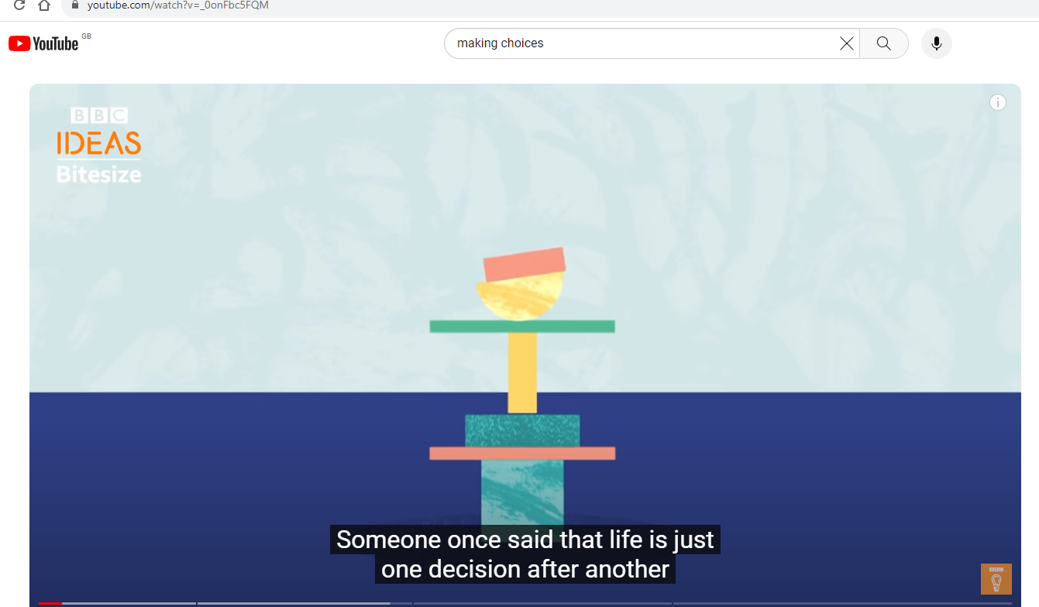
Watch the video
Discuss – what 3 ideas does this video come up with?
How to make better decisions– 3.40 mins

Slide 5
Types of Decision Making
What Are the 3 Types of Decision Making?
Strategic: Long-term, high-level decisions determine the direction of an your life. e.g. Who will I marry/live with? What career shall I choose? Which college will I choose when I Leave school? What GCSEs/BTECs shall I choose?
Tactical: These decisions translate strategic direction into action, focusing & reflecting on how and why we do things and how we can do them better. e.g. - always getting to school late, so setting your clock alarm earlier, - not getting good marks for homework, so giving yourself more time to do it better, - not having the right pens etc for lessons, getting a pencil case and the right equipment
Operational: Daily, routine decisions that you have to make every day. e.g. Which socks will I wear? What shall I have for breakfast? Who will I sit with at lunch?
We are going to be looking at LONG TERM STRATEGIC decision making, to help you with your option choices

Slide 6
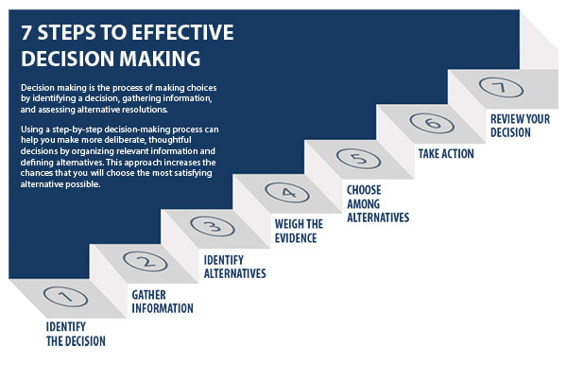
7 Effective Decision Making Steps
Look at the diagram – Most of us make decisions by only following steps 1, 3 and 5/6
Most of us don’t
Gather enough information
Weigh up the evidence
Review the decision
You need to learn the
importance of these 3 steps
and how to do them
Look at the diagram – Most of us make decisions by only following steps 1, 3 and 5

Slide 7
What will you be doing over the next 5 sessions?
Decision making Process – Swot analysis
Decision making Process - Thinking Hats Process
Decision making Process – Ranking (Cost Benefit analysis)
Collecting Information - Subject Skills
How can I use this information to make better GCSE/BTEC Options?

Slide 8
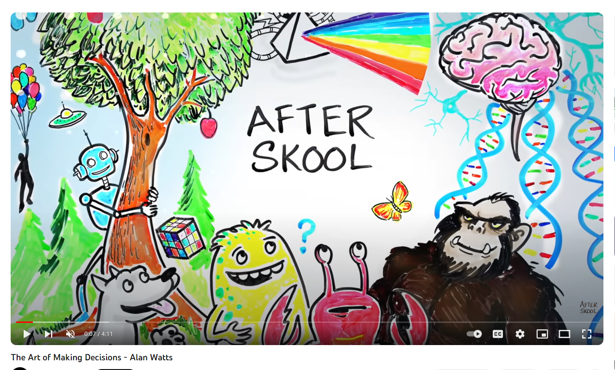
Watch the video
Discuss – what is the key point of this video?
The art of making decisions – 4.10 mins

Slide 9
Make Sure you can access START
START is the careers online software package that the school provides for you.
Make sure you can access it – you do not be want to be wasting time in your sessions logging on
Remember - Through your Profile and Locker you should be recording your experiences, skills and events. You will be able to access this long after you have left school, so keep this all up to date to help you produce quality CV’s and Personal Statements.
Remember the START site has a massive range of information and activities to help you on your career pathway
Can you access START?
Remember to log your activity on Decision Making in your profile?

