Slide 1
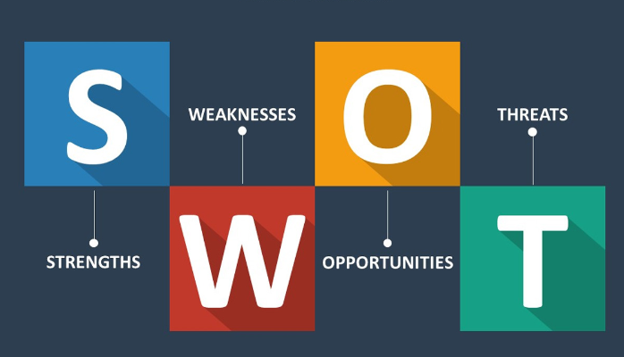
Decision Making
Preparing to make your GCSE/BTEC choices
Preparing to be successful in making good decisions
SWOT Analysis
Discuss – Have you ever heard of SWOT Analysis?

Slide 2
Today’s Session
This is what we are covering today
Why do we need to look at decision making?
What is SWOT Analysis
How will it help with the 7 effective steps of decision making
How to conduct SWOT analysis
SWOT a simple start
Case study
How to use SWOT in GCSE/BTEC Options

Slide 3
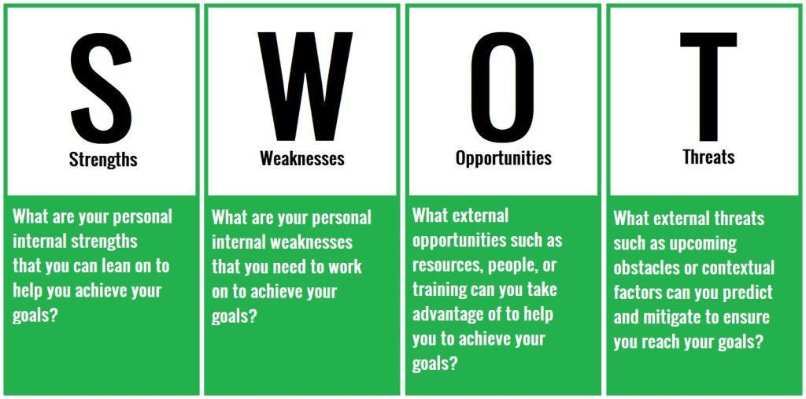
Today’s Session

Slide 4
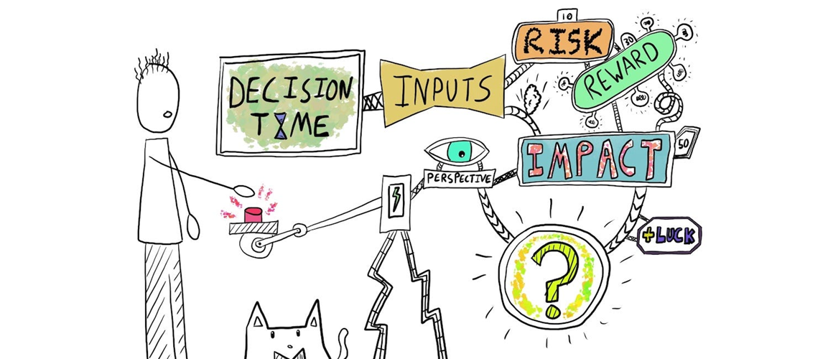
Why do we need to look at decision making?
Making decisions can be scary and stressful, as you know they might have life long consequences and you want to make the RIGHT CHOICE
Is there such a thing as the RIGHT CHOICE?
There isn’t such a thing as the RIGHT CHOICE – there are good choices and bad choices, there are better and worse choices
You need to learn how to make GOOD CHOICES
By looking at how you can make decisions you can empower yourself to make better decisions which in turn should give you a better quality of life.
This should also take a lot of the stress out of making a decision as you now have the understanding of how to make better decisions.

Slide 5
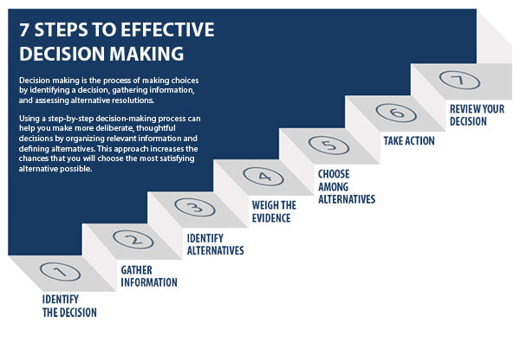
7 Effective Decision Making Steps
Look at the diagram – Most of us make decisions by only following steps 1, 3 and 5/6
Most of us don’t
Gather enough information
Weigh up the evidence
Review the decision
You need to learn the
importance of these 3 steps
and how to do them
Look at the diagram – Most of us make decisions by only following steps 1, 3 and 5
SWOT Analysis is a way to consider steps 3, 4, and 7

Slide 6
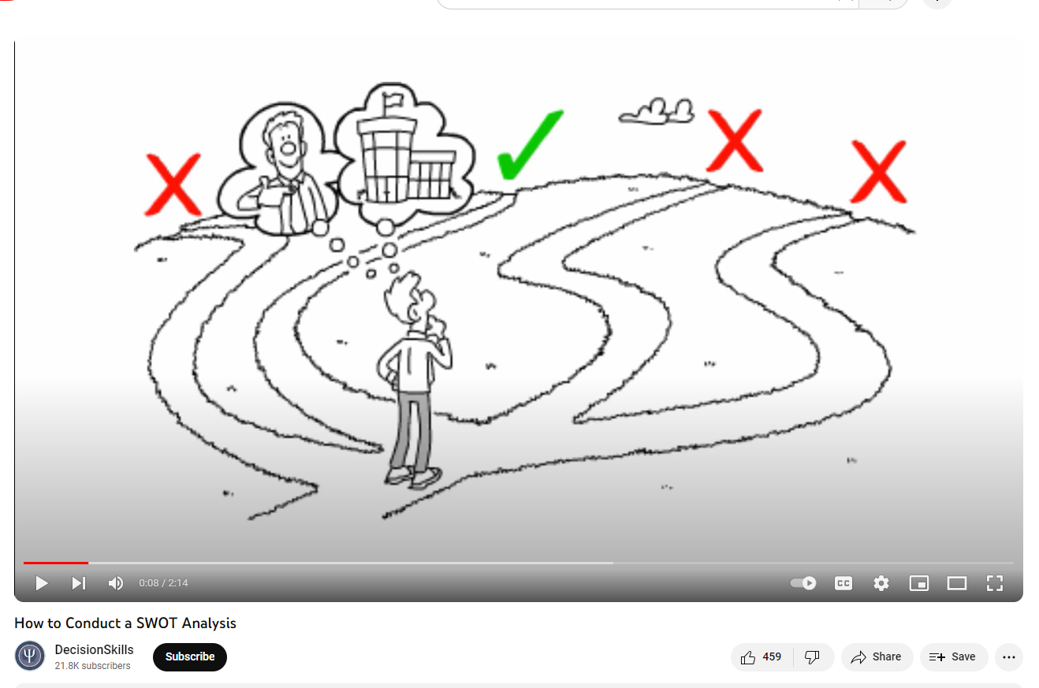
Watch the video
Discuss – what are the 4 parts of the SWOT Analysis?
How to conduct SWOT analysis – 2.14 mins

Slide 7
SWOT – simple start
football, art, music, chatting with others, maths, languages
Positive, team player, leader, good listener
football, art, music, too chatty/ don’t listen , maths, languages
Lazy, can’t get up in the morning, get angry, give up, shy
Identify your greatest strength
Talent
Attitude
Identify your worst weakness
Skills
Attitude
GCSEs choices, playing for school teams, drama,
Get a part-time job, join a club, spend time with friends
Not enough GCSEs choices, too few places in school teams and drama productions
No part-time job, join clubs meet at times you cannot get to, friends meet at time you cannot get to
Identify opportunities
Coming up
School
Outside school
Identify threats
School
Outside school

Slide 8
Setting Goals – imagine you want to get a part time job
Discuss in groups
Imagine this is your friend -
Why might a Friday night job not work out?
Why might an apprenticeship be hard?
What do you think they should do?
Like cooking
Like trying out new food
Can work hard
Struggle to get up early in the morning
Easily distracted
Like going out with my mates on a Friday night
BTEC in Food technology
Apprenticeship in Catering post 16
Job in local restaurant on a Friday night
Parents think a chef is a bad career
Training takes 2 years
Wages are too low to live on independently
As a class decide/vote if going for the job is a good choice?
REMEMBER there is not a right or wrong choice but making good choices with reasons

Slide 9
How can you use SWOT when it comes to GCSE/BTEC options?
Remember from the video clip that you can use multiple SWOT analysis boxes to compare different choices.
So if you get down to 6 options you can complete a SWOT analysis on each and compare to choose the best 4
Discuss what you think the strengths and weaknesses of doing this might be

Slide 10
Make Sure you can access START
START is the careers online software package that the school provides for you.
Make sure you can access it – you do not be want to be wasting time in your sessions logging on
Remember - Through your Profile and Locker you should be recording your experiences, skills and events. You will be able to access this long after you have left school, so keep this all up to date to help you produce quality CV’s and Personal Statements.
Remember the START site has a massive range of information and activities to help you on your career pathway
Can you access START?
Remember to log your SWOT activity on Decision Making in your profile.

Slide 11
Developing SWOT for yourself
Spend the remaining time trying to …..
Identify your key strengths and weaknesses
(both Hard and Soft Skills)
Identify any goals you might have (what opportunities and threats might be involved?)

