Slide 1
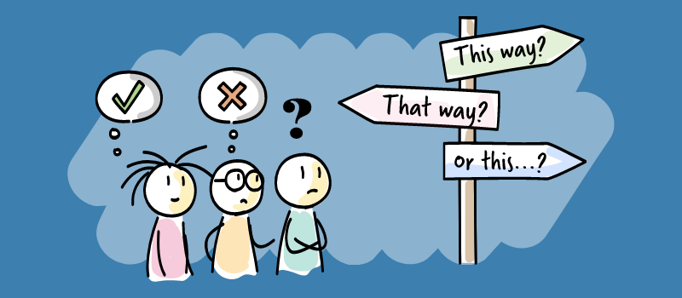
Decision Making
Preparing to make your GCSE/BTEC choices
Preparing to be successful in making good decisions
Thinking Hats
Discuss – Have you ever heard of Thinking Hats?

Slide 2
Today’s Session
This is what we are covering today
Why do we need to look at decision making?
What is Thinking Hats?
How will it help with the 7 effective steps of decision making
How to use Thinking Hats
Thinking Hats - a simple start
Case study
How to use Thinking Hats in GCSE/BTEC Options

Slide 3
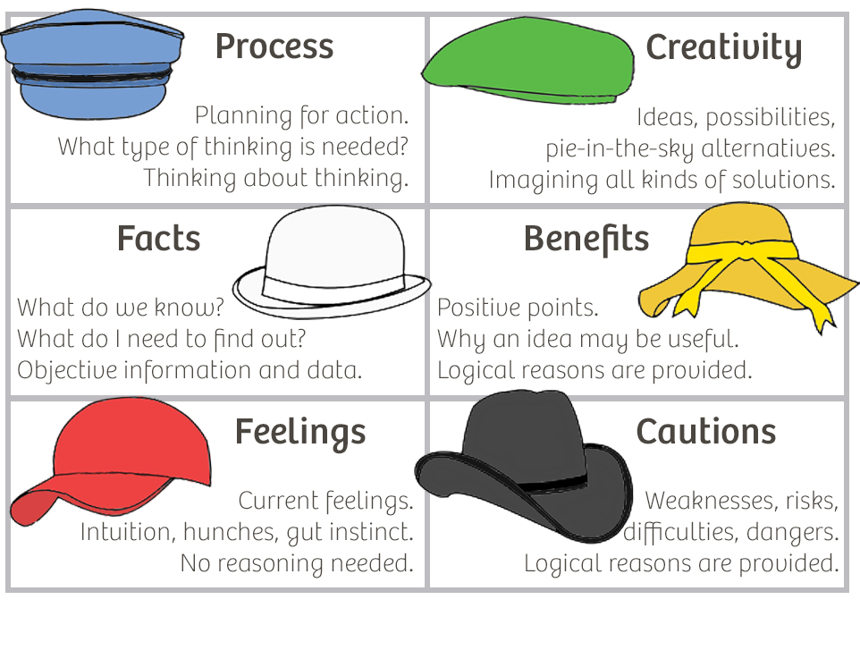

Slide 4
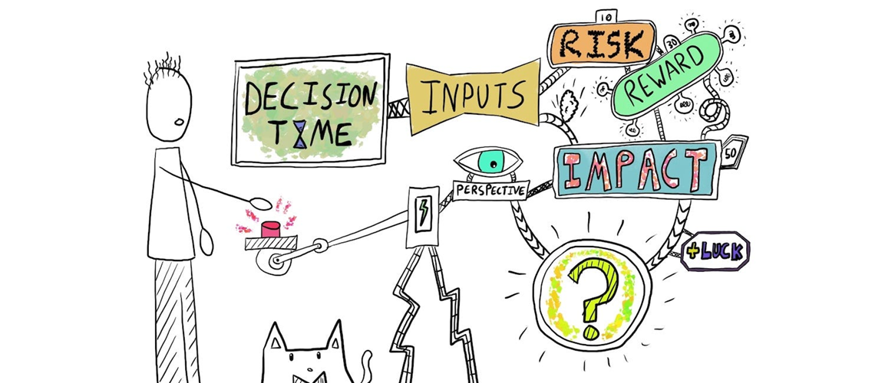
Why do we need to look at decision making?
Making decisions can be scary and stressful, as you know they might have life long consequences and you want to make the RIGHT CHOICE
Is there such a thing as the RIGHT CHOICE?
There isn’t such a thing as the RIGHT CHOICE – there are good choices and bad choices, there are better and worse choices
You need to learn how to make GOOD CHOICES
By looking at how you can make decisions you can empower yourself to make better decisions which in turn should give you a better quality of life.
This should also take a lot of the stress out of making a decision as you now have the understanding of how to make better decisions.

Slide 5
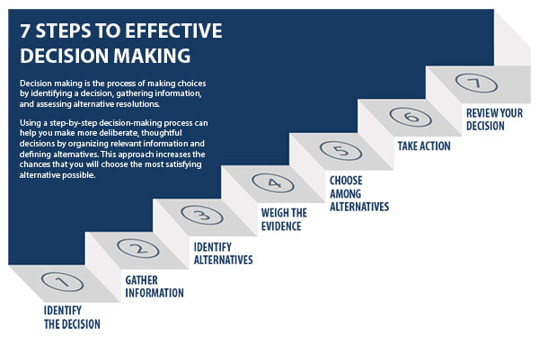
7 Effective Decision Making Steps
Look at the diagram – Most of us make decisions by only following steps 1, 3 and 5/6
Most of us don’t
Gather enough information
Weigh up the evidence
Review the decision
You need to learn the
importance of these 3 steps
and how to do them
Look at the diagram – Most of us make decisions by only following steps 1, 3 and 5
THINKING HATS is another way to consider steps 3, 4, and 7

Slide 6
Watch the video
Discuss – what is the point of the different colours?
What is Six Thinking Hats? – 1.58 mins

Slide 7
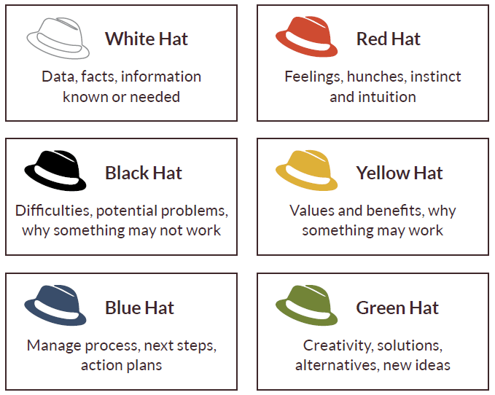
Thinking Hats – simple start
Discuss – Which the key word for each colour hat?
Make a decision based on FEELINGS
Make a decision based on FACTS
Make a decision based on VALUES
Make a decision based on Problems
Make a decision based on where you are trying to get to
Make a decision based on CREATIVITY

Slide 8
Thinking Hats – interesting point
We naturally urge ourselves to be cautious and so often put more importance on the negative points than the positive.
Discuss – Which Hat do you think most people use to make a decision?
This means we can miss out on opportunities which is why you need to reflect on the other ways of looking at a decision to make sure you do not miss out
Most people make a decision with a Black Hat
Discuss – Why can using the six hats help you make a better decision?

Slide 9
Thinking Hats – simple start
Discuss – Look at the 6 decisions About buying a house, which were made using which hat?
Buying a house because it needs to big enough for your ill grandparents to live with you.
Buying a small house because you want to buy a bigger one later
Buying a house because you can see how you can redesign it and create your own space
Choosing a house because it is value for money
Not buying a house because you will lose money
Buying a house because it suits you

Slide 10
How can you use Thinking Hats when it comes to GCSE/BTEC options?
White Hat – Which subject will I be most successful at?
Red Hat – Which subject will I enjoy the most?
Black Hat – Which subject do I find too hard to do?
Yellow Hat – Which subject will develop my values?
Blue hat – Which subject do I need for my Career Plan?
Green Hat – Which subject will develop my creativity?
Discuss what you think the strengths and weaknesses of doing this might be

Slide 11
Make Sure you can access START
START is the careers online software package that the school provides for you.
Make sure you can access it – you do not be want to be wasting time in your sessions logging on
Remember - Through your Profile and Locker you should be recording your experiences, skills and events. You will be able to access this long after you have left school, so keep this all up to date to help you produce quality CV’s and Personal Statements.
Remember the START site has a massive range of information and activities to help you on your career pathway
Can you access START?
Remember to log your THINKING HATS activity on Decision Making in your profile.

Slide 12
Developing Thinking Hats for yourself
White Hat – Which subject will I be most successful at?
Red Hat – Which subject will I enjoy the most?
Black Hat – Which subject do I find too hard to do?
Yellow Hat – Which subject will develop my values?
Blue hat – Which subject do I need for my Career Plan?
Green Hat – Which subject will develop my creativity?
Spend the remaining time trying to …..
Answer the subject questions for each hat
Work out which hat you use to decide ….
Who you go out with?
What job you want to do?
Which sport you play?
Which charity you will support?
What colour you will paint your room?
Won’t try something new because I will look stupid!

