Slide 1





Decision Making
Preparing to make your GCSE/BTEC choices
Preparing to be successful in making good decisions
Subject Life/Soft Skills
Discuss – Have you ever considered the different skills that you can develop in each subject?

Slide 2


What are skills ?
A skill is the ability to do something well, especially because you have practised it.
What skills do you have?
Drawing?
Telling jokes?
Sport?
Cooking?
Work out a skill that you have.

Slide 3

Today’s Session
This is what we are covering today
What are skills?
Why do we need to look at decision making?
What are Hard and Soft Skills?
How will it help with the 7 effective steps of decision making
What are skills and why are they important?
Soft skills – the essential skills
Assess your skills - weakest and strongest.
What skills for what job?
How to find out which skills each subject offers.

Slide 4

Why do we need to look at decision making?
Making decisions can be scary and stressful, as you know they might have life long consequences and you want to make the RIGHT CHOICE
Is there such a thing as the RIGHT CHOICE?
There isn’t such a thing as the RIGHT CHOICE – there are good choices and bad choices, there are better and worse choices
You need to learn how to make GOOD CHOICES
By looking at soft or life skills you can work out which ones you are good at and which you need to improve. Having a good set of Life/Soft Skills will empower your Life and give you a better quality of life.
Applying a good set of life/soft skills will make you better at making decisions.

Slide 5
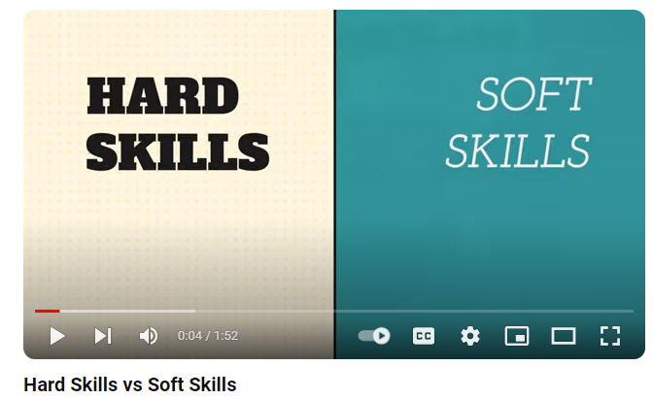
Watch the video
Discuss –
What are the differences between hard and soft skills?
What are hard and soft skills – 1.52 mins

Slide 6

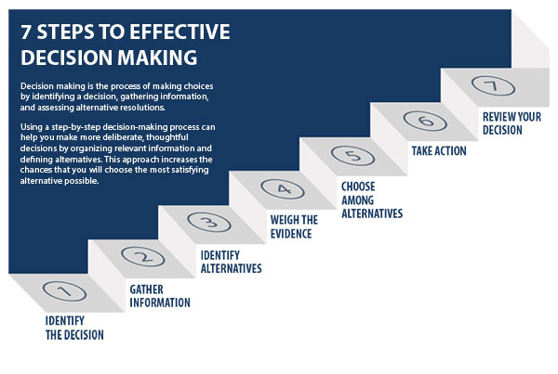
7 Effective Decision Making Steps
Look at the diagram – Most of us make decisions by only following steps 1, 3 and 5/6
Most of us don’t
Gather enough information
Weigh up the evidence
Review the decision
You need to learn the
importance of these 3 steps
and how to do them
Look at the diagram – Most of us make decisions by only following steps 1, 3 and 5
Thinking about the key skills each subject offers is another way to consider steps 3, 4, and 7 in your option process

Slide 7
What are skills and why are they so important?
Technical Skills - Employers will be looking for technical skills that are specific to a particular role/job. You need to know the specific technical skills needed for job/career you are interested in. Often employers will train their staff these skills.
Essential Skills - Employers will be looking for these skills in candidates for all jobs. These are the skills that allow you to work in a team, solve problems, meet targets, take responsibility and be a valuable employee.
Basic Skills - Basic skills are the skills that will help you succeed in life and in education. They include Maths, English and general IT/ computer skills. It is very difficult to be successful without them.
Discuss –
Which skill set are the skills you develop to pass GCSE exams?
Which skills are the soft/life skills?

Slide 8
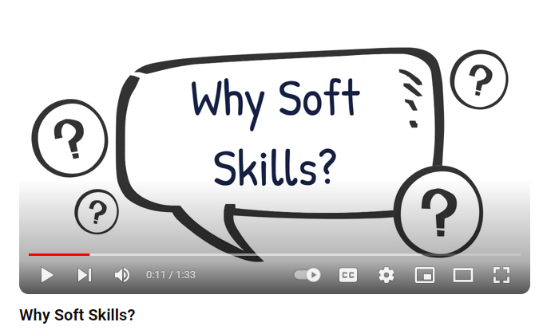
Watch the video
Discuss –
Why are soft skills important?
Why soft skills? – 1.33 mins

Slide 9


Essential life/soft Skills
Taking positive steps on your life journey is not just about your education - what you learn outside of a classroom can have a huge impact on the opportunities available to you in the future.
These eight skills are the ones you need to do almost everything well - they will help you to take your next steps in life with confidence and support you to achieve your career goals and life ambitions.

Slide 10
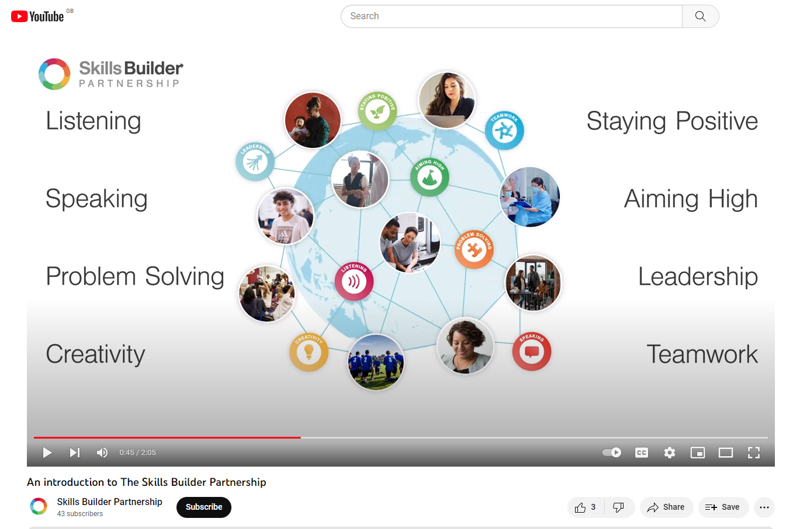
This video clip introduces the eight key essential skills
https://www.youtube.com/watch?v=ziJ8TS_V0f8
2 mins

Slide 11
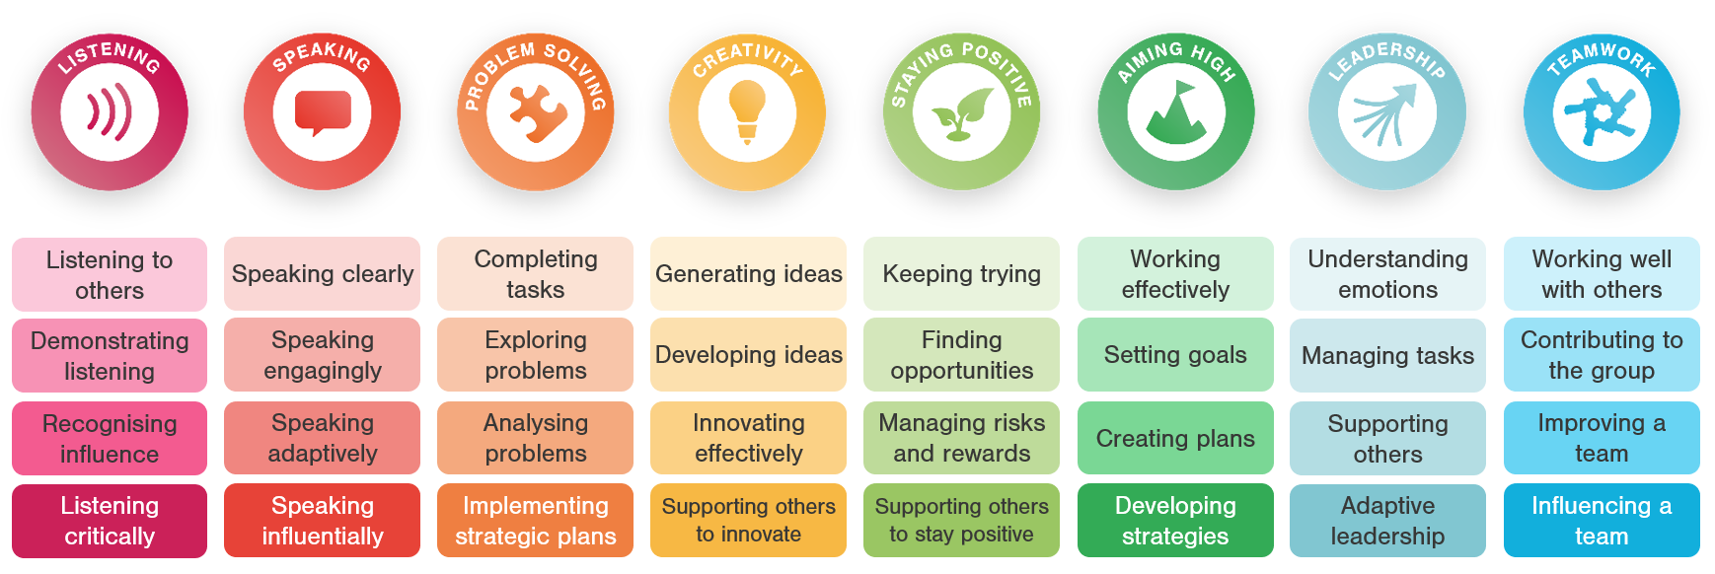
Which do you think you are strongest at and which is your weakest?

Slide 12
Think which skill might be the most important for each job?
 | Listening | Speaking | Problem Solving | Creativity | Staying Positive | Aiming High | Leadership | Teamwork
Teacher
Paramedic
Mechanical engineer
Solicitor
Programmer

Slide 13
Finding out what Life/Soft skills each subject offers
Ask your teacher
Look in the Option booklet – each subject will clearly outline which key skills they develop
Option Evening – don’t just ask whether the teachers think you should do the subject, and find out about the course structure and what you need to learn BUT also find out what key skills it can develop in you.

Slide 14

Make Sure you can access START
START is the careers online software package that the school provides for you.
Make sure you can access it – you do not be want to be wasting time in your sessions logging on
Remember - Through your Profile and Locker you should be recording your experiences, skills and events. You will be able to access this long after you have left school, so keep this all up to date to help you produce quality CV’s and Personal Statements.
Remember the START site has a massive range of information and activities to help you on your career pathway
Can you access START?
Remember to log your SKILLS activity on Decision Making in your profile.

Slide 15
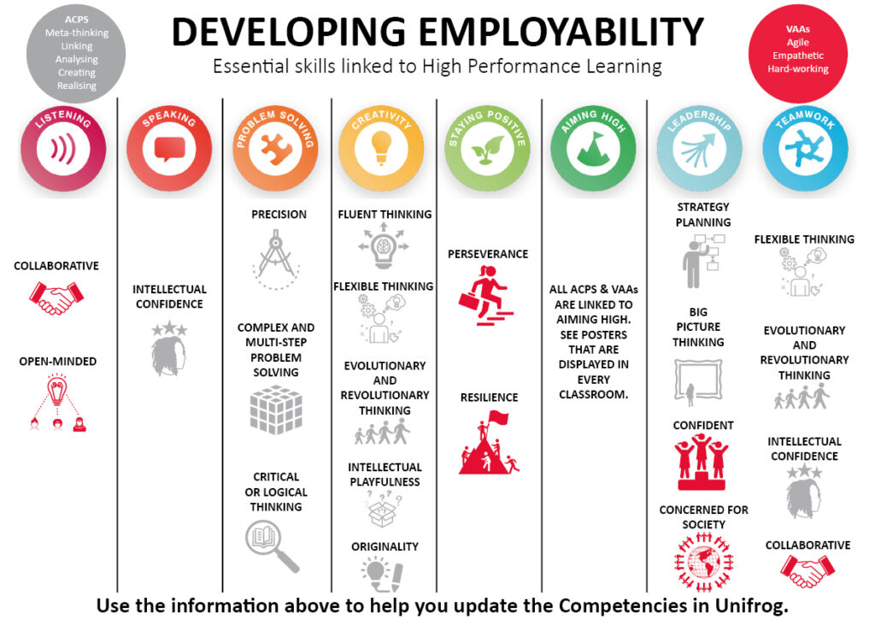

If you have time discuss which subjects let you develop which essential skills?
Speaking clearly
Being engaging &
challenging
Asking questions
Doing things to the highest standard
Goal setting
Planning
Going the extra mile

