Slide 1
Decision Making How can I use this information from the last 5 sessions to make better GCSE/BTEC Options?
Preparing to make your GCSE/BTEC choices
Preparing to be successful in making good decisions
List the 3 decision making processes you have been introduced to.
What are soft and hard skills?
Discuss - How important are soft and hard skills?
Do you need to take your option choices seriously?
Can different Ways of looking at your decisions allow you to make better choices?

Slide 2
Today’s Session
This is what we are covering today
Why do we need to look at decision making?
Options video
What are the different types of decisions
7 effective steps of decision making
What we have been looking at over the last 5 sessions
SWOT Analysis, Thinking Hats, Cost/Benefit, Subject Skills
kjvb

Slide 3
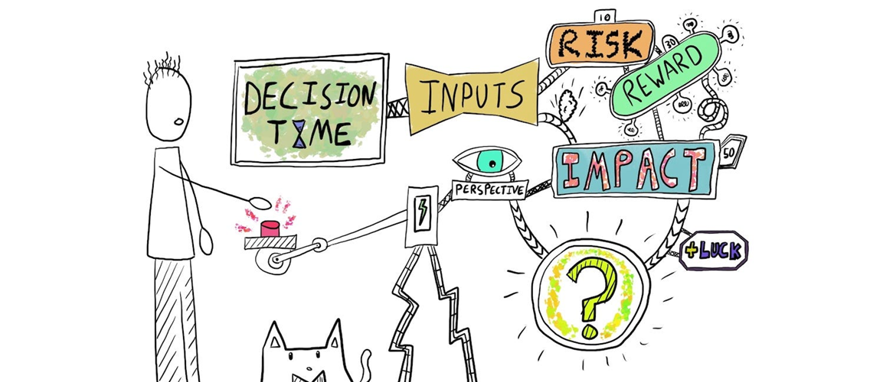
Why do we need to look at decision making?
You are about to make your GCSE/BTEC course choices !!
Making decisions can be scary and stressful, as you know they might have life long consequences and you want to make the RIGHT CHOICE
Is there such a thing as the RIGHT CHOICE?
There isn’t such a thing as the RIGHT CHOICE – there are good choices and bad choices, there are better and worse choices
You need to learn how to make GOOD CHOICES
By Thinking about your GCSE/BTEC choices and thinking about where these options might take you can make decisions you can empower yourself to make better decisions which in turn should give you a better quality of life.
This should also take a lot of the stress out of making a decision as you now have the understanding of how to make better decisions.

Slide 4
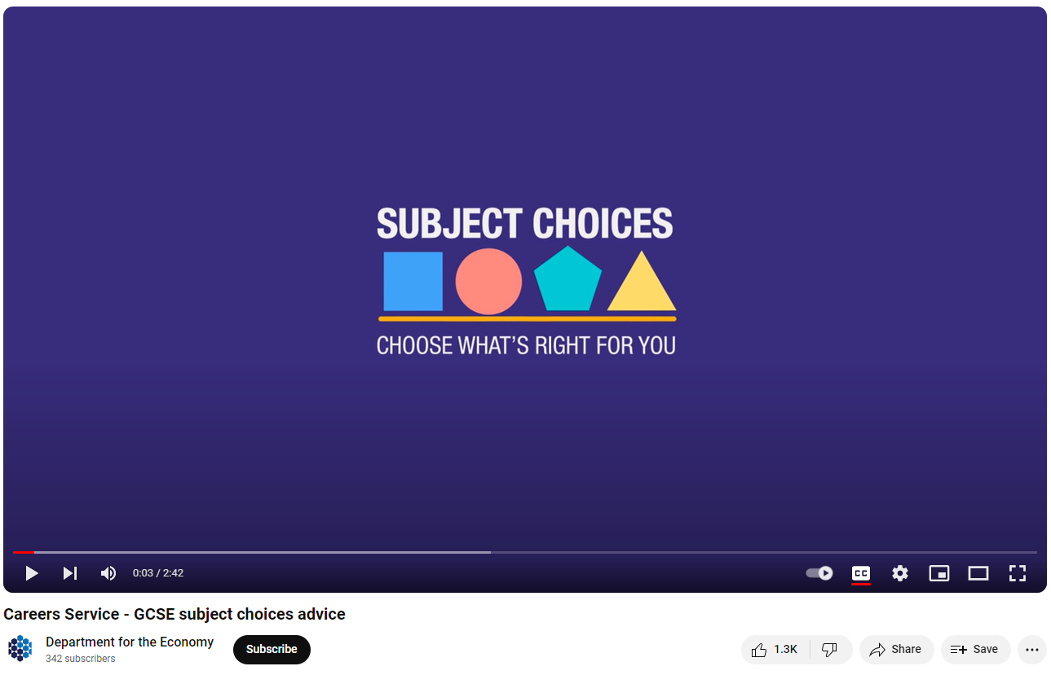
Watch the video
Discuss –
Is technology going to change the future job market?
Which 3 areas does the video suggest will still give job opportunities?
Gov site with careers advice
https://www.nidirect.gov.uk/campaigns/careers
GCSE Subject choices – 2.42 mins
STEM Jobs, Creative jobs, Practical Skill Jobs

Slide 5
Types of Decision Making
What Are the 3 Types of Decision Making?
Strategic: Long-term, high-level decisions determine the direction of an your life.
e.g. What career shall I choose? Which college will I choose when I Leave school?
What GCSEs/BTECs shall I choose?
Tactical: These decisions translate strategic direction into action, focusing & reflecting on how and why we do things and how we can do them better.
Operational: Daily, routine decisions that you have to make every day
You are going to be making a LONG TERM STRATEGIC decision when you choose your GCSE/BTEC options

Slide 6
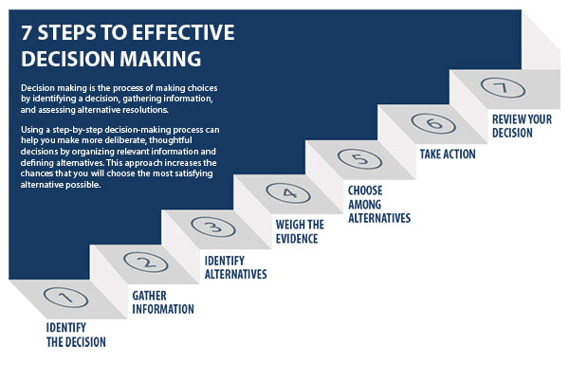
7 Effective Decision Making Steps
Look at the diagram – Most of us make decisions by only following steps 1, 3 and 5/6
Most of us don’t
Gather enough information
Weigh up the evidence
Review the decision
You need to learn the
importance of these 3 steps
and how to do them
Look at the diagram
– You have now seen it 5 times make sure you engage with all the steps when you make your GCSE/BTEC Options

Slide 7
What have you looked at over the last 5 sessions?
Introduction into Decision making
Decision making Process – Swot analysis
Decision making Process - Thinking Hats Process
Decision making Process – Ranking (Cost Benefit analysis)
Collecting Information - Subject Skills

Slide 8
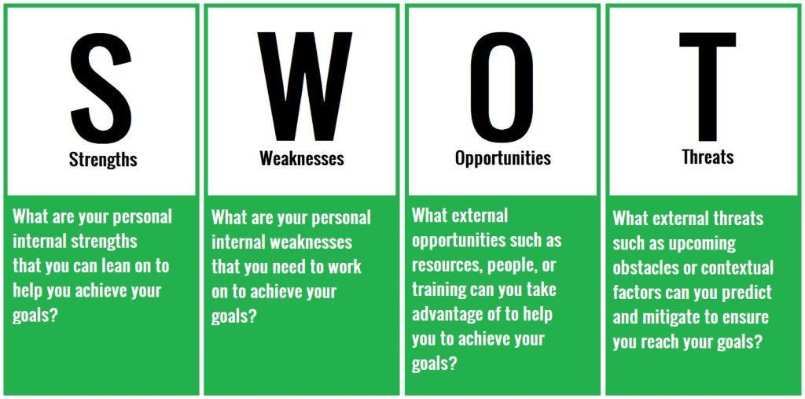
SWOT Analysis – simple reminder
This allows you to recognise your strengths and weaknesses, what opportunities you could use and what might stop you
football, art, music, chatting with others, maths, languages
Positive, team player, leader, good listener
football, art, music, too chatty/ don’t listen , maths, languages
Lazy, can’t get up in the morning, get angry, give up, shy
Identify your greatest strength
Talent
Attitude
Identify your worst weakness
Skills
Attitude
GCSEs choices, playing for school teams, drama,
Get a part-time job, join a club, spend time with friends
Not enough GCSEs choices, too few places in school teams and drama productions
No part-time job, join clubs meet at times you cannot get to, friends meet at time you cannot get to
Identify opportunities
Coming up
School
Outside school
Identify threats
School
Outside school

Slide 9
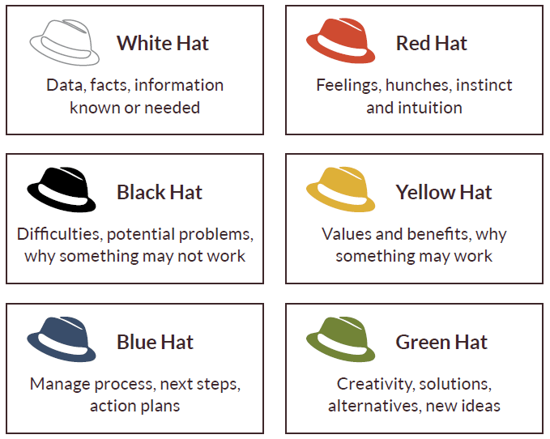
How can you use Thinking Hats when it comes to GCSE/BTEC options?
White Hat – Which subject will I be most successful at?
Red Hat – Which subject will I enjoy the most?
Black Hat – Which subject do I find too hard to do?
Yellow Hat – Which subject will develop my values?
Blue hat – Which subject do I need for my Career Plan?
Green Hat – Which subject will develop my creativity?
Discuss what hat do you mostly wear?

Slide 10
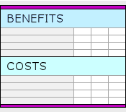
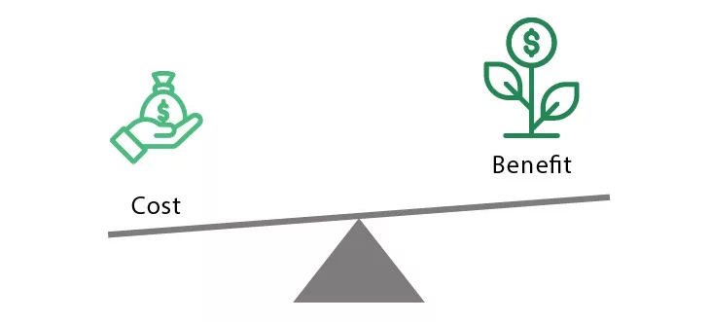
Why is cost/benefit a helpful way to make a decision?
This process allows you to identify potential benefits & problems/costs that might come from a decision.
By weighting them with a number it allows you identity how important each cost or benefit is.
A final number allows you come to a clear decision.
What are the potential benefits?
Discuss – Why can using cost/benefit analysis help you make a better GCSE/BTEC decision?
What are the potential costs?

Slide 11
Finding out what Life/Soft skills each subject offers
Ask your teacher
Look in the Option booklet – each subject will clearly outline which key skills they develop
Option Evening – don’t just ask whether the teachers think you should do the subject, and find out about the course structure and what you need to learn BUT also find out what key skills it can develop in you.

Slide 12
How can I use this information from the last 5 sessions to make better GCSE/BTEC Options?
This is the form that you have to fill in for your options
Most of you will probably know 2 options that you definitely want to do but have a choice of 3 to 5 that you might do for the other 2
- use the SWOT to identify which subjects will use your strengths
- use Thinking Hats to consider your options and make sure you are not making choices with your black hat
- use Cost/Benefit to compare your final choices
- use subject skills to make sure you are developing a full set of skills

Slide 13
Watch the video if you have time
Discuss – What were the things Donna regretted?
GCSE Choices Donna’s story – 2.40 mins

Slide 14
Make Sure you can access START
START is the careers online software package that the school provides for you.
Make sure you can access it – you do not be want to be wasting time in your sessions logging on
Remember - Through your Profile and Locker you should be recording your experiences, skills and events. You will be able to access this long after you have left school, so keep this all up to date to help you produce quality CV’s and Personal Statements.
Remember the START site has a massive range of information and activities to help you on your career pathway
Can you access START?
Remember to log your activity on Decision Making in your profile?

