Slide 1
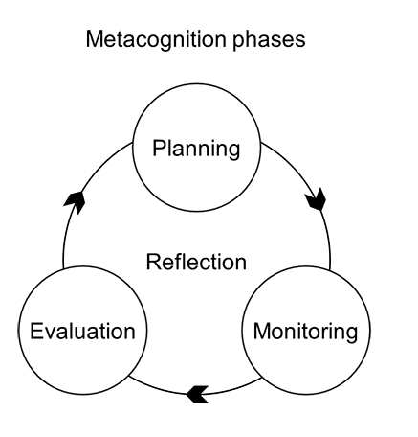
The cycle of metacognition
Metacognition means thinking about our learning processes. It involves planning how to approach a task, monitoring how we are doing with a task and evaluating how we completed a task.
All of this involves reflecting on our learning.
Metacognition can involve identifying strengths and weaknesses or gaps in knowledge or missing notes through using learning checklists. It can involve planning effective revision timetables and evaluating our work against model answers.

Slide 2
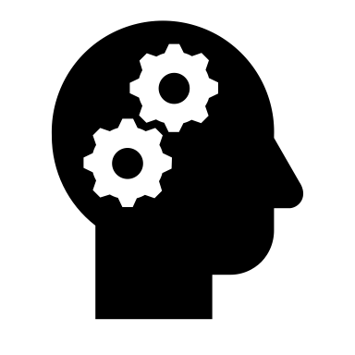
Memory and Cognitive Load Theory
According to Cognitive Load Theory, our memory can be divided into long term memory and working memory.
Long term memory is like a store of all the things that we know and have previously learned. It is almost unlimited in terms on how much we are capable of learning.
Working memory is the bit of our mind that we use when we have to hold instructions or information in our mind to try to complete a task. It can only hold a small number of bits of information at a time.
Cognitive Overload occurs when too many demands are made on our working memory.
Notes:
This is very simplified but should be sufficient detail for students to begin to think about how some forms of revision will be more / less effective.

Slide 3
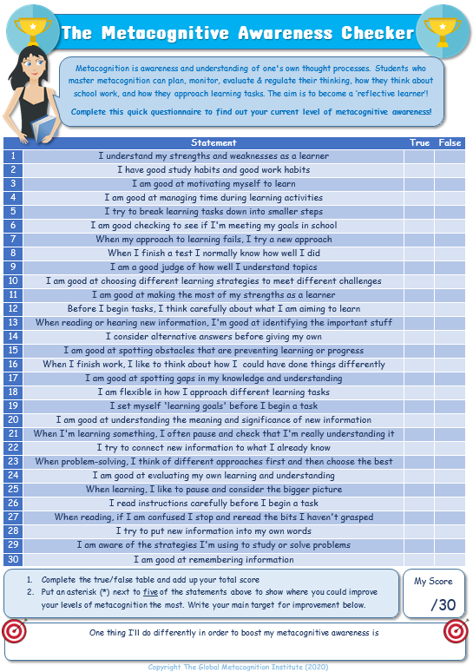
Notes:
This is the most important part of the session

Slide 4
The cycle of self regulation
Planning
Monitoring
Evaluating
Regulating
During a learning activity you monitor your progress. You might consider whether the strategy you selected is right for the task, how well you are progressing and whether there is anything distracting you.
When starting a learning activity, you think about the goals you want to reach and what strategies you might use to reach your goals.
Regulation means making changes based on evaluation. For example, deciding to select the same / a different strategy next time based on how effective it was or making changes to reduce distractions and increase focus.
As you come close to completing a task you consider how well your approach has worked. Did you achieve your goal? What were the strengths and weaknesses of your approach? Did the strategies that you used help or hinder your learning?
Notes:
This slide was in last week’s lesson but I felt that there was too much last week so thought I would include again for reference if it is useful or if anyone felt that it was rushed.

Slide 5
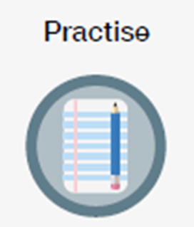
The cycle of self regulation
Match the various questions with the appropriate stage of the cycle of self regulation.
Stage in Cycle of self regulation | Questions you might ask yourself
Planning | How am I progressing with his task? What is going well? What might be hindering my progress?
Monitoring | How well did I complete this task? What were the strengths and weaknesses of my approach?
Evaluating | What do I need to do differently next time? What distracted me? How can I avoid those distractions?
Regulating | What am I trying to achieve? What strategies will help me to achieve this?

Slide 6
Answers: The cycle of self regulation
Match the various questions with the appropriate stage of the cycle of self regulation.
Stage in Cycle of self regulation | Questions you might ask yourself
Planning | How am I progressing with his task? What is going well? What might be hindering my progress?
Monitoring | How well did I complete this task? What were the strengths and weaknesses of my approach?
Evaluating | What do I need to do differently next time? What distracted me? How can I avoid those distractions?
Regulating | What am I trying to achieve? What strategies will help me to achieve this?

Slide 7
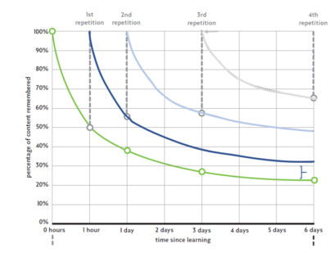
Ebbinghaus’ Forgetting Curve
The Green line shows the rate at which we naturally forget new information.
This chart also shows the impact of going over key information repeatedly.
Each time that we revisit information we are able to remember more.
Source : https://teachlikeachampion.org/blog/an-annotated-forgetting-curve/

Slide 8
Improving revision strategies
Revision Strategy A | Revision Strategy B | Explanation – Strategy B is better than A because …
Read through notes on a regular basis and important information should stick in your mind. | Revisit key information regularly but don’t just read notes. Use self quizzing or flashcards to test yourself and don’t be disheartened if it seems difficult. | It is natural to struggle to remember new information. Ebbinghaus’ forgetting curve shows that unless we revisit information a number of times we forget a great deal of new information.
Focus on revising information soon after you have learned it in class and just before exams. | Revisit information regularly. Plan your revision so that you go over topics several times. | The largest drop in memory happens soon after we are introduced to new information. It is more beneficial to revisit information frequently so that it will be stored in long term memory. The process of self testing, quizzing and active revision helps information to be stored in long term memory. (links to forgetting curve)
You will be less confused if you try to learn each new piece of information on its own and just repeat it until you remember it. | Try to make links between new knowledge and existing knowledge. Draw concept maps, flow charts or timelines to explain how ideas are linked together. | Knowledge is ‘sticky’ the more that you know about a topic the easier it is to process new information. We connect new knowledge to existing knowledge to form schema. These are networks of knowledge. The more that we know about a topic, the easier it is to learn new information that is linked to it.
Doing well in tests will increase confidence so it is worth cramming before exams. | You are more likely to remember well if you are well fed, hydrated and rested so plan your revision timetable to avoid cramming. | How you feel affects how well you remember. It is difficult to concentrate and work effectively if you are distracted by feeling unwell.
Spend time reading through lists of key words. They will sink in eventually or you will be able to figure out what they mean from the context. | Use strategies like look, cover, write, check to ensure that you have memorised key content. | Memorising key words, equations etc. frees up space in working memory and so reduces cognitive load. If you know key words etc. fluently then you can put your effort into applying your knowledge and constructing a good answer rather than trying to remember what a word means.
Make sure that your work is nicely decorated. Use visuals to make your pages more interesting and highlighter to add colour. | Ensure that notes are organised and laid out clearly. Keep notes simple and clear so that you are going over the most important information. | The way information is presented affects learning. Dual coding – where images can be used to help remember ideas can be effective but unnecessary decoration can make it harder to concentrate on key information.
Don’t worry too much about missed work. Your teacher will probably go over anything important that you have missed. | Ensure that you catch up on missing work and have learned all key words / key content on knowledge organisers. This makes new learning much easier. Use Personalised learning checklists to keep up to date with your work. | Personailsed learning checklists can help you to take more responsibility for your learning. Understanding how to manage your learning is a key part of metacognition. Knowledge is ‘sticky’ the more that you know about a topic the easier it is to process new information. We connect new knowledge to existing knowledge to form schema. These are networks of knowledge. The more that we know about a topic, the easier it is to learn new information that is linked to it.
Notes:
Students should compare to those on the board. They are not expected to answer in as much detail as examples given. Retain this work for next lesson.

