Slide 1
THE BRIDGEWATER BATON
MATHS

Slide 2
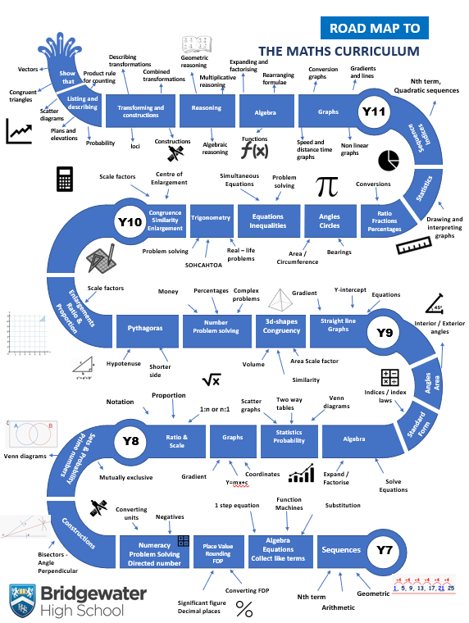
The Bridgewater journey in MATHS
Our “Roadmap” for this subject:

Slide 3
The Bridgewater journey in MATHS
KS3 in particular:

Slide 4
Further information for MATHS can be found at:
Within the CURRICULUM INFORMATION table there are links to each subject’s:
Curriculum Intent statement
Curriculum map
Road map
Assessment statements
https://bridgewaterhigh.org/key-stage-3-subjects/

Slide 5
In Maths, it is particularly vital for us that pupils arrive with:
Confidence calculating times tables up to 12 x 12
Ability to calculate using the four operations
Understanding of size and scale of numbers, including negative numbers
Knowledge of names of a mixture of 2d and 3d shapes and how to classify them
Ability to manipulate fractions, including simplifying and using the four operations
Experience applying mathematical knowledge to worded, real life problems

Slide 6
In Maths, key vocabulary which we use at Bridgewater includes the following:
Terminology | Description and examples
Sum | Addition
Product | Multiplication
Command words | Description
Calculate | The answer is a number – work it out mathematically
Evaluate | The answer is a number – work it out mathematically
Simplify | Reduce an expression, fraction or equation to a simpler, easier form
Solve | Find the value(s) that satisfy an equation or inequality
Expand | Multiply out the brackets
Factorise | Put into brackets

Slide 7
Further support for you in MATHS
We are pleased to offer the following to support your Maths provision and transition:
Guidance through Bridgewater KS2-3 meetings
Possible masterclasses on a bespoke basis
Guidance on how to deliver certain topics via contact directly with Maths staff
CONTACT –
Harriet Matthews, KS3 Co-Ordinator
h.matthews@bridgewaterhigh.com
Claire Beswick, Head of Mathematics
c.beswick@bridgewaterhigh.com

