Slide 1
THE BRIDGEWATER BATON
SCIENCE

Slide 2
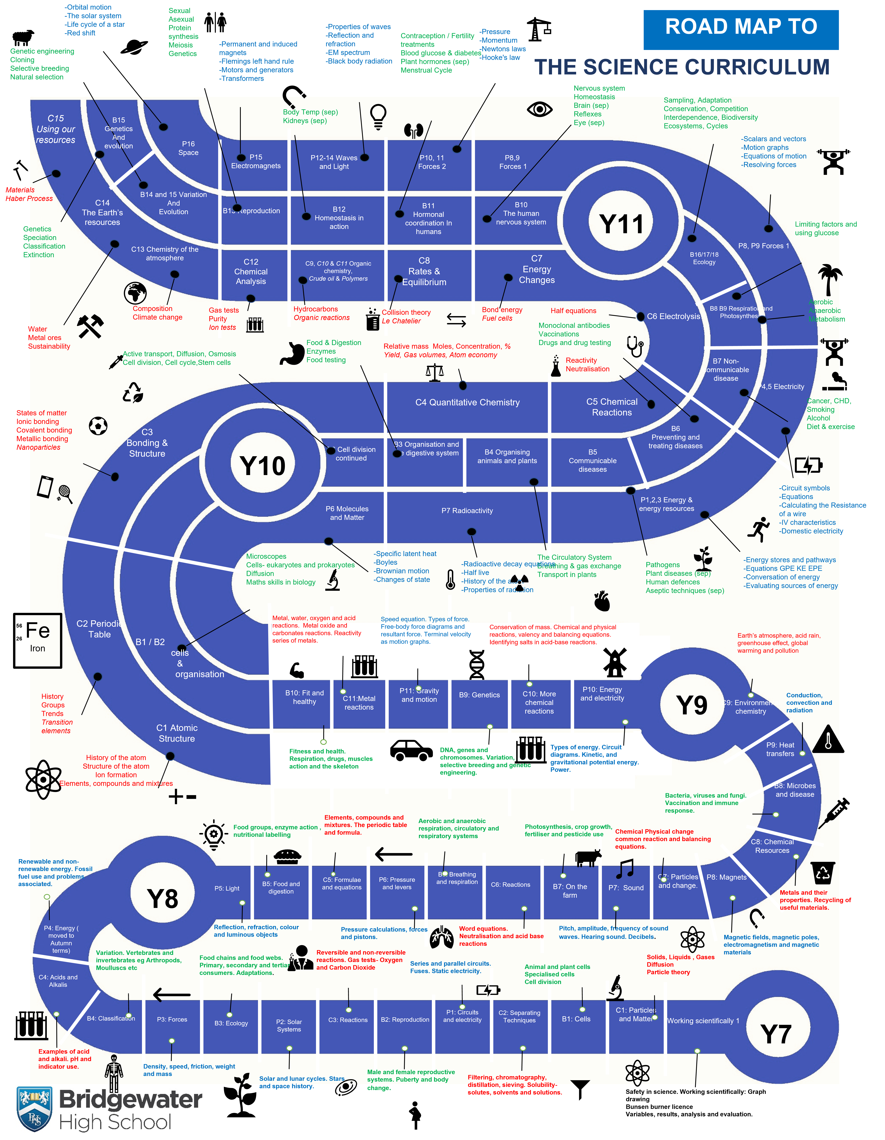
The Bridgewater journey in SCIENCE
Our “Roadmap” for this subject (may require some zooming in!)

Slide 3
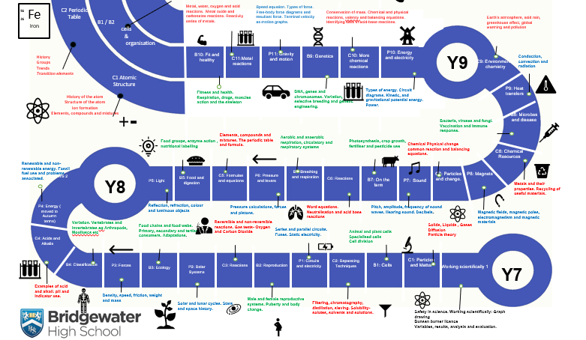
The Bridge- water journey in SCIENCE
KS3 in particular:

Slide 4
Further information for SCIENCE can be found at:
Within the CURRICULUM INFORMATION table there are links to each subject’s:
Curriculum Intent statement
Curriculum map
Road map
Assessment statements
https://bridgewaterhigh.org/key-stage-3-subjects/

Slide 5
In Science, it is particularly vital for us that pupils arrive with:
1. Know that scientists use investigations to answer questions.
2. Understand that we need to control variables to ensure we get valid results.
3. Understand how to write a basic method and are able to follow a method.
4. Can make and record observations and use equipment to take accurate measurements.
5. Know how to draw tables to record results.
6. Understand there are different methods of presenting results and can draw bar graphs to present findings.
7. Know what a conclusion is and can use their data to write a basic conclusion.

Slide 6
In Science, key vocabulary which we use at Bridgewater includes the following:
Terminology | Description and examples
Hypothesis | A testable statement linking the independent and dependent variables.
Independent variable | The variable we change in the experiment.
Dependent Variable | The variable we measure in the experiment.
Control Variable | The variable we keep the same in an experiment.
Reproducible | When others can reproduce the same data.
Reliability | When results are consistent.
Validity | When results are close to their true value.
Continuous Data | Numerical data where the number can be any size.
Discrete Data | Data with numbers but where only certain values are allowed.
Categoric data | Data which has no numbers but can be put into categories or groups.

Slide 7
Further support for you in SCIENCE
We are pleased to offer the following to support your Science provision and transition:
Guidance through Bridgewater KS2-3 meetings
Possible masterclasses on a bespoke basis
Guidance on how to deliver certain topics via contact directly with Science staff (where possible including visits to/from Bridgewater)
CONTACT –
Sam Gavin, KS3 Co-Ordinator
s.gavin@bridgewaterhigh.com
Alan McMahon, Head of Science
a.mcmahon@bridgewaterhigh.com

