Slide 1


Unit 7.1 - Introduction to e-safety
Name:
Target:
A definition of eSafety is

Slide 2
How you will be assessed
Your teacher will look at your workbook and leave comments regarding the completion of your work.
You will have regular questioning and quick fire questions at the beginning of lessons.
You will sit a mid unit and end of unit test to assess your knowledge.
You will produce your website which your teacher will assess.

Slide 3
Unit 7.1 Assessment Grid
ADVANCED | INTERMEDIATE | FOUNDATION
I have created a detailed plan for all E- Safety website pages with a detailed explanation of my design decisions. | I have created a detailed E-Safety website plan with an explanation of some of my design decisions. | I have created a basic E-safety website plan.
The web pages include text and images and I have made comments showing why the text and images are suitable for audience and purpose. | The web pages include text and images that are suitable for audience and purpose. | At least one webpage has text, an image and at least one webpage includes colour.
My website includes consistent colours that are suitable for audience and purpose and I have made evaluative comments about the website and how it is suitable for the target audience. | My website includes consistent colours and layout to all web pages and I have made comments on why they are suitable for audience and purpose. | The website is neat and organised and I have made some comments about my website in an evaluation.
I understand the importance of developing effective online friendships and can describe good and bad friendships and the impact they have on individuals. | I understand online friendships and can describe good and bad friendships. | I understand the term online friendship.
I understand the term cyberbullying and the impact it can have on people. I know how to report any issues I have relating to eSafety. | I can describe the term and give examples of cyberbullying. I can find relevant websites to give me advice. | I understand the term cyberbullying. I know I should speak to an adult if I need help

Slide 4
ICT | Year 7 | Autumn Term | E-Safety/web Design
Topic – E-Safety
1 | Blog | A personal website on which a person records their opinions.
2 | Chatroom | A ‘virtual room’ where users can ‘talk’ with each other by typing.
3 | Online friendships | Characteristics of good online friendships include Support, consent, trust and kindness
4 | Cyberbullying | Bullying that takes place using digital/electronic devices.
5 | Cyberstalking | Stalking someone online.
6 | Cyberspace | A term for the Internet which is often viewed as a virtual world.
7 | Fabotage | A slang word for ‘Facebook Sabotage’.
8 | Filter | Preventing certain types of material from reaching your PC.
Topic – E-Safety
9 | Firewall | A program that helps stop hackers, viruses and worms reach your PC.
10 | Flaming | Sending an offensive message to a specific person over the Internet.
11 | Forum | An online discussion group, like a chat room.
12 | Griefing | A player in an online game deliberately irritates other players.
13 | Hacker | People who gain unauthorised access to data using a computer.
14 | Malware | ‘Malicious software’, programs that damage your computer.
15 | Troll | A person who posts inflammatory comments in an online community.
16 | Zipit | Made by Childline. The app helps teenagers deal with difficult sexting and flirting situations.
Knowledge Organiser
Topic – Features of a well-designed website
1 | The website meets the needs of the target audience.
2 | The website is fit for the purpose intended e.g. to sell things, to entertain, to provide information etc.
3 | The images on the website are effective, of good quality and are appropriate for the target audience.
4 | The text/information on the website is concise, of good quality and is appropriate for the target audience.
Topic – Features of a well-designed website
5 | The layout of the website is efficient and intuitive.
6 | The hyperlinks and navigation features on the website make it easy for the target audience to use.
7 | The website has an appropriate ‘house-style’ and effective colour scheme that meets the needs of the target audience
8 | The information provided on the website is up-to-date, reliable and valid.
Command Words
1 | State | Give a specific name or value without explanation or calculation.
2 | Give | Present information which determines the importance of an event or issue.
3 | Describe | Give a detailed account of a situation, event, pattern or process
4 | Explain | Give a detailed account including reasons or causes.
5 | Evaluate | Assess the implications and limitations; to make judgements about the ideas, works, solutions or methods in relation to selected criteria
Key Words
1 | E-Safety is ….. | Making sure that YOU are protected from harm when using the Internet and other technology and YOU get the maximum benefit when using any technology without risk to yourself or others.
2 | Target Audience | A group of people at which the website is aimed e.g. teenage girls
3 | Purpose | The reason for which the website has been created e.g. to entertain
4 | Intuitive | Easy to use and understand
5 | House-style | A preferred way to present/layout digital material
Notes:
Knowledge Organiser

Slide 5
Lesson 1
Understand what is meant by the term eSafety.
Recognise how technology has changed friendships.
Be able to define good online friendships
Apply your knowledge and provide advice to a friend about online friendships.

Slide 6
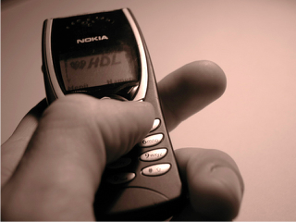
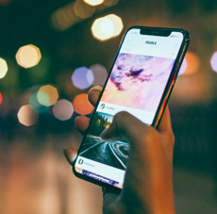
Task 1: Friendships in a digital world
Lesson 1
How have friendships changed in this time period?
‘Sam’
13 year old in 2001
Are these changes positive or negative?
‘Alex’
13 year old in 2021

Slide 7
Lesson 1
Apply Knowledge Task - Helping a friend
Your friend is talking to someone who they met online, but they don’t know if this person is a good friend.
Write a message with three pieces of advice to help them work it out.

Slide 8
Lesson 1
Next steps : Characteristics of good friendships online
Match the good online friendship characteristic to the example of how this could be shown in a friendship online.
Support
1. Asking your friend if you can post a picture of them before uploading it.
2. Knowing that you can share private information with your friend and they won’t share it with their followers.
Kindness
Consent
3. Messaging a friend to check they’re okay after noticing nasty comments of them online.
Trust
4. Telling people to stop sharing an embarrassing photo of your friend.
Notes:
Answers:
1 - Consent
2 - Trust
3 - Kindness (also shows support)
4 - Support (also shows kindness)
Support, consent, trust and kindness

Slide 9
Lesson 2
Learning Objectives
Be able to define Cyberbullying
Identify characteristics of cyberbullying
Identifying places where you can report a problem
Know the steps to take when reporting a problem

Slide 10

Quick Fire Questions
Lesson 2
eSafety is….
Good friendships make you feel….
Bad friendships make you feel….
When thinking of online friendships consent means….

Slide 11
Task 1 – CyberBullying Research
Lesson 2
Definition: Type your definition here
Click here to find out more from Childline
List at least 8 facts about cyber bullying

Slide 12

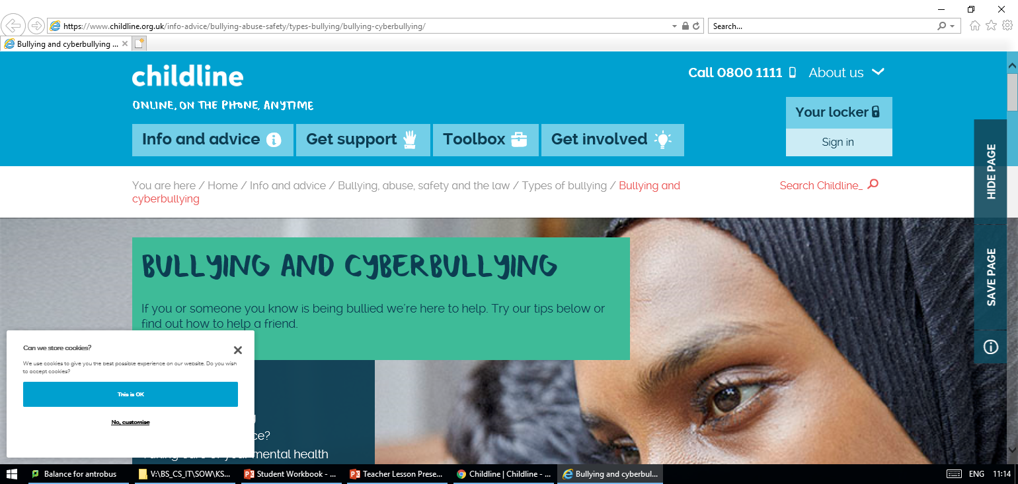
Lesson 2
Apply knowledge task
Seeking help
Explain how these websites can help support young people and how you would report any concerns.

Slide 13
Next steps
Lesson 2
Evaluate the websites we have looked at today
Was the content appropriate for your age, did you understand it
What did you think of the layout and design
What improvements would you make

Slide 14
Lesson 3
Learning Objectives
Understand the terms Audience, Purpose & Fitness for Purpose?
Understand what makes an effective web-site?
Successfully evaluate websites aimed at different target audiences?

Slide 15
Quick Fire Questions
Lesson 3
Cyberbullying is …
Cyberbullying only happens on social media sites?
        False
Only girls experience cyberbullying
        False
If you are worried about cyberbullying or any other eSafety issues you can get advice from…. Trusted adult or a site like Childline

Slide 16
Task 1 – CyberBullying Research
Lesson 3
Website | Target Audience | Purpose of Website | Is the website fit for purpose? Why? Why not? | Is the design of the website effective? Why? Why not? Explanation should include the use of appropriate images, text, layout, hyperlinks and how easy the website is to navigate/use. Is the information reliable? Valid? How do you know?
EXAMPLE http://www.premierleague.com | The target audience for this website is people who are football fans and want information about the Premier League. | The main purpose of this website is to give people information about the Premier League and you can access premier league club websites. Another purpose of the website is to sell things as you can also buy tickets and club merchandise. | I think that this website is fit for purpose because it provides lots of information about each club and you can buy tickets and merchandise for any club. | I think that this website is effective, because: Images – are relevant and eye-catching and they represent the premier league. They are also exciting and good quality. Text – is clear and the easy to read. There is enough text to explain the different sections but not too much to clutter up the page.
http://www.bbc.co.uk/
www.bridgewaterhigh.com
https://disney.co.uk/

Slide 17
Lesson 3
Next steps – Evaluate your favourite websites
Website | Target Audience | Purpose of Website | Is the website fit for purpose? Why? Why not? | Is the design of the website effective? Why? Why not? Explanation should include the use of appropriate images, text, layout, hyperlinks and how easy the website is to navigate/use. Is the information reliable? Valid? How do you know?
IMDB | People who like films, going to the cinema and all things about film characters, music and different genres. | To provide details and interesting facts about films. Also to show trailers and general information. | Yes because it is up-to-date, with pictures and information and is really interesting. | Pictures of film action, lots of text information, links to other pages on the website and also other websites plus easy navigation from page to page.
Own Choice 2
Own Choice 3

Slide 18
Lesson 4 and 5
Learning Objectives
Understand how to structure your E-safety website properly.
Understand why consistent layout is important.
Use a structure chart/storyboard to design an effective and well planned website using a consistent layout.
Take into consideration the audience when designing your website.

Slide 19
Quick Fire Questions
Lesson 4/5
Target audience means…
Fit for purpose means…
One purpose of a website is…
It is important the website is well designed because…

Slide 20
Task 1 - Create a structure chart
Lesson 4/5

Slide 21
Task 2 – Colour schemes and fonts
Lesson 4/5
Colour Scheme - background
Text Colour
Font Style
Font Size – Headings/Titles
Font Size – Body text
Other

Slide 22
Task 3 – Site Map
Lesson 4/5
How will the pages link together
Label the pages
Arrange them appropriately
Draw arrows represent which page links to which
PAGE 1
PAGE 2
PAGE 3
PAGE 4

Slide 23
Task 4 – Content design
Lesson 4/5
Home page

Slide 24
Lesson 4/5
Cyberbullying

Slide 25
Lesson 4/5
Online Friendships

Slide 26
Lesson 4/5
Help and Advice

Slide 27
Lesson 4/5
Next Steps – Peer feedback
I have used the following features in my page design I have designed my website in this way because Complete a Peer review What changes would you now make

Slide 28
Mid Unit Assessment
Learning Objectives
Complete your mid-unit assessment (Link to be shared by your teacher)
Fill in the information on the next slide and highlight which statements you have achieved so far
Complete any unfinished work up until this point

Slide 29
Unit 7.1 Assessment Grid
Fill the targets you think you have achieved with green
ADVANCED | INTERMEDIATE | FOUNDATION
I have created a detailed plan for all E- Safety website pages with a detailed explanation of my design decisions. | I have created a detailed E-Safety website plan with an explanation of some of my design decisions. | I have created a basic E-safety website plan.
The web pages include text and images and I have made comments showing why the text and images are suitable for audience and purpose. | The web pages include text and images that are suitable for audience and purpose. | At least one webpage has text, an image and at least one webpage includes colour.
My website includes consistent colours that are suitable for audience and purpose and I have made evaluative comments about the website and how it is suitable for the target audience. | My website includes consistent colours and layout to all web pages and I have made comments on why they are suitable for audience and purpose. | The website is neat and organised and I have made some comments about my website in an evaluation.
I understand the importance of developing effective online friendships and can describe good and bad friendships and the impact they have on individuals. | I understand online friendships and can describe good and bad friendships. | I understand the term online friendship.
I understand the term cyberbullying and the impact it can have on people. I know how to report any issues I have relating to eSafety. | I can describe the term and give examples of cyberbullying. I can find relevant websites to give me advice. | I understand the term cyberbullying. I know I should speak to an adult if I need help
In my mid unit test I scored
: /20
Which means I am
Developing
Securing
Mastering
Exceeding

Slide 30
Lesson 6 / 7 / 8
Learning Objectives – Using Dreamweaver
Start to learn the skills you will need to start creating your eSafety website.
Be able to choose the most appropriate software for the task.
Use these skills to start to create pages that are suitable for the target audience and fit for purpose
Notes:
Old lesson 5

Slide 31
Quick Fire Questions
Go to your workbook and answer the quick fire questions
Lesson 6
A hyperlink connects to what 3 things ?
A structure chart shows….
Fonts for my website should be…
Colour for my website should be…
What is Navigation
What does consistency mean ?
Why are logos important ?
What does formatting do ?

Slide 32
Lesson 9
Learning Objectives – review / evaluate
Understand why it is important to review/ evaluate your work.
Be able to include strengths, weaknesses and improvements in your review.
Complete the self and peer assessment documents to review your e-safety website.
Make sure your review is detailed enough to master your A/I/F targets …
Notes:
Old lesson 5

Slide 33
Lesson 9
Task Starter – Using Dreamweaver
Open Dreamweaver – then Open New
Use split and New |Document
Starter Templates
Try to edit text and images with your own
from your designs
Check in split screen
Save in Folder
Open from folder to view or
Open in Dreamweaver to edit

Slide 34
Task 1 – Website Evidence
Lesson 9

Slide 35
Task 1 – Website Evidence
Lesson 9

Slide 36
Task 1 – Website Evidence
Lesson 9

Slide 37
Task 1 – Website Evidence
Lesson 9

Slide 38
Task 2 – Self Evaluation
Lesson 9
Explain what you were asked to do for this project and how you think you met the needs of your target audience.
How did you ensure that the text and images you used were suitable for purpose and your target audience?
How did you choose the colour scheme for your website? How did you ensure that the colour scheme you used was suitable for purpose and your target audience?
Discuss why the software you chose to use was the most appropriate for your task.
Now that you have used the software, what was good/bad about it?
What new techniques have you learned during this project?
Did you encounter any problems during the project? If so, how did you overcome them?
What have you particularly enjoyed about this project? What aspects did you not enjoy?
If you had to do the project again, what would you do differently next time?

Slide 39
Task 2 – Self Evaluation
Next steps – Peer Evaluation
Lesson 9
.
Criteria | Y/N | Suggested improvements
Heading on each page?
Suitable images on each page?
Consistent layout (Colours, Fonts etc)
Suitable text on each page? Is it related to the topic?
At least 4 web pages including homepage?
Hyperlinks on each page?
Do the hyperlinks work?
Overall feedback
Mark each section identifying if you think criteria has been met or not (Yes or No) For each section, provide a suggestion which will help to improve their website.
Peer evaluation was completed by:
Date:

Slide 40
End of Unit Assessment
Learning Objectives
Complete your end-of-unit assessment (Link to be shared by your teacher)
Fill in the information on the next slide and highlight which statements you have achieved so far
Complete any unfinished work up until this point

Slide 41
Unit 7.1 Assessment Grid
Fill the targets you think you have achieved with green
ADVANCED | INTERMEDIATE | FOUNDATION
I have created a detailed plan for all E- Safety website pages with a detailed explanation of my design decisions. | I have created a detailed E-Safety website plan with an explanation of some of my design decisions. | I have created a basic E-safety website plan.
The web pages include text and images and I have made comments showing why the text and images are suitable for audience and purpose. | The web pages include text and images that are suitable for audience and purpose. | At least one webpage has text, an image and at least one webpage includes colour.
My website includes consistent colours that are suitable for audience and purpose and I have made evaluative comments about the website and how it is suitable for the target audience. | My website includes consistent colours and layout to all web pages and I have made comments on why they are suitable for audience and purpose. | The website is neat and organised and I have made some comments about my website in an evaluation.
I understand the importance of developing effective online friendships and can describe good and bad friendships and the impact they have on individuals. | I understand online friendships and can describe good and bad friendships. | I understand the term online friendship.
I understand the term cyberbullying and the impact it can have on people. I know how to report any issues I have relating to eSafety. | I can describe the term and give examples of cyberbullying. I can find relevant websites to give me advice. | I understand the term cyberbullying. I know I should speak to an adult if I need help
In my end of unit test I scored
: /20
Which means I am
Developing
Securing
Mastering
Exceeding

