Slide 1
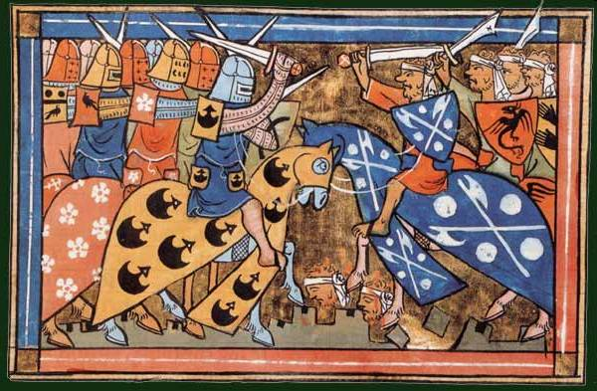
Knowledge Organiser: Year 7 Spring Term 1
Enquiry: : Were the Crusades truly a religious war?
Theme: How far have beliefs led to positive change in History?
What key knowledge do I already have ?
What key knowledge do I need to understand my enquiry question?
Term | Definition
Christianity | The religion based on the person and teachings of Jesus Christ, or its beliefs and practices.
Pope | Head of the Roman Catholic Church. Very influential to as at this time he was the leader of all Christians.
Religious | Links to religion and therefore people’s beliefs.
Cultural | Links to the ideas, customs and arts of a society.
Social | Links to society or how it is organised.
Term | Definition
Mappa Mundi | The largest medieval map which shows the Jerusalem at the centre of the world.
Judaism / Synagogue / Torah | Religion of the Jews, based on the Old Testament. Jews worship in a synagogue. The Jewish Holy book is called the Torah.
Islam / Muslim / Mosque | Religion based on the belief there is one God and Mohammed is his prophet. Followers are called Muslims. The Muslim place of worship is a mosque.
Wailing Wall | Last remaining part of King Herod’s temple. This is important to Jews. It is in Jerusalem.
Rock Mosque | Muslims believe this is the site from where Mohammed visited heaven. It is in Jerusalem.
Church of the Holy Sepulchre | Christians believe this is the site where Jesus was buried. It is in Jerusalem.
Cross | The cross is the symbol of Christianity. This was often displayed by the Christian crusaders.
Pope Urban | The Pope who called on Christians to seize Jerusalem from the Turkish Muslims.
Saladin | Leader of the Muslim armies after 1176.
Richard the Lionheart | King of England who led the Third Crusade
Saracens | The word used by Christian crusaders to describe Muslims.
Franks | The word used by Muslims to describe Christians.
Avicenna | Physician whose methods influenced medicine throughout the Crusades. Has been called the ‘father of modern medicine’.
Astrolabe | Instrument used to measure the altitude of stars and planets. It could also be used to help tell the time.
Trebuchet | A large catapult filled with rocks. Often used to attack a castle.
Concentric Castles | Castle with a second outside wall mirroring the first. Made it much harder for invaders to attack. E.g Beaumaris castle.
Key knowledge I will need in this and future topics:
Term | Definition
Holy Land | Religious area of the Middle East. Most important area is what we now call Jerusalem.
Christianity | See above
Crusades | Religious wars fought between Muslims and Christians for control of Jerusalem.
Pope | See above
Pilgrimage | A religious journey, for example some people went to the Holy Land on pilgrimage. People who go on a pilgrimage are called pilgrims.

