Slide 1
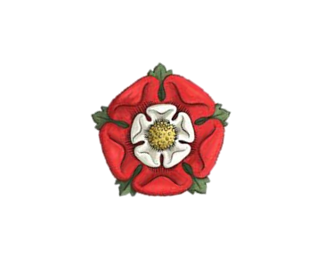
Knowledge Organiser: Year 7 Summer Term 1
Enquiry: : What was the impact of Henry VII’s win at Bosworth?
Theme: How far is war a catalyst for change?
What key knowledge do I already have?
What key knowledge do I need to understand my enquiry question?
Term | Definition
Monarch | A term for the king or queen.
Baron / noble | An important and influential person – often had a lot of land. In this unit a key noble is Lord Stanley who plays a key role in the Battle of Bosworth.
Heir | A person who is legally allowed to take the rank and property of someone who has died. For example, Henry VIII was the heir of Henry VII.
Legacy | What has been left behind or passed on. For example, the Domesday book and stone castles were a legacy of William I.
Succession | Inheriting land, property or a title.
Political | Links to the government or how the country is run
Term | Definition
Wars of the Roses | A series of battles fought in medieval England from 1455 to 1485 between the House of Lancaster and the House of York.
Yorkist | A supporter of the House of York. 1st Monarch was Richard II. Symbol was a white rose.
Lancastrians | A supporter of the House of Lancaster. 1st monarch was Edward IV. Symbol was a red rose.
Usurper | A person who takes a position of power illegally or by force. Both Richard III and Henry VII were arguably usurpers of the throne.
Richard III | Brother of Edward IV. Usurped the throne in 1485. Controversy surrounds him regarding the ‘Princes in the Tower’. Was killed at the Battle of Bosworth.
‘Pretenders to the throne’ | People who lie and claim they have a claim to be King. Two pretenders to the throne that challenged Henry VII were Lambert Simnel and Perkin Warbeck
Finance | The management of large sums of money.
Bonds | A sum of money a person is forced to pay. This was so high it ensured their loyalty. Used by Henry on nobles.
Acts of Attainders | Where the King says somebody is guilty of a crime and sentences them without a trial. Often leads to a loss of title and property. Use by Henry on the nobles.
Symbolism | The use of symbols to represent ideas or qualities. For example, the Tudor Rose.
Alliances | A relationship is formed between people or countries with similar aims e.g. to fight a war or to trade. Henry VII created alliances with other countries to get acceptance of the Tudors as the ruling family of England.
Key Knowledge I need for this and future units.
Term | Definition
Battle of Bosworth | The name of the battle between King Richard III and Henry Tudor for the throne.
Consolidation | The action or process of making something stronger or more solid.
Henry Tudor | Henry had a distant claim to the throne. Landed at Milford Haven in 1485 and challenged Richard III at the Battle of Bosworth. Was victorious and became King Henry VII and started the reign of the Tudors.

