Slide 1
Year 7 Revision
Weekly classes: Please use all slides
Fortnightly classes: refer to the units of work we have studied only: WW2/ Dance alphabet

Slide 2
Subject Dance | Year 7 | Autumn: Half term 1 | Topic: EPA for Change
Key Performance Skills
1 | Timing | How well a dancer can find the beat in the music and is in time with musical and other dancers cues | The use of time or counts when matching movements to sound and/or other dancers.
2 | Projection | The energy the dancer uses to connect with and draw in the audience. Making movements bigger to invite the audience in. | An interpretative performance skill that is used to help portray a character/ mood or story.
3 | Sense of style | This is how a dancer interprets the stylistic features of the style of dance or music. | The stylistic features of Lion King is musical theatre.
4 | Focus | Focus is where you are looking when doing certain movements | This can draw the audience to an important point you want to communicate
5 | Facial expressions | Use of face to show mood/ character or story | An interpretative performance skill that helps to communicate a story/character/ theme/ mood.
Key words
Canon | The same movement repeated one after the other | A choreography tool – RELATIONSHIPS- that creates different effects in a group dance
Formation | Standing in a circle, triangle, line and square | Shapes or patterns created in space by dancers.
Pathways | Circular, crossing over and direct | Designs traced in space (on the floor or in the air).
Transitions | Linking movements | Used as a tool to link together movement, sections, phrases and changes in formation
Movement memory | A physical representation of the memory of the movement of a dance | A mental performance skill that exercises both the mind and the body. Use of repetitive rehearsal can improve this.
Key Physical Skills
1 | Extension | Lengthening one or more muscles/limbs. | A physical performance skill that is shown best in both arms and legs.
2 | Co-ordination | Moving one or more body parts at once. | The efficient combination of body parts.
3 | Balance | On one body part, in a shape, and with another dancer | A steady or held position achieved by an even distribution of weight.
4 | Control | Control of your body or body parts while dancing | The ability to start and stop movement, change direction and hold a shape efficiently.
5 | Action accuracy | Jump, turn, gesture, stillness, leap, fall, lunge, kneel, roll, slide, punch, kick, contract, plie, push and pull. | What a dancer does eg travelling, turning, elevation, gesture, stillness, use of body parts, floor-work and the transference of weight.
6 | Space accuracy | Levels, directions, pathways, shapes, designs and patterns. | A design traced in space (on the floor or in the air).
7 | Dynamic accuracy | Fast, slow, smooth, jerky, soft, controlled, sharp, swing, fall and flick | The qualities of movement based upon variations in speed, strength and flow.

Slide 3
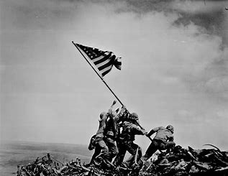
Subject Dance | Year 7 | Autumn: Half term 2 | Topic: WW2
Key Choreography Skills
Improvisation | Exploration or generation of movements without planning. | Selecting appropriates movements to communicate going to war, front line and the blitz.
EFGSTT | 6 basic dance actions: Elevate/ Fall/ Gesture/ Stillness/ Travel/ Turn | A choreography tool- ACTIONS- The 6 basic actions used as much as possible to create variety in a dance piece
Space | Levels, directions, pathways, shapes, designs and patterns. | SPACE: A design traced in space (on the floor or in the air).
Dynamics | Fast, slow, smooth, jerky, soft, controlled, sharp, swing, fall and flick | DYNAMICS: The qualities of movement based upon variations in speed, strength and flow.
Levels | High – jumping Medium – Plie and lunge Low – Rolling and floorwork | SPACE: Distance from the ground: low, medium or high.
Transitions | Linking movements | STRUCTURE: Used as a tool to link together movement, sections, phrases and changes in formation
Rehearsal | Working with your group to aid movement memory. | Attributes and skills required for refining performance such as commitment, systematic repetition, teamwork, responsibility and effective use of time.
Key movements
1 | Elevate | Jump/ hop/ leap
2 | Fall | Movement away from your centre body line
3 | Gesture | Movement that does not hold any weight, e.g. an arm movement, head nod, shoulder shrug
4 | Stillness | A movement of still ness to create an effect, this is usually done in a particular position to highlight the theme/ story of the dance but can also show the physical skill of balance.
5 | Travel | Ways of moving across the space/ turn/ run/ hop/ roll/ cartwheel/ jump/ lift
6 | Turn | A change of direction when moving, e.g. ½ / ¼ or full turn.
Command Words
1 | How | In what way or manner, by what means
2 | Who | Giving further information about a story, person or people
3 | What | Asking for information specifying one or more people or things from a definite set.
4 | Why | Giving a reason or explanation to support the answer of the question.

Slide 4
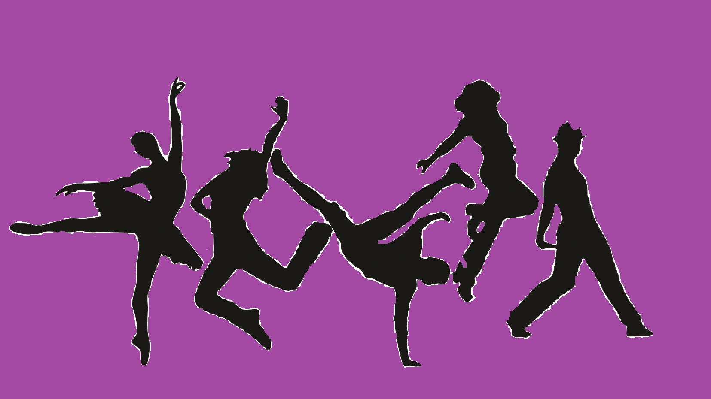
Subject Dance | Year 7 | Spring: Half term 2 | Topic: Dance Alphabet
Key Choreography Skills
Dance by chance | Using letters with corresponding actions to make words | A choreography approach which uses chance to link together movements
Improvisation | Exploration or generation of movements without planning. | Selecting appropriate movements to give variety to a dance or to link to a given theme/ dance idea.
EFGSTT | 6 basic dance actions: Elevate/ Fall/ Gesture/ Stillness/ Travel/ Turn | A choreography tool- ACTIONS- The 6 basic actions used as much as possible to create variety in a dance piece
Space | Levels, directions, pathways, shapes, designs and patterns. | SPACE: A design traced in space (on the floor or in the air).
Dynamics | Fast, slow, smooth, jerky, soft, controlled, sharp, swing, fall and flick | DYNAMICS: The qualities of movement based upon variations in speed, strength and flow.
Levels | High – jumping Medium – Plie and lunge Low – Rolling and floorwork | SPACE: Distance from the ground: low, medium or high.
Transitions | Linking movements | STRUCTURE: Used as a tool to link together movement, sections, phrases and changes in formation
Pathways | Circular, crossing over and direct | SPACE: Designs traced in space (on the floor or in the air).
Rehearsal | Working with your group to aid movement memory. | Attributes and skills required for refining performance such as commitment, systematic repetition, teamwork, responsibility and effective use of time.
Key movements
Elevate | Jump/ hop/ leap
Fall | Movement away from your centre body line
Gesture | Movement that does not hold any weight, e.g. an arm movement, head nod, shoulder shrug
Stillness | A movement of still ness to create an effect, this is usually done in a particular position to highlight the theme/ story of the dance but can also show the physical skill of balance.
Travel | Ways of moving across the space/ turn/ run/ hop/ roll/ cartwheel/ jump/ lift
Turn | A change of direction when moving, e.g. ½ / ¼ or full turn.

Slide 5
Subject Dance | Year 7 | Spring: Half term 1 | Topic: Bugsy Malone
Key Performance Skills
Characterisation | Adapting your body and dance movements to show that you are a ‘bad guy’. Over confident attitude, head held high and comedic moments in the dance. | Using your body to communicate a different character
Timing | Counting the beats in the music. | The use of time or counts when matching movements to sound and/or other dancers.
Musicality | Matching the lyrics and movements in the bad guys song. | The ability to make the unique qualities of the music evident in performance.
Rehearsal | Working with your group to aid movement memory. | Attributes and skills required for refining performance such as commitment, systematic repetition, teamwork, responsibility and effective use of time.
Key movements
1 | Tableau | A dance freeze frame where dancers are on different levels, held in a position.
2 | Jazz hands | Shaking of the hands with fingers spread out.
3 | Box step | 4 beat stepping pattern in a square
4 | Egyptian arms | Angular arm gestures
5 | Wobble knees | Knocking of knees together
6 | Gesture with the hat | Holding and flicking a hat to the beat
7 | Gallops | Sideways step
8 | Kneel down | Kneeling on to the floor
9 | Sway | Transference of weight in a leaning
10 | Look over the shoulder | A exaggerated look to the side
Key Physical Skills
1 | Extension | Lengthening one or more muscles/limbs. | A physical performance skill that is shown best in both arms and legs.
2 | Co-ordination | Moving one or more body parts at once. | The efficient combination of body parts.
3 | Balance | On one body part, in a shape, and with another dancer | A steady or held position achieved by an even distribution of weight.
4 | Control | Control of your body or body parts while dancing | The ability to start and stop movement, change direction and hold a shape efficiently.
5 | Action accuracy | Jump, turn, gesture, stillness, leap, fall, lunge, kneel, roll, slide, punch, kick, contract, plie, push and pull. | What a dancer does e.g. travelling, turning, elevation, gesture, stillness, use of body parts, floor-work and the transference of weight.
6 | Space accuracy | Levels, directions, pathways, shapes, designs and patterns. | A design traced in space (on the floor or in the air).
7 | Dynamic accuracy | Fast, slow, smooth, jerky, soft, controlled, sharp, swing, fall and flick | The qualities of movement based upon variations in speed, strength and flow.

Slide 6
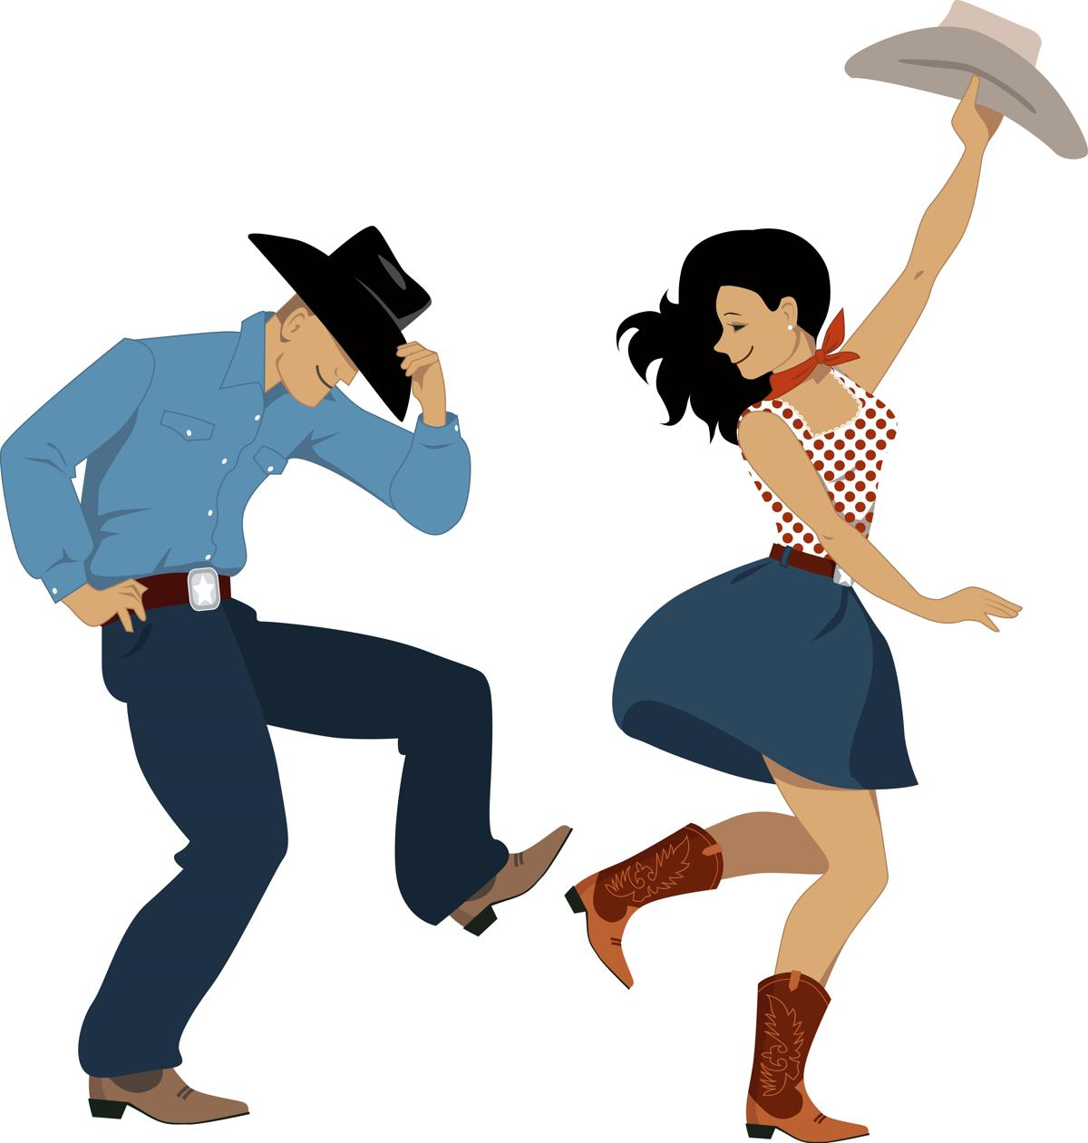
Subject Dance | Year 7 | Summer: Half term 1 | Topic: American Hoedown
Key movements
Heel taps | Stepping your heels in a pattern
Do-si-do | Partner movement where to pass your partner and loop around their backs.
Swing your partner | Linking arm movement rotating around each other.
Gallop | Sideways movement
Jumps | Jumping with your feet together and apart
Lasso | Arm gesture of swinging a rope
Grapevine | Stepping pattern to the side. Side, behind, side and jump.
Cabriole | A step where you lift your legs to the side of your body through jumping and click your heels together
Two step | A step to do alone or with a partner: 4 steps- quick quick, slow, slow like you are walking
Cupid Shuffle | A squared step: 4 heel taps in front, a rock steps *8 travelling to one side, repeat travelling to the opposite side and then 8 rock walks on the sport to do a quarter turn to face a different direction
Cowboy boogie | Step behind side front hitch, repeat on opposite sidestep forwards hitch, forwards hitch, step back *3 hitch. Boogie forward *2, back *2, forward back boogie step hitch ½ OR ¼ turn. Repeat facing new direction.
Tush Push | Heel tap, in double heel, repeat. Alternate heel taps *3, Clap. Boogie forward *2 back *2. Body roll. Cha cha cha step forwards (step together step, opposite leg forwards back) repeat travelling back. 4 steps to do a turn (1/4OR ½)
Key Choreography Skills
Relationships | The use of who you dance with, in terms of dancers, formations, music and groupings. | These are RELATIONSHIPS between dancers, music and where you dance.
Levels | Changing the level of a movement e.g. from high to low | SPACE: different level/ heights created in space by dancers.
Longways set | A large group of dancers standing in two lines facing each other | SPACE: A formation that is used in barn dancing
Pathways | Circular, crossing over and direct | SPACE: Designs traced in space (on the floor or in the air).
Crossing pathways | Using travelling movements to cross through each others formation | SPACE: Designs traced in space on the floor
Groupings | Solo, duet, trios and quartets | RELATIONSHIPS: Using different groupings in a dance makes the relationships look more effective.
Canon | The same movement repeated one after the other | RELATIONSHIPS: A choreography tool – that creates different effects in a group dance
Call and response | Where one dancer moves and the another replies. This approach is similar to a conversation. | RELATIONSHIPS: A choreographic approach used mainly in Indian dance.
Repetition | Doing a part of a dance or a movement again | ACTION: A choreography tool repeating actions that show the style/ dance idea
Transitions | The linking of steps or sections of a dance | STRUCTURE:A choreography tool to ensure that the dance links together seamlessly
Command Words
1 | How | In what way or manner, by what means
2 | Who | Giving further information about a story, person or people
3 | What | Asking for information specifying one or more people or things from a definite set.
4 | Why | Giving a reason or explanation to support the answer of the question.

