Slide 1
Health and Fitness Knowledge Organiser Year 7-9
Honesty
Courage
Self-motivate
Responsibility
Resilience
Integrity
Self-discipline
Self-belief

Slide 2
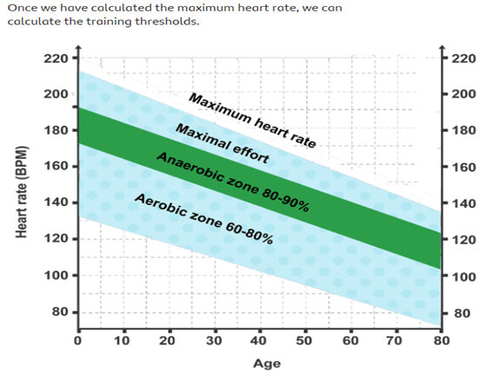
Subject | Year 8 | Term | Topic:-health and Fitness
Name of Topic:- Training Methods
1 | Interval Training | Training that involves set periods of work followed by set periods of rest.
2 | Continuous Training Cooper Run Cross Country | Exercising for a sustained period of time without rest A fitness test in which you try to cover as much distance as possible in 12 minutes. Individual runs a race over natural terrain such as the playing fields.
3 | Circuit Training | A series of exercises performed one after the other with a rest in between. Each circuit involves different activities called ‘stations’.
4 | Fartlek Training | Also known as ‘speed play’, this type of training involves performers varying their speed / intensity.
Year 8
 | Aerobic Training is the ability to train/exercise with the presence of oxygen Anaerobic training is the ability to train/exercise without the presence of Oxygen
F.I.T.T Principles of training
 | Principles of Overload (F.I.T.T) : Works with the principle of PROGRESSIVE OVERLOAD. F = Frequency –refers to how often someone trains.. I = Intensity - how hard a performer trains e.g. how fast they run. T = Time - refers to how long you train for. T = Type -refers to the type of training used.
Sets and Reps
 | Rep (repetition) is one complete motion of an exercise. Set is a group of consecutive repetitions. For example, you can say, “I did two sets of ten reps on the chest press.” This means that you did ten consecutive chest presses, rested, and then did another ten chest presses.
Command Words
1 | Name | Recall one or more pieces of information.
2 | State | Write down what the term in the question means.
3 | Give | Recall one or more pieces of information.
4 | Describe | Give an account in words of someone or something including all of the relevant characteristics, qualities or events.
5 | Explain | Make an idea, situation or problem clear by describing it in detail revealing relevant data or facts
6 | How | Discuss the creation of something giving specific references to support.

Slide 3
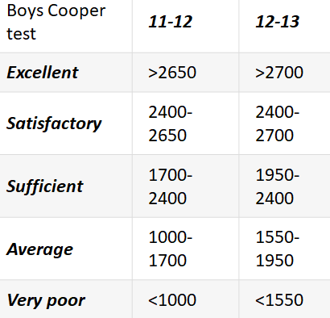
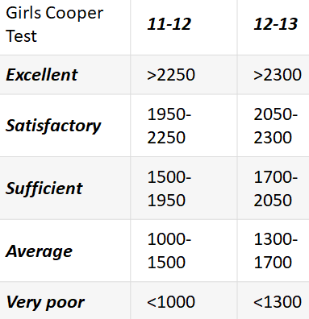
Subject | Year 8 | Term | Topic:-health and Fitness
Year 8
 | Principles of Training (S.P.O.R.T): S = Specificity Training should be specific to the needs of an individual and demands of the sport that they take part in. PO = Progressive Overload Working harder than normal whilst gradually and sensibly increasing the intensity of training. R = Reversibility If an individual stops or decreases their training level, then fitness and performance are likely to drop. T = Tedium Tedium refers to boredom. Training should be altered and varied to prevent an individual from getting bored and demotivated.

