Slide 1
ICT | Year 7 | Autumn Term | E-Safety/web Design
Topic – E-Safety
1 | Blog | A personal website on which a person records their opinions.
2 | Chatroom | A ‘virtual room’ where users can ‘talk’ with each other by typing.
3 | Online friendships | Characteristics of good online friendships include Support, consent, trust and kindness
4 | Cyberbullying | Bullying that takes place using digital/electronic devices.
5 | Cyberstalking | Stalking someone online.
6 | Cyberspace | A term for the Internet which is often viewed as a virtual world.
7 | Fabotage | A slang word for ‘Facebook Sabotage’.
8 | Filter | Preventing certain types of material from reaching your PC.
Topic – E-Safety
9 | Firewall | A program that helps stop hackers, viruses and worms reach your PC.
10 | Flaming | Sending an offensive message to a specific person over the Internet.
11 | Forum | An online discussion group, like a chat room.
12 | Griefing | A player in an online game deliberately irritates other players.
13 | Hacker | People who gain unauthorised access to data using a computer.
14 | Malware | ‘Malicious software’, programs that damage your computer.
15 | Troll | A person who posts inflammatory comments in an online community.
16 | Zipit | Made by Childline. The app helps teenagers deal with difficult sexting and flirting situations.
Knowledge Organiser
Topic – Features of a well-designed website
1 | The website meets the needs of the target audience.
2 | The website is fit for the purpose intended e.g. to sell things, to entertain, to provide information etc.
3 | The images on the website are effective, of good quality and are appropriate for the target audience.
4 | The text/information on the website is concise, of good quality and is appropriate for the target audience.
Topic – Features of a well-designed website
5 | The layout of the website is efficient and intuitive.
6 | The hyperlinks and navigation features on the website make it easy for the target audience to use.
7 | The website has an appropriate ‘house-style’ and effective colour scheme that meets the needs of the target audience
8 | The information provided on the website is up-to-date, reliable and valid.
Command Words
1 | State | Give a specific name or value without explanation or calculation.
2 | Give | Present information which determines the importance of an event or issue.
3 | Describe | Give a detailed account of a situation, event, pattern or process
4 | Explain | Give a detailed account including reasons or causes.
5 | Evaluate | Assess the implications and limitations; to make judgements about the ideas, works, solutions or methods in relation to selected criteria
Key Words
1 | E-Safety is ….. | Making sure that YOU are protected from harm when using the Internet and other technology and YOU get the maximum benefit when using any technology without risk to yourself or others.
2 | Target Audience | A group of people at which the website is aimed e.g. teenage girls
3 | Purpose | The reason for which the website has been created e.g. to entertain
4 | Intuitive | Easy to use and understand
5 | House-style | A preferred way to present/layout digital material
Notes:
Knowledge Organiser

Slide 2
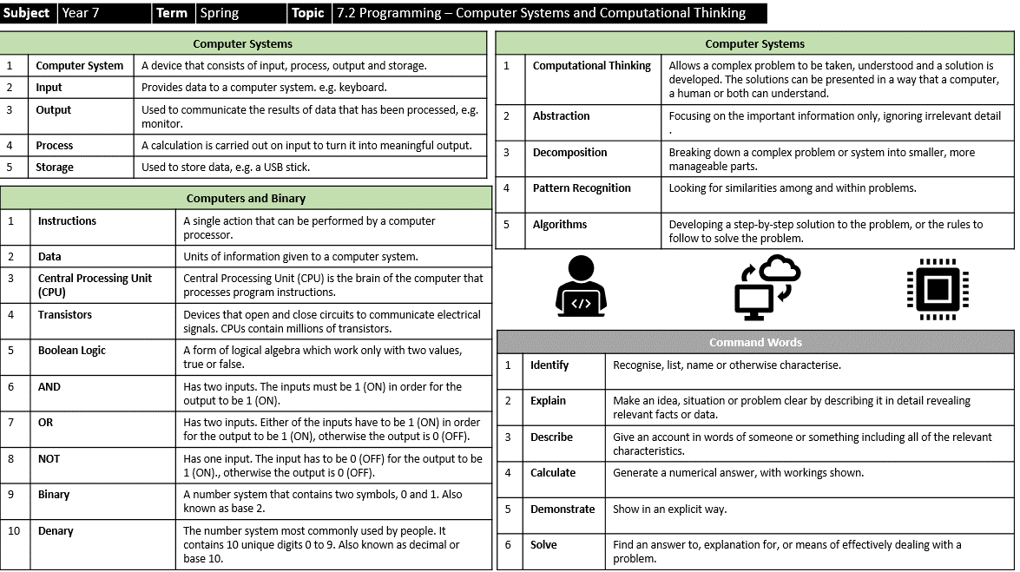
Knowledge Organiser
Notes:
Knowledge Organiser

Slide 3
GOODS are physical products such as a Mars bar or a mobile phone.
SERVICES are things that are provided such as hair dressing, car cleaning, dog walking.
An ENTERPRISE is simply another name for a business.
A business AIM is the overall target or goal of the business it can be financial or non-financial.
A BRAND can be defined as: a name, term, design, symbol or any other feature that identifies a product.
Images
Bitmap | A digital image that is made up of a series of pixels.
Pixel | A pixel is a small square part of an image that can store binary values which represent a certain (intensity of) colour.
Colour depth | The number of colours that can be represented in each pixel.
Binary | The natural language of the computer where data can only be in one of two states (ON and OFF) or (1 and 0)
Resolution | The number of pixels that can be stored per inch.
DATA REPRESENTATION | Digital images are made up of pixels. Each pixel in an image is made up of binary numbers.
Methods of Promotion & advertising
Television Adverts
Radio Adverts
Social Media – Posts, Own Channel
Print – leaflets, newspapers, magazines
The target market is who you want to sell your goods or services to. ​This will be a specific market segment or group of customers with similar characteristics
e.g. males, aged 12-16.
Demographic – based on age or cultural background
​Geographic – based on country, region or local area where you live

Slide 4
ICT | Year 8 | Autumn Term | Cybersecurity/Web Design
Topic – Cybersecurity (Malware)
Malware – malicious software
1 | Virus | Replicated by reproducing itself or infecting other programs by modifying them.
2 | Trojan | Used to hack into a computer by misleading the user of its true intent.
3 | Spyware | Software that aims to gather information about a person without their knowledge.
4 | Adware | Software that presents unwanted advertisements to the user’s computer. Adware is not illegal.
Topic – Cybersecurity (Social Engineering)
Social Engineering – is a set of methods criminals used to trick us into handing over information like passwords and credit card details
1 | Blagging | Using an invented situation to engage a victim to gain personal information. E.g. Nigerian Prince scam
2 | Phishing | When a user is sent a fake email that looks like it is from a bank/business hoping to gather personal information.
3 | Pharming | An attack intended to direct a website’s traffic to another fake site by hacking a DNS server or redirecting the computer electronically.
4 | Shouldering | A simple way to get passwords/PIN numbers by criminals standing behind you and watching.
Topic – Cybersecurity (Prevention)
Biometrics | Using something that is unique to a person to unlock a device eg fingerprint | Passwords | Using a secret word to unlock a device – must include numbers/special characters | CAPTCHA | A test that a human can pass but a computer program cannot
Penetration Testing | ‘Ethical Hacking’ - Testing a computer systems to find security vulnerabilities | Firewall | Software to help protect a computer network from unauthorised access | Encryption | Used to scramble information so that it can be sent safely over the Internet
Topic – Features of a well-designed website
1 | The website meets the needs of the target audience.
2 | The website is fit for the purpose intended e.g. to sell things, to entertain, to provide information etc.
3 | The images on the website are effective, of good quality and are appropriate for the target audience.
4 | The text/information on the website is concise, of good quality and is appropriate for the target audience.
Important things I learned last year
Online friendships | Characteristics of good online friendships include Support, consent, trust and kindness
Cyberbullying | Bullying that takes place using digital/electronic devices.
eSafety is | Making sure that YOU are protected from harm when using the Internet and other technology and YOU get the maximum benefit when using any technology without risk to yourself or others.
Command Words
1 | State | Give a specific name or value without explanation or calculation.
2 | Give | Present information which determines the importance of an event or issue.
3 | Describe | Give a detailed account of a situation, event, pattern or process
4 | Explain | Give a detailed account including reasons or causes.
5 | Evaluate | Assess the implications and limitations; to make judgements about the ideas, works, solutions or methods in relation to selected criteria
Key Words
1 | Cybersecurity | Cybersecurity is the branch of Computer Science that deals with online threats, how to keep data safe and preventing cybercrime (criminal activity carried out using a computer/computer networks)
2 | Target Audience | A group of people at which the website is aimed e.g. teenage girls
3 | Purpose | The reason for which the website has been created e.g. to entertain
4 | Intuitive | Easy to use and understand
5 | House-style | A preferred way to present/layout digital material

Slide 5
Revision Tips – How Can I Revise?
Use Online Resources
You Tube has lots of helpful video clips of how to answer questions. BBC Bitesize is interactive and colourful. The revision pages are short, snappy and you can test yourself.
Index Cards
Write notes on index cards to keep all of your ideas connected. This will make it easier to revise a part of a topic.
Just a Minute
With a friend take it in turns talking about a topic for a minute. Think about what was said and how you can add extra ideas.
Use Your Phone
Use your microphone to record yourself speaking about your topic and play it back to yourself. You may want to listen to important facts on the bus or on your walk to school.
Quiz
Attempt revision quizzes online about your topic.
Post-It Notes
Write down as many facts or key terms as you can remember about a topic.
Make Useful Notes
Write notes down about key terms and key concepts covered. Use a highlighter to pick out key words to help you find facts faster.
Mind Maps
Write down all the key concepts you have learned in a topic.
Presentations
Create presentations about the topic to explain key concepts.

