Slide 1
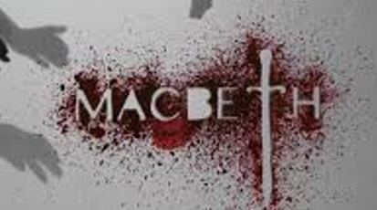
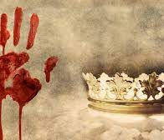
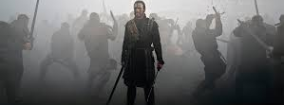
Macbeth MT Feedback
By William Shakespeare

Slide 2
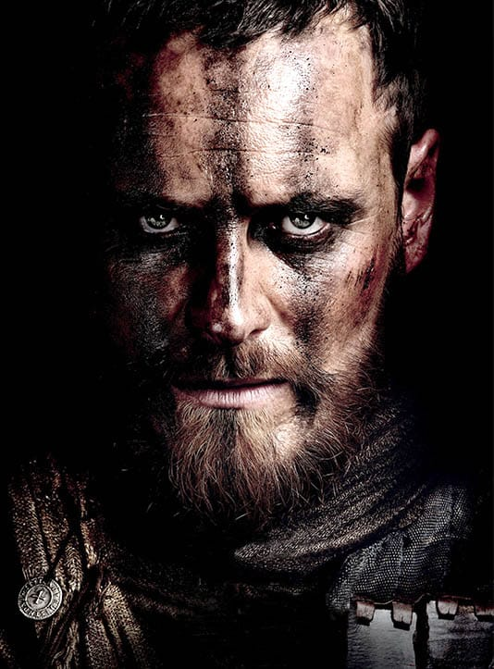
QMA Question:
How does Shakespeare present the character Macbeth in the play ‘Macbeth’?

Slide 3
How does Shakespeare present Macbeth throughout the play?
Aim for 5-6 PETAL chains
Cover the development of his character from the beginning of the play until the end
ZOOM analysis
Identify Shakespeare’s writing techniques and explain their effects
Shakespearean tragedy- can you link 2-3 points to Macbeth’s character?
Proofread and double check your work carefully

Slide 4
Model PEA chain
Macbeth is shown to be under the influences of the witches. This has been suggested in the quotation “Though marshell’st me the way I was going”. The verb “marshall’st” is a reference to the witches leading him to Duncan’s room to murder him, and hints at supernatural forces at work. This could prompt sympathy for Macbeth, as he is being manipulated by the witches into an act he does not wish commit, but it could also show Macbeth as weak-minded, as he is able to commit an horrendous crime with little persuasion.

Slide 5
Objectives:
To record all you remember about Macbeth and develop your understanding of how he is presented?
To recap the main elements of tragedy and consider which link to Macbeth’s character

Slide 6
How does Shakespeare want us to feel about Macbeth?
As a writer, Shakespeare influences how we feel about each character.
By selecting the right language and describing the right actions, Shakespeare completely transforms Macbeth’s character by the end of the play.
In your QMA you will be asked to show how Macbeth changes and why?

Slide 7
What can you remember about Macbeth?
Start
Middle
End

Slide 8
Macbeth:
At the start of the play, Macbeth is presented as a 'brave' warrior who is loyal to his king-he doesn't seem to want more power than he has
In the middle of the play Macbeth has been manipulated by Lady Macbeth, has killed the king and trusts no one
By the end of the play, Macbeth has been transformed into a vicious, blood-thirsty tyrant who will stop at nothing to keep his crown

Slide 9
Let's start at the beginning:
How does Shakespeare present the character Macbeth at the start of the play?

Slide 10
Point: 1 At the start of the play, Macbeth is seen as respected and fierce warrior…
Meaning?
Effect on the audience?
‘For brave Macbeth--well he deserves that name’--
Zoom

Slide 11
In the exposition, Macbeth is presented as a brave warrior. Macbeth is described to King Duncan as “brave Macbeth… well he deserves that name…”. This tells us that Macbeth has fought without fear for Scotland and that nothing has phased him. The use of the adjective “brave” tells us that he perhaps has the reputation of being completely fearless. We are impressed by Macbeth’s loyalty to his country and his King.

Slide 12
Point 2: When Macbeth meets the witches, who tell him he is to be king, he is tempted by the power.
Meaning?
Effect on the audience?
“what greatness is promised thee”
Zoom

Slide 13
Point 3: Upon telling Lady Macbeth, he is manipulated her.
Meaning?
Effect on the audience?
“when you durst do it, then you were a man”
Zoom

Slide 14
Point 4: After murdering Duncan, Macbeth is overcome by guilt. (Dramatic transformation from ‘brave Macbeth’)
Meaning?
Effect on the audience?
“Sleep no more! Macbeth hath murdered sleep.”
Zoom

Slide 15
Point 5: Upon murdering his close ally Banquo, Macbeth, the tyrant, is terrified by his ghostly return…
Meaning?
Effect on the audience?
‘Thy bones are marrowless, thy blood is cold;’
Zoom
Zoom
Link to tragedy? Supernatural elements?

Slide 16
Point 6: After being visited by ghostly apparitions, Macbeth feels invincible…
Meaning?
Effect on the audience?
“None of woman born shall harm Macbeth”
Zoom
Link to tragedy? Supernatural elements?

Slide 17
Point 7: After the death of his wife, Macbeth has lost all of his humanity”
Meaning?
Effect on the audience?
“she should have died thereafter” (she would have died at some point anyway)
Zoom

Slide 18
Point 8: At the conclusion of the play, Macbeth is shown to have delivered a self-fulfilled prophecy”
Meaning?
Effect on the audience?
“Macduff was from his mother’s womb untimely ripped”
Zoom

Slide 19
Using the notes in your books and the extracts, make notes on the following: Think about what Shakespeare wants us to know and how we are supposed to react.
Macbeth the warrior…
Macbeth meets the witches…
Macbeth wants to be king...?

Slide 20
Soliloquy | An act of speaking one's thoughts aloud when by oneself or regardless of any hearers, especially by a character in a play.
Aside | A remark or passage in a play that is intended to be heard by the audience but unheard by the other characters in the play.
Metaphor | A figure of speech, which is not literal
Dramatic Irony | When the audience knows information the characters do not.
Hamartia | A fatal flaw leading to the downfall of a tragic hero or heroine.

Slide 21
How to boost your language analysis

Slide 23
Now plan two PETAL chains using your notes on Macbeth at the start of the play
•Point-
•Evidence-
•Technique-
•Analyse-meaning, zoom, effect on the audience
•Link-

Slide 24
Now practise writing a PETAL chain in full:
Shakespeare first presents Macbeth as …................ By describing Macbeth as '….........' , Shakespeare shows us....................
The use of the word/ metaphor/ verb/ adjective '…..............' allows us to understand how.............and as an audience we react with.................because...................Macbeth at this point in the play is.........

