Slide 1
THE BRIDGEWATER BATON
English

Slide 2
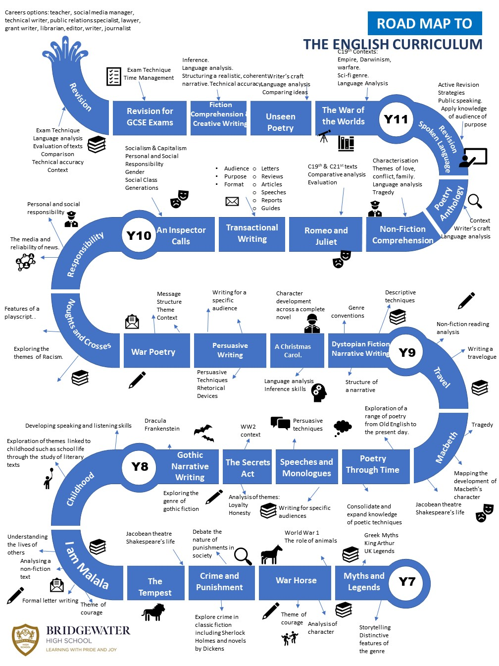
The Bridgewater journey in English
Our “Roadmap” for this subject:

Slide 3
The Bridgewater journey in English
KS3 in particular:

Slide 4
Further information for English can be found at:
Within the CURRICULUM INFORMATION table there are links to each subject’s:
Curriculum Intent statement
Curriculum map
Road map
Assessment statements
https://bridgewaterhigh.org/key-stage-3-subjects/

Slide 5
Our Curriculum Intent for English at Bridgewater states that:
At Bridgewater, we are committed to providing a curriculum that is broad, balanced, and challenging, which also builds rich knowledge and develops skills which prepare students for their next steps in education, training and employment.
The English faculty aims to support this by providing a curriculum that meets the diverse needs of individual students whilst fostering a love of reading. We understand that reading underpins the basis of all learning and, therefore, use English lessons to create ambitious and aspiring readers. This love is then supported with outside of the classroom experiences which develop skills and encourage students to pursue this love through wider avenues.
Bridgewater students join the school with higher than average levels of attainment and the majority move onto A-Levels and University. Our curriculum is designed around making that route accessible for all, through careful planning and sequencing of the curriculum and choice of texts studied at both Key Stage 3 and Key Stage 4.
As an academic school that is inclusive of every pupil, the English curriculum aims to deliver the key skills required to be successful in the challenging English exams but also to develop a plethora of skills that students will be able to use in their everyday life once leaving school. We also aim to support students who through their SEND needs may be unable to access GCSEs, ensuring that, where possible, they leave school with an English qualification.

Slide 6
The Locally Agreed Syllabus for KS2 for English is too huge to include here, so instead here are some thoughts on how we can work together:
We know how hard primary school staff work to ensure pupils are ready for high school and we are keen to bridge the transition gap in any way we can.
We can aim to prevent the transition dip at Bridgewater by:
Increasing staff awareness of how able and independent most pupils are when they finish Y6
Using the terminology used by primary school teachers to aid progression through common language
Raising staff expectations of what Y7 can achieve
More collaboration between primary staff and English staff at Bridgewater to create a strong network for improvement

Slide 7
Further contact for you in English
We are pleased to offer the following to support your English provision and transition:
Teacher visits to meet with your staff to discuss transition issues
Teacher visits to observe Y5 or 6 lessons to see how we can continue to challenge pupils and maintain progress momentum
Pupil visits to our library linked to a KS2/3 reading club
CONTACT – Kelly Jarvis KS3 Coordinator of English
k.jarvis@bridgewaterhigh.com

