Slide 1
Year 7 Assessment Week Revision and Preparation guide
Section A and B of the assessment will be multiple choice – you will need to revise from the Knowledge Organisers in this presentation.
Section C will be a 30 minute timed observation drawing of a glass bottle- to prepare for this, you will need to practise drawing bottles and adding tone to your drawings using pencil, to create a realistic drawing that looks 3D.

Slide 2
Art and Design | Year 7 | Summer | Creative Creatures
Key Words- Art and Design
1 | Collage | Sticking different materials or images onto a surface to create a new image.
2 | Ceramics | Pots and other articles made from clay hardened by heat
3 | 3 D | A form that has height, width and depth Eg. A sculpture.
4 | Design | A plan or drawing that is produced before something is made.
5 | Illustration | Pictures that describe a story.
6 | Imagination | Something made up, not real
Materials / Tools
1 | Clay Tools | Instruments used when working with clay
2 | Clay | A natural substance that can be moulded when wet, and is dried and baked to make bricks, pottery, and ceramics.
3 | Glazes | A liquid material that is applied to a ceramic object to add colour.
4 | Oxides | A liquid made from powdered metal, applied after firing to add colour.
5 | Kiln | Oven used to bake clay pieces.
6 | Slip | Clay mixed with water to make a thick substance used to glue clay together.
Theme- Creative Creatures
1 | Sara Fanelli | Collage Artist
2 | Poetry | Written work in which the expression of feelings and ideas are written in a distinctive style and rhythm.
3 | Marjan Wouda | Sculptor
4 | Sculpture | An artistic form in which materials are made into three-dimensional art objects.
Formal elements
1 | Line | Lines are marks that span a distance between two points
2 | Tone | The lightness or darkness of colours used, which can help to create a sense of depth or distance.
3 | Colour | Example red, blue, green, etc.
4 | Shape | A flat, enclosed area of an artwork created through lines, textures, colours or an area enclosed by other shapes such as triangles, circles, and squares.
5 | Space | The distances or areas around, between, and within components of a piece.
6 | Texture | Making something look like it might feel in real life.
7 | Form | Creating a 3D shape.
Techniques / processes
1 | Pinch Pot | Pressing the thumb into a ball of clay, and manipulating the clay into a pot.
2 | Imaginative drawing | A made up drawing or idea from something that is not real.
3 | Haiku | Japanese poetry using 5,7,5 syllable structure.
4 | Firing | The process of baking the clay in a special oven called a kiln.
Command Words8
1 | Name | Recall one or more pieces of information.
2 | Analyse | Looking at the work of other artists to see how they have created their work.
3 | Evaluate | To assess the successes and areas for improvement in work.
4 | Describe | Give an account in words of a piece of art work eg. Looking at how the artist has used colour.
5 | Present | To show work in progress or a finished piece to a group and to talk about it.
6 | How | Discuss the creation of a piece of artwork.
7 | Reflect | Think about your work as it progresses in order to make improvements.
8 | Discuss | Talk or write about a topic in detail.
Artists
1 | Eric Carle
2 | Barbara Hepworth
3 | Henry Moore
4 | Louise Bourgeois
5 | Anish Kapoor
6 | Anthony Gormley
7 | Sara Fanelli
8 | Benjamin Flouw

Slide 3
Art and Design | Year 7 | Spring | Creative Creatures
Key Words- Art and Design
1 | Collage | Sticking different materials or images onto a surface to create a new image.
2 | Ceramics | Pots and other articles made from clay hardened by heat
3 | 3 D | A form that has height, width and depth Eg. A sculpture.
4 | Design | A plan or drawing that is produced before something is made.
5 | Illustration | Pictures that describe a story.
6 | Imagination | Something made up, not real
Materials / Tools
1 | Clay Tools | Instruments used when working with clay
2 | Clay | A natural substance that can be moulded when wet, and is dried and baked to make bricks, pottery, and ceramics.
3 | Glazes | A liquid material that is applied to a ceramic object to add colour.
4 | Oxides | A liquid made from powdered metal, applied after firing to add colour.
5 | Kiln | Oven used to bake clay pieces.
6 | Slip | Clay mixed with water to make a thick substance used to glue clay together.
Theme- Creative Creatures
1 | Sara Fanelli | Collage Artist
2 | Poetry | Written work in which the expression of feelings and ideas are written in a distinctive style and rhythm.
3 | Marjan Wouda | Sculptor
4 | Sculpture | An artistic form in which materials are made into three-dimensional art objects.
Formal elements
1 | Line | Lines are marks that span a distance between two points
2 | Tone | The lightness or darkness of colours used, which can help to create a sense of depth or distance.
3 | Colour | Example red, blue, green, etc.
4 | Shape | A flat, enclosed area of an artwork created through lines, textures, colours or an area enclosed by other shapes such as triangles, circles, and squares.
5 | Space | The distances or areas around, between, and within components of a piece.
6 | Texture | Making something look like it might feel in real life.
7 | Form | Creating a 3D shape.
Techniques / processes
1 | Pinch Pot | Pressing the thumb into a ball of clay, and manipulating the clay into a pot.
2 | Imaginative drawing | A made up drawing or idea from something that is not real.
3 | Haiku | Japanese poetry using 5,7,5 syllable structure.
4 | Firing | The process of baking the clay in a special oven called a kiln.
Command Words8
1 | Name | Recall one or more pieces of information.
2 | Analyse | Looking at the work of other artists to see how they have created their work.
3 | Evaluate | To assess the successes and areas for improvement in work.
4 | Describe | Give an account in words of a piece of art work eg. Looking at how the artist has used colour.
5 | Present | To show work in progress or a finished piece to a group and to talk about it.
6 | How | Discuss the creation of a piece of artwork.
7 | Reflect | Think about your work as it progresses in order to make improvements.
8 | Discuss | Talk or write about a topic in detail.
Artists
1 | Eric Carle
2 | Barbara Hepworth
3 | Henry Moore
4 | Louise Bourgeois
5 | Anish Kapoor
6 | Anthony Gormley
7 | Sara Fanelli
8 | Benjamin Flouw

Slide 4
Art and Design | Year 7 | Summer | Still Life/Natural Forms
1. Key Words- Art and Design
1 | Natural Form | Objects found in nature. E.g. shells, flowers.
2 | Still Life | A group of objects.
3 | Observational drawing | Something that has been drawn from real life.
4 | Print making | A technique for transferring images from one surface to another
5 | Composition | The arrangement of a piece of artwork or design
6 | Proportion | Describes how the sizes of different parts of a piece of art or design relate to each other.
7 | Colour Wheel | A circle with different coloured sectors used to show the relationship between colours.
8 | Primary colours | 3 colours from which all other colours can be made. Red, blue and yellow.
9 | Secondary colours | Colour made by mixing two primary colours. Green, orange and purple.
10 | Complementary colours | Opposite each other on the colour wheel. E.g. red and green
Formal elements
1 | Line | Lines are marks that span a distance between two points
2 | Tone | The lightness or darkness of colours used, which can help to create a sense of depth or distance.
3 | Colour | Example red, blue, green, etc.
4 | Shape | A flat, enclosed area of an artwork created through lines, textures, colours or an area enclosed by other shapes such as triangles, circles, and squares.
5 | Space | The distances or areas around, between, and within components of a piece.
6 | Texture | Making something look like it might feel in real life.
7 | Form | Creating a 3D shape.
1. Materials / Tools
1 | Printing Ink | A sticky pigmented substance used to print with.
2 | Roller | A tool used to transfer ink onto a printing block
3 | Printing Palette | A flat surface to roll ink on.
4 | Drawing Pencil | A tool used to create a range of lines and tones in a drawing. Eg. 2B, 4B, 6B
1. Techniques / Processes
1 | Drawing | Making a mark on paper or other surface.
2 | Painting | Painting is the practice of applying paint or colour to a surface. The medium is most commonly applied with a brush.
3 | Printing | Making pictures and patterns on paper and fabric by pressing a prepared print tile covered with ink against it.
4 | Colour mixing | Learning about colour theory and how to make new colours.
5 | Mark Making | Describes the different lines, dots, marks, patterns and textures created in an artwork.
Command Words
1 | Name | Recall one or more pieces of information.
2 | Analyse | Looking at the work of other artists to see how they have created their work.
3 | Evaluate | To assess the successes and areas for improvement in work.
4 | Describe | Give an account in words of a piece of art work eg. Looking at how the artist has used colour.
5 | Present | To show work in progress or a finished piece to a group and to talk about it.
6 | How | Discuss the creation of a piece of artwork.
7 | Reflect | Think about your work as it progresses in order to make improvements.
8 | Discuss | Talk or write about a topic in detail.
Natural form /Still Life Artists
1 | Angie Lewin
2 | Patrick Caulfield
3 | Georgia O’Keeffe
4 | Yuliya Vladkovska
5 | Yvonne Cheah
6 | Paul Cezanne

Slide 5
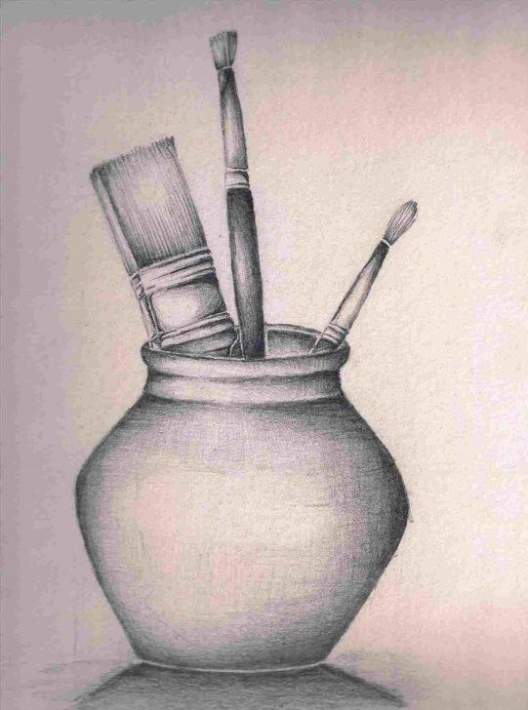
Still life drawing practise for yr7 assessment Art & Design.
As part of your yr7 assessment you will be asked to do an observational drawing and to apply tone to it using pencil.
An Observational Drawing – a drawing of something that is in front of you. To draw what you can see – to observe.
EXAMPLE

Slide 6
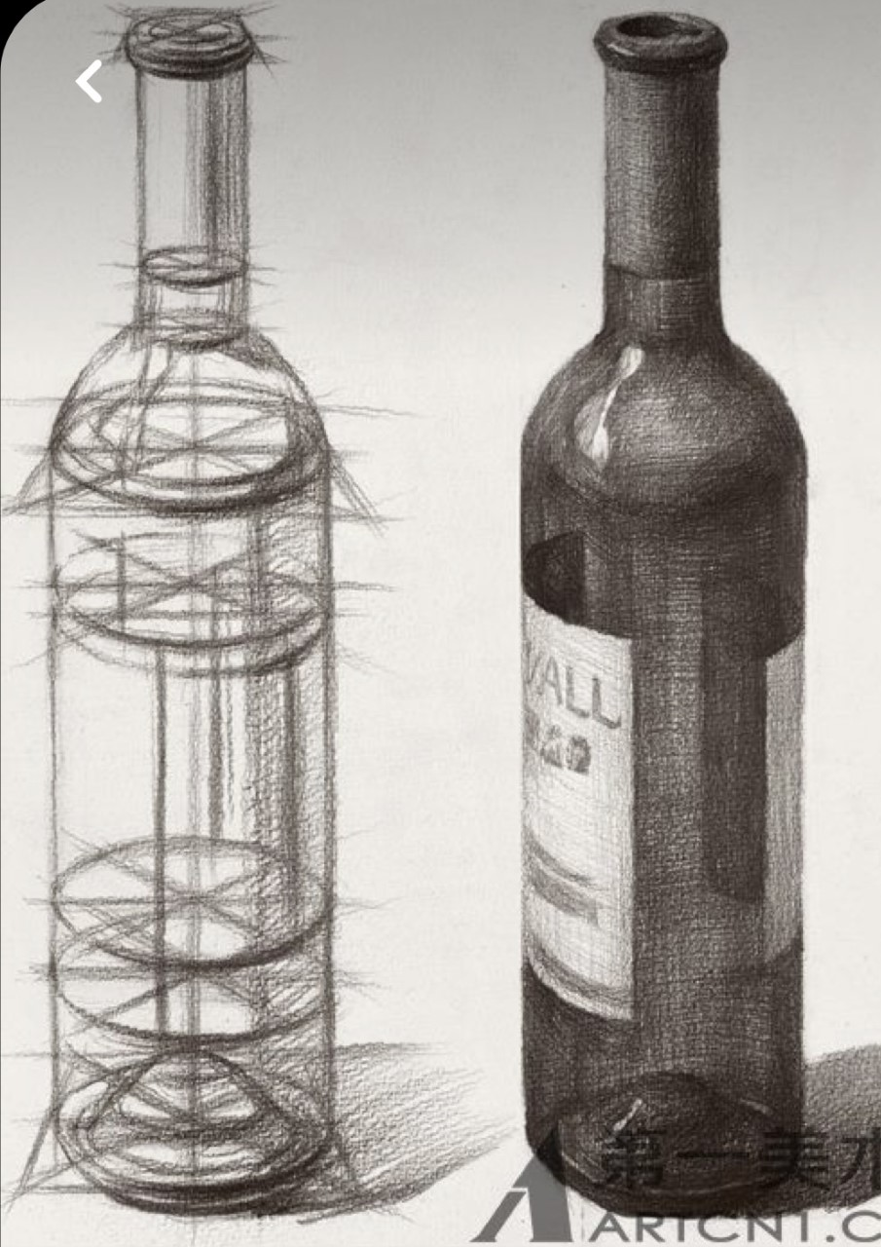
To prepare for your drawing assessment, practise drawing bottles.
This could be clear or coloured glass or even plastic.
You should practise drawing different types and shapes of bottles – wine, perfume, clear glass or plastic etc…

Slide 7
First Steps
Position your bottle in front of you – not too close and not too far away.
Make sure that you can only see part of the label if it has one that is very detailed.
Begin by making a light sketch of the shape of the bottle that you are drawing in pencil.
Next sketch in where the labels are and the top or lid if it has one.

Slide 8
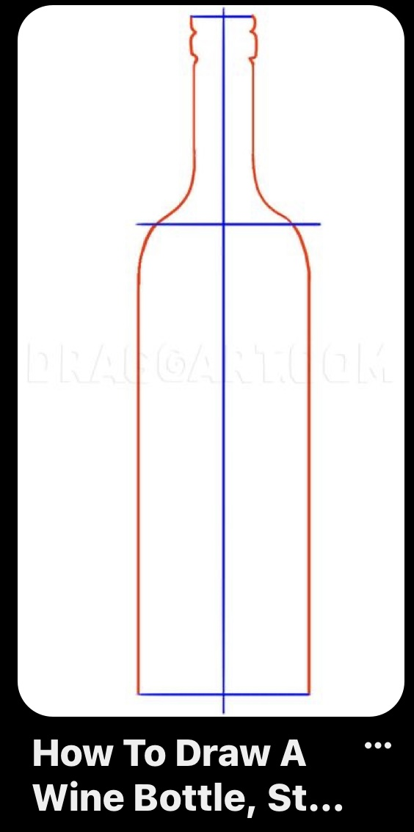
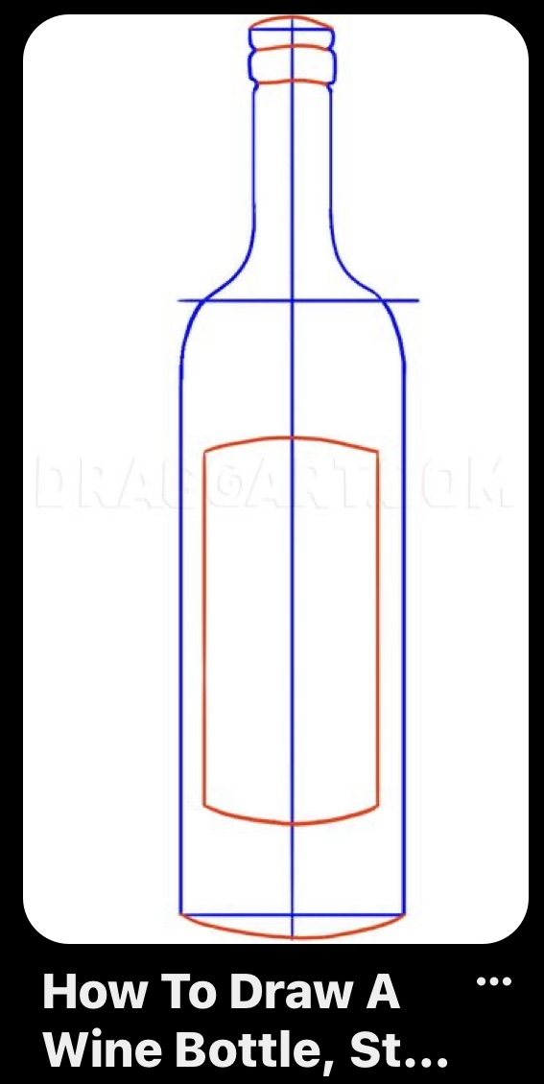

Slide 9
Second Steps
Add a light covering of pencil to your drawing and smudge it with a cotton bud to create a medium tone all over.
Then add the darkest tones pressing harder with your pencil – remember to apply the tone using a shading motion that is going to make the shape of your bottle look 3D.
Next use a rubber to gently rub in the lighter tones back in.

Slide 10
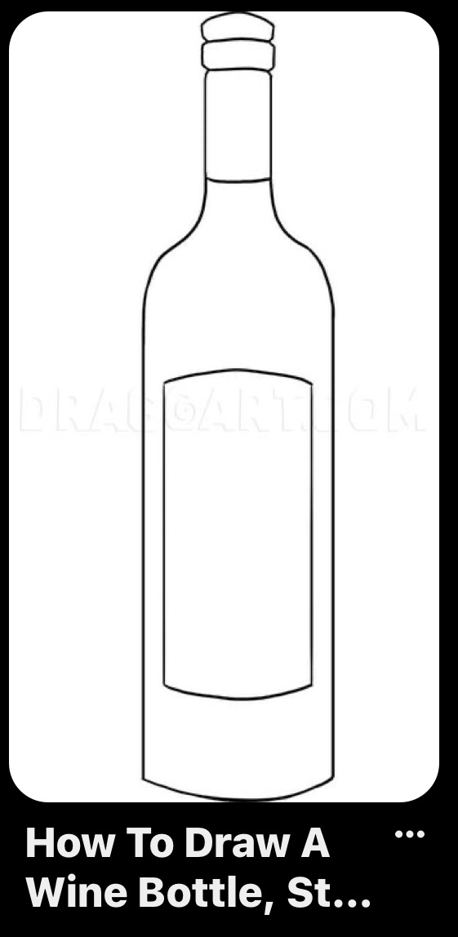
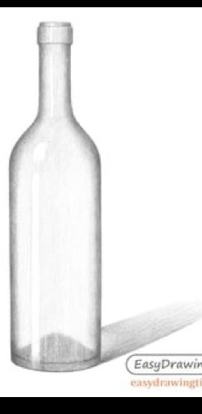

Slide 11
Final Steps
Then rub in any highlights pressing harder with your rubber to create the lightest areas and reflections.
Work back into your drawing to polish it to make it look as good and as realistic as you can.
Add a shadow if you can see one
Finally rub out any lines that are not needed and clean the background up around your drawing.

Slide 12
